Slide 1
CACHE 4 – Round 1
Casitas B-lineage Lymphoma B (CBL-B)

Slide 2
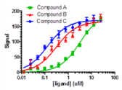
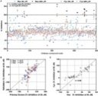
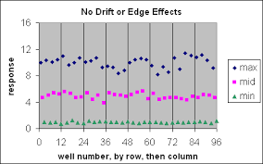
HTS summarizing flowchart
FP Counter screening: 11 confirmed hits were tested with CBL-B and the unrelated target GID4 in their respective FP assays. 20 points, 2-fold dilutions starting from 200 µM in duplicates.
10 of the 11 hits demonstrated selective binding to CBL-B (IC50/ K_{disp} ≤150 µM) showing no dose-dependent FP signal reduction in GID4 assay. The other compound was very insoluble and non-selective.
The 10 selective hits were advanced to Round 2.
NMR analysis: confirmed hits selected from dose-response confirmation step were tested with CBL-B (for fluorinated compounds) or fluorinated-Tryptophan labeled CBL-B (for non-fluorinated compounds).
Only one compound (the most potent hit) demonstrated clear binding in this assay.
Final Hit Rate: 0.006%
FP Hit confirmation for 46 compounds selected from the primary screen: 20 points, 2-fold dilutions starting from 200 µM in duplicates. In parallel compound-only controls (without protein) were tested at the same concentrations in duplicates.
Hit criteria: dose dependency with IC₅₀/ K_{disp} ≤150 µM - 11 compounds selected.
FP Primary HTS: 1688 compounds were tested in duplicates as 2 independent runs @50 µM compound concentration.
Initial hit criteria: ≥15% FP signal reduction in a single run - 45 compounds selected.
Criteria#2: compounds demonstrating inconclusive “overflow” signal in 2 runs – 1 compound selected.
Assay setup and validation: 8 previously published reference compounds were used for (https://patents.google.com/patent/WO2020264398A1/en) Fluorescence Polarization (FP) assay optimization and uniformity tests (http://www.ncbi.nlm.nih.gov/books/NBK83783/)

Slide 3
Primary screening (Fluorescence polarization assay)
QC plots
Run 1 vs. Run 2 correlation
(compounds were tested at 50 µM concentration in duplicates)

Slide 4
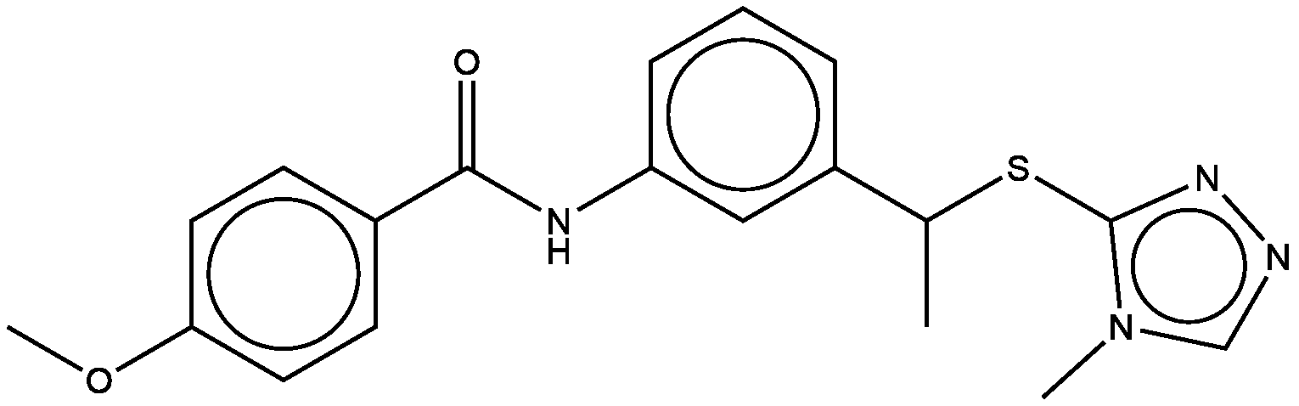
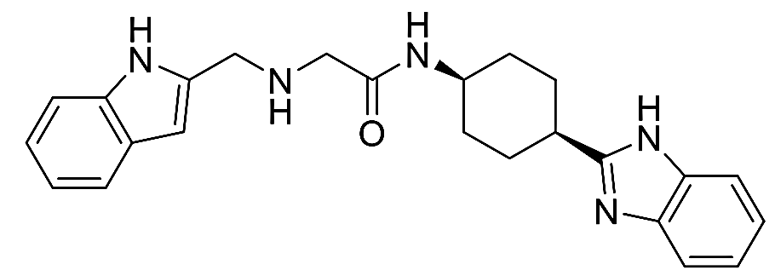
Hit confirmation/Dose response and Counter screen/Dose response (FP assay) control compounds (from patents)
C2777683
PFI-7
(GID4 chemical probe)
EL000923
 | CBL-B (FP assay) | GID4 (FP assay)
Hill Slope | -5.2 | N/A
K_{disp} (µM) | 0.43 | No DR
 | CBL-B (FP assay) | GID4 (FP assay)
Hill Slope | -0.9 | N/A
K_{disp} (µM) | 49.7 | No DR
 | CBL-B (FP assay) | GID4 (FP assay)
Hill Slope | N/A | -1.8
K_{disp} (µM) | No DR | 1.5
CBL-B FP assay: CBLB_3ZNI:34-427 at 625 nM and BODIPY FL-labeled MSC2787102A-1 at 10 nM; Buffer: 20 mM HEPES pH 7.5, 150 mM NaCl, 0.5 mM TCEP, 0.01 TritionX-100, 2% DMSO.
GID4 FP assay: GID4_116-300 at 5 µM and C-terminally FITC-labeled PGLWKS peptide at 40 nM; Buffer: 50 mM Tris pH 7.5, 0.01 TritionX-100, 2% DMSO.

Slide 5
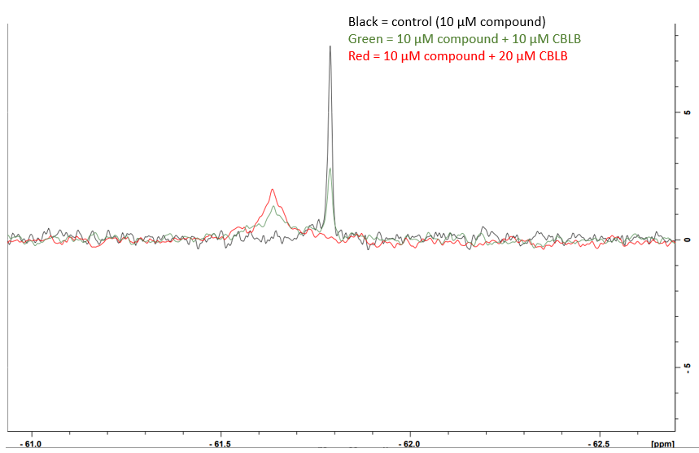
F19-NMR profile of C2777683 (CBL-B reference control)

Slide 6
CACHE4HI_1954_17
Primary Screen (% FP at 50 μM)
Trial 1-Fluorescence interference
Trial 2- Fluorescence interference
FP hit confirmation/dose response
FP counter screen/dose response
 | Run 1 | Run 2
Hill Slope | -1.4 | -1.2
K_{disp} (µM) | 3.1 | 3.9
 | CBL-B (FP assay) | GID4 (FP assay)
Hill Slope | -1.2 | -0.7
K_{disp} (µM) | 3.1 | 4.1
Binds to GID4!!!

Slide 7
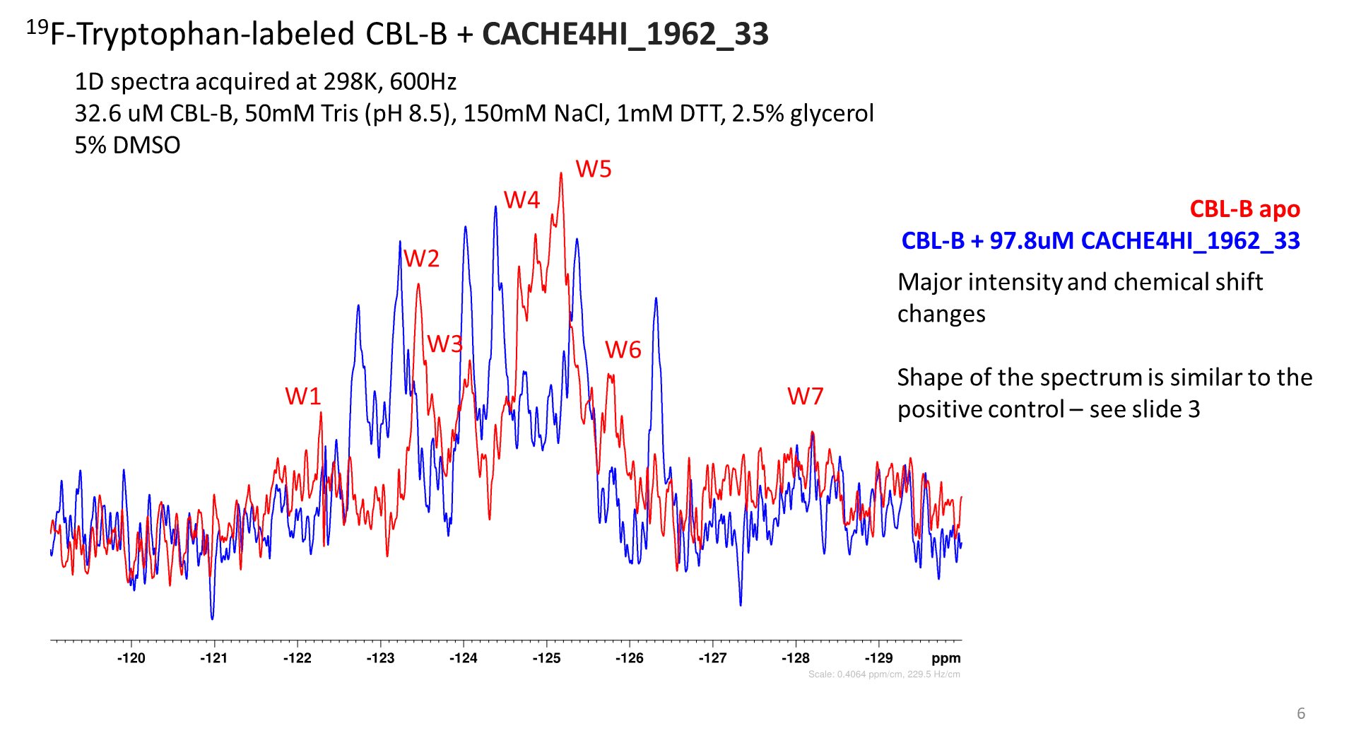
CACHE4HI_1962_33
Primary Screen (% FP at 50 μM)
Trial 1-15.8
Trial 2-18.1
Binding confirmed!
FP hit confirmation/dose response
FP counter screen/dose response
 | Run 1 | Run 2
Hill Slope | -0.7 | -0.7
K_{disp} (µM) | 7.7 | 7.2
 | CBL-B (FP assay) | GID4 (FP assay)
Hill Slope | -0.6 | N/A
K_{disp} (µM) | 7.6 | No DR
Selective!

Slide 8
CACHE4HI_2117_63
Primary Screen (% FP at 50 μM)
Trial 1-15.8
Trial 2- 14.8
FP hit confirmation/dose response
FP counter screen/dose response
 | Run 1 | Run 2
Hill Slope | -0.9 | -0.7
K_{disp} (µM) | 43.2 | 88.6
 | CBL-B (FP assay) | GID4 (FP assay)
Hill Slope | -0.9 | -0.5
K_{disp} (µM) | 57.8 | No DR

Slide 9
CACHE4HI_1946_60
Primary Screen (% FP at 50 μM)
Trial 1-29.9
Trial 2- 7.4
FP hit confirmation/dose response
FP counter screen/dose response
 | Run 1 | Run 2
Hill Slope | -3 | -2.6
K_{disp} (µM) | 27.7 | 24.3
 | CBL-B (FP assay) | GID4 (FP assay)
Hill Slope | -1.9 | -2.7
K_{disp} (µM) | 48.6 | >100

Slide 10
CACHE4HI_1963_55
Primary Screen (% FP at 50 μM)
Trial 1-44.0
Trial 2- 39.4
FP hit confirmation/dose response
FP counter screen/dose response
 | Run 1 | Run 2
Hill Slope | -3.6 | -4.0
K_{disp} (µM) | 35.4 | 32.0
 | CBL-B (FP assay) | GID4 (FP assay)
Hill Slope | -2.1 | N/A
K_{disp} (µM) | 15.9 | No DR

Slide 11
CACHE4HI_1948_91
Primary Screen (% FP at 50 μM)
Trial 1-43.2
Trial 2- 55.5
FP hit confirmation/dose response
FP counter screen/dose response
 | Run 1 | Run 2
Hill Slope | -1.3 | -1.4
K_{disp} (µM) | 116.2 | 85.6
 | CBL-B (FP assay) | GID4 (FP assay)
Hill Slope | -0.8 | N/A
K_{disp} (µM) | 258.8 | No DR

Slide 12
CACHE4HI_1946_25
Primary Screen (% FP at 50 μM)
Trial 1- 49.0
Trial 2- 56.4
FP hit confirmation/dose response
FP counter screen/dose response
 | Run 1 | Run 2
Hill Slope | -1.2 | -1.3
K_{disp} (µM) | 68.6 | 90.0
 | CBL-B (FP assay) | GID4 (FP assay)
Hill Slope | -1.2 | N/A
K_{disp} (µM) | 86.0 | No DR

Slide 13
CACHE4HI_1957_30
Primary Screen (% FP at 50 μM)
Trial 1-72.9
Trial 2- 85.1
FP hit confirmation/dose response
FP counter screen/dose response
 | Run 1 | Run 2
Hill Slope | -2.6 | -3.3
K_{disp} (µM) | 95.7 | 70.2
 | CBL-B (FP assay) | GID4 (FP assay)
Hill Slope | -1.4 | N/A
K_{disp} (µM) | 270.9 | No DR

Slide 14
CACHE4HI_1958_44
Primary Screen (% FP at 50 μM)
Trial 1-57.4
Trial 2- 57.8
FP hit confirmation/dose response
FP counter screen/dose response
 | Run 1 | Run 2
Hill Slope | -1.1 | -1.1
K_{disp} (µM) | 101.5 | 139.6
 | CBL-B (FP assay) | GID4 (FP assay)
Hill Slope | -0.9 | -0.9
K_{disp} (µM) | 125.2 | No DR

Slide 15
CACHE4HI_1955_60
Primary Screen (% FP at 50 μM)
Trial 1-55.5
Trial 2- 51.4
FP hit confirmation/dose response
FP counter screen/dose response
 | Run 1 | Run 2
Hill Slope | -1.3 | -1.3
K_{disp} (µM) | 111.9 | 111.9
 | CBL-B (FP assay) | GID4 (FP assay)
Hill Slope | -1.0 | N/A
K_{disp} (µM) | 115.7 | No DR

Slide 16
CACHE4HI_1974_46
Primary Screen (% FP at 50 μM)
Trial 1-74.8
Trial 2- 83.1
FP hit confirmation/dose response
FP counter screen/dose response
 | Run 1 | Run 2
Hill Slope | -1.6 | -1.4
K_{disp} (µM) | 111.4 | 100.7
 | CBL-B (FP assay) | GID4 (FP assay)
Hill Slope | -0.8 | N/A
K_{disp} (µM) | 48.7 | No DR

