Slide 1
CACHE 5
Participant 2123

Slide 2
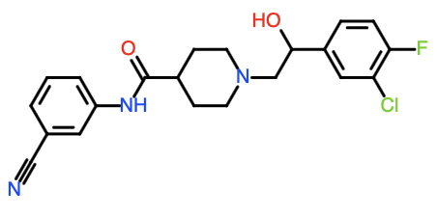
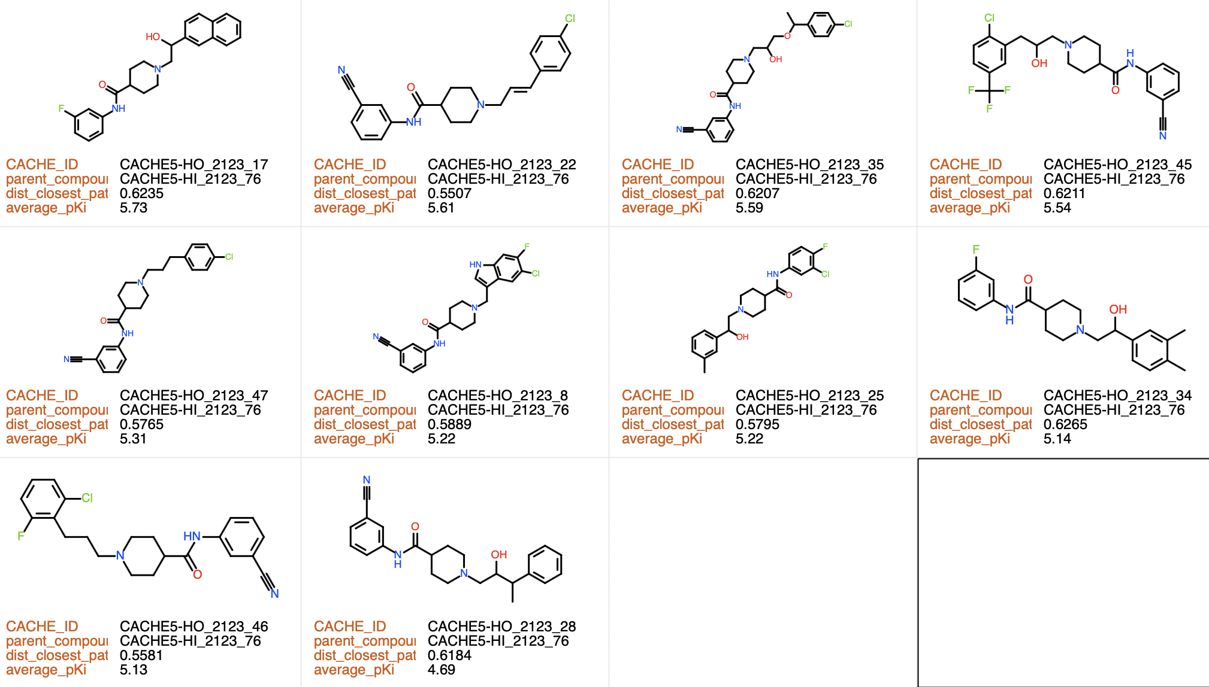
9 analogs with pKi > 5.
2 analogs with 5>pKi>4.5
34 inactive analogs
CACHE5-HI_2123_76
Ki = 3.4 µM
Parent molecule (experimentally confirmed hit from Round 1)
Round 2 analogs (experimentally confirmed hit from Round 2)

Slide 3
CACHE 5
Participant 2127

Slide 4
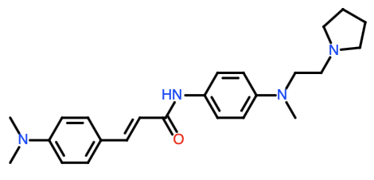
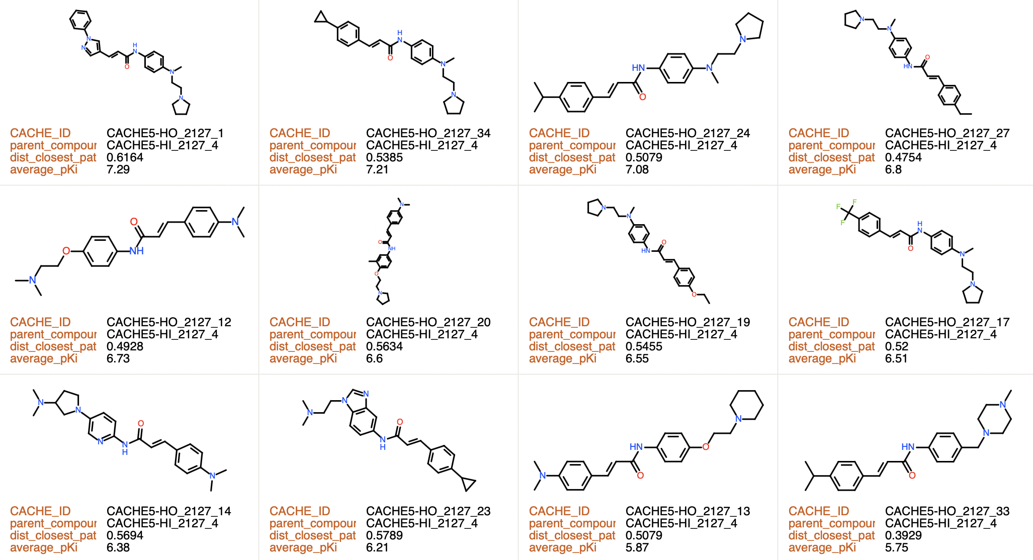
19 analogs with pKi > 5.
15 inactive analogs
Antagonist activity confirmed
CACHE5-HI_2127_4
Competition: Ki 170 nM
Antagonist activity: confirmed

Slide 5
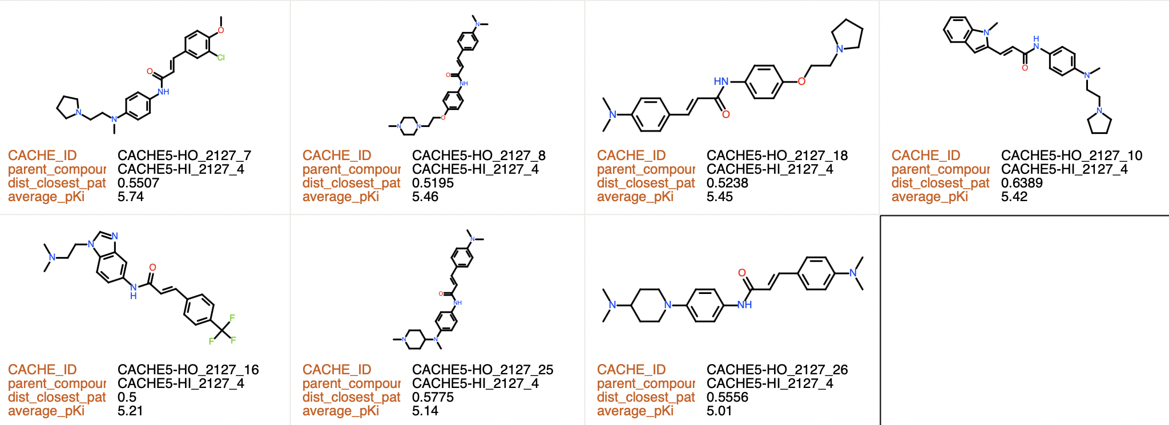
19 analogs with pKi > 5.
15 inactive analogs
CACHE5-HI_2127_4
Competition: Ki 170 nM
Antagonist activity: confirmed

Slide 6
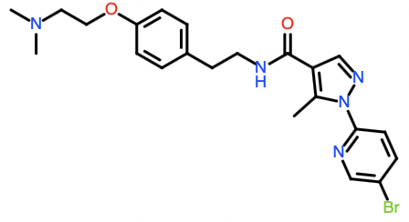
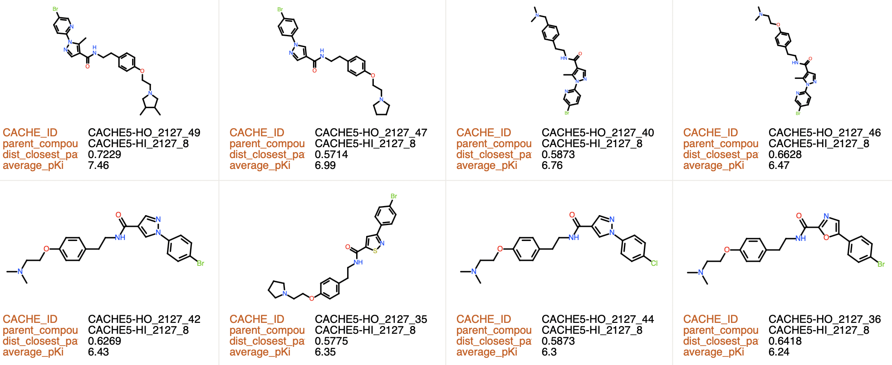
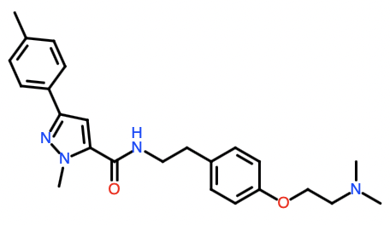
12 analogs with pKi > 5.
3 inactive analogs
CACHE5-HI_2127_8
Competition: Ki = 0.71 µM
Antagonist activity: confirmed
Antagonist activity confirmed
CACHE5-HI_2127_6
Ki = 11 µM

Slide 7
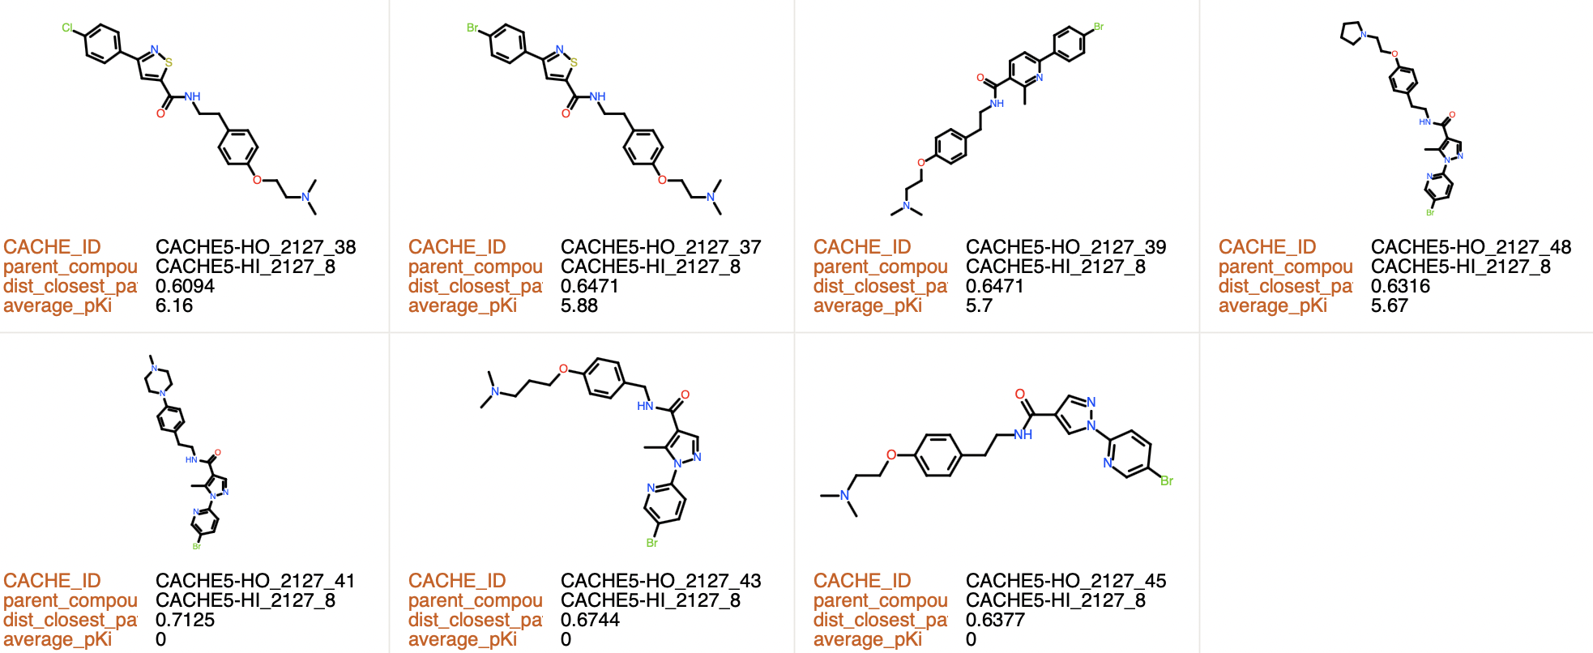
12 analogs with pKi > 5.
3 inactive analogs
CACHE5-HI_2127_8
Competition: Ki = 0.71 µM
Antagonist activity: confirmed
CACHE5-HI_2127_6
Ki = 11 µM

Slide 8
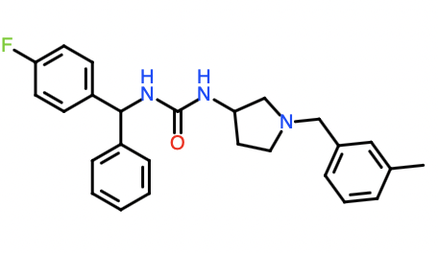
No analog in Round 2
CACHE5-HI_2127_22
Cloudy
Competition: Ki = 1 µM
Antagonist activity: confirmed

Slide 9
CACHE 5
Participant 2128

Slide 10
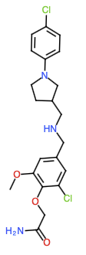
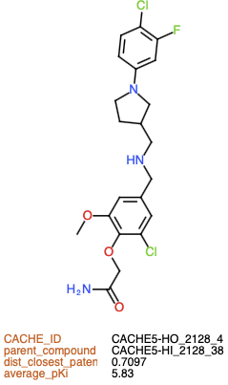
1 analogs with pKi > 5.
31 inactive analogs
CACHE5-HI_2128_38
Ki = 8.7 µM

Slide 11
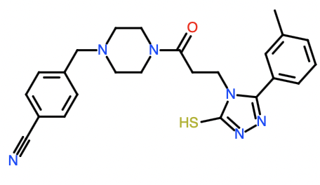
0 analog with pKi > 5.
17 inactive analogs
CACHE5-HI_2128_78
Ki N/A
PAM
Cloudy

Slide 12
CACHE 5
Participant 2132

Slide 13
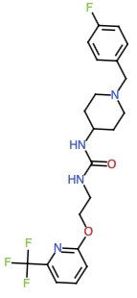
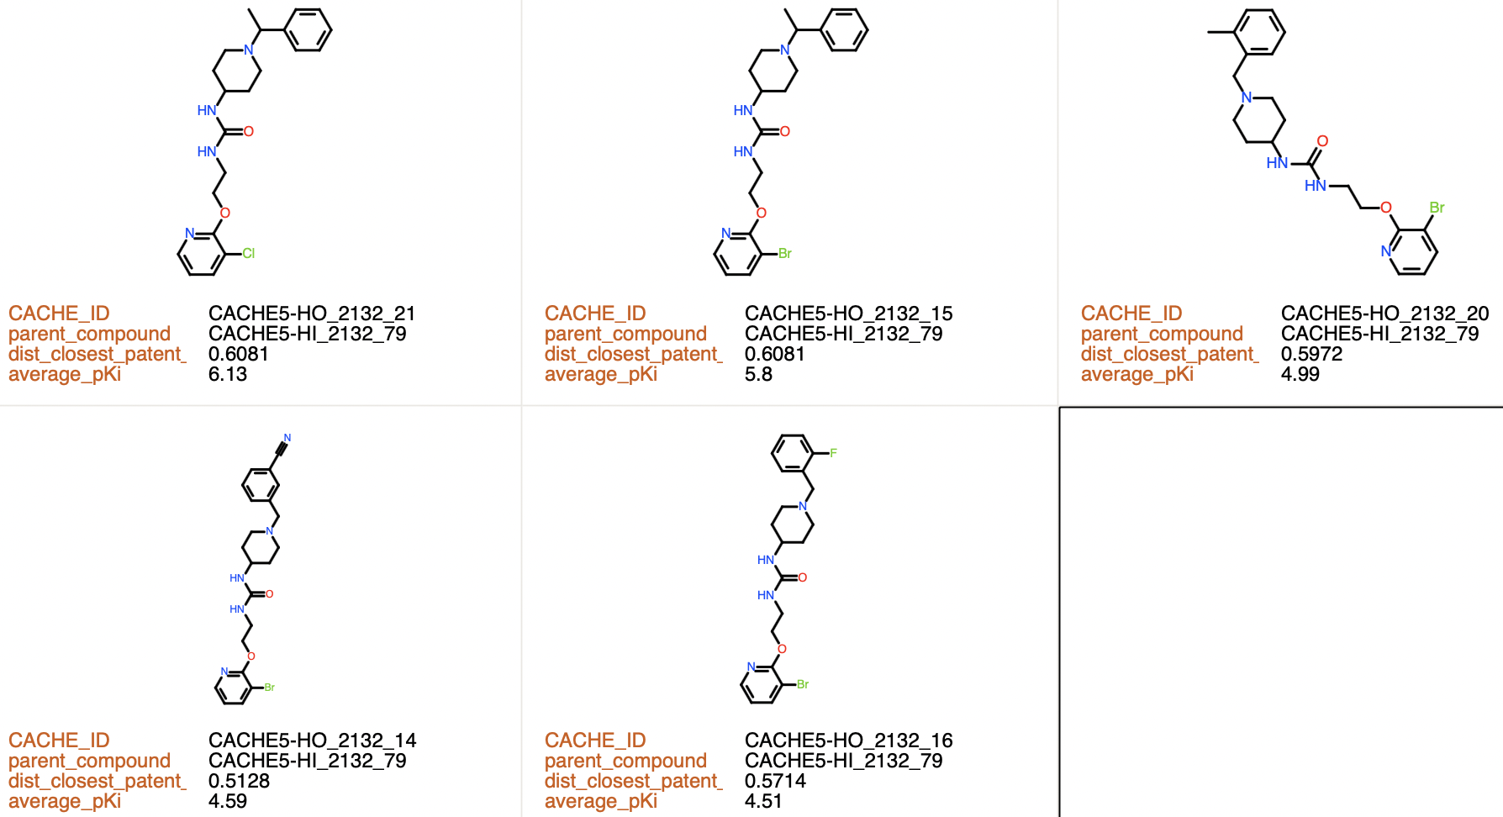
2 analogs with pKi > 5.
3 analogs with 5>pKi>4.5
9 inactive analogs
Antagonist activity confirmed
CACHE5-HI_2132_79
Ki = 2.6 µM

Slide 14
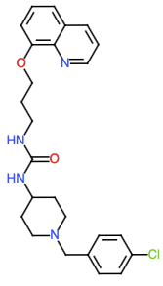
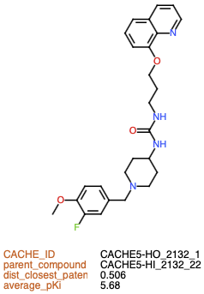
1 analog with pKi > 5.
1 inactive analog
CACHE5-HI_2132_22
Ki = 3.2 µM

Slide 15
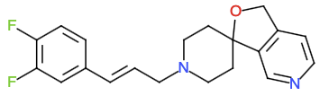
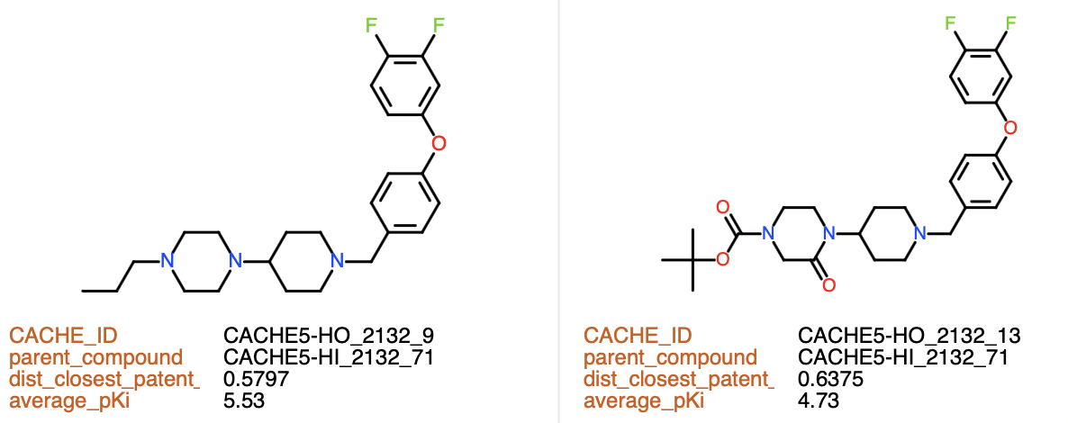
1 analogs with pKi > 5.
1 analogs with 5>pKi>4.5
10 inactive analogs
CACHE5-HI_2132_71
Competition: Ki = 1 µM
Antagonist activity: confirmed
Antagonist activity confirmed

Slide 16
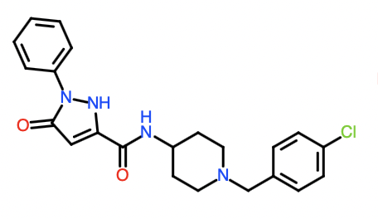
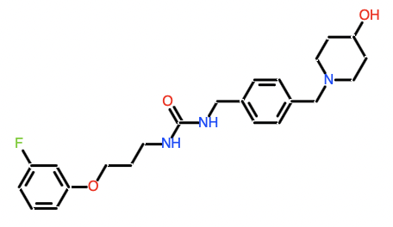
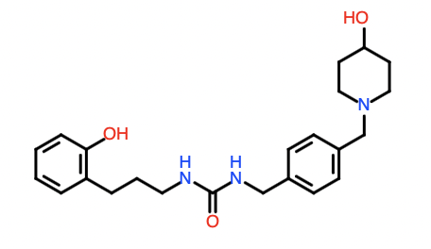
No analogs selected in Round 2
CACHE5-HI_2132_44
Competition: Ki = 20 µM
Antagonist activity: very weak
CACHE5-HI_2132_69
Ki = 21 µM
CACHE5-HI_2132_73
Competition: Ki = 29 µM
Antagonist activity: very weak

Slide 17
CACHE 5
Participant 2133

Slide 18
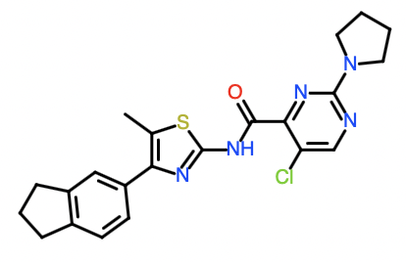
0 analogs with pKi > 5.
15 inactive analogs
CACHE5-HI_2133_11
Ki N/A
PAM
Cloudy

Slide 19
CACHE 5
Participant 2140

Slide 20
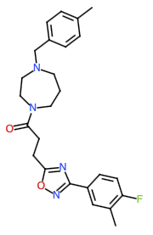
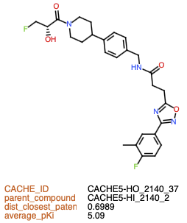
1 analogs with pKi > 5.
37 inactive analogs
CACHE5-HI_2140_2
Ki = 23 µM

Slide 21
CACHE 5
Participant 2141

Slide 22
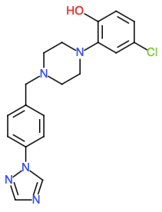
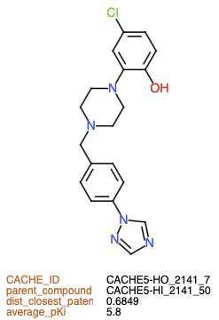
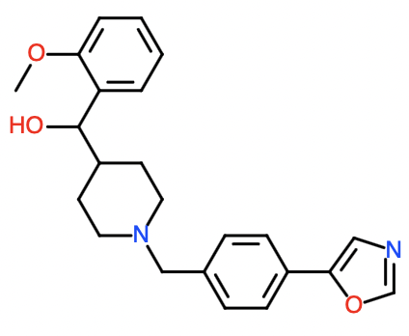
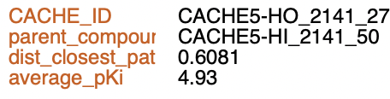
1 analogs with pKi > 5.
1 analogs with 5>pKi>4.5
34 inactive analogs
CACHE5-HI_2141_50
Cloudy
Competition: Ki = 1.9 µM
Antagonist activity: very weak
Same compound

Slide 23
CACHE 5
Participant 2142

Slide 24
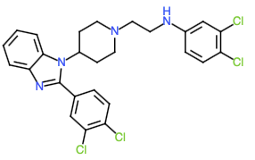
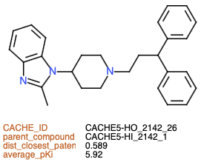
1 analogs with pKi > 5.
26 inactive analogs
CACHE5-HI_2142_1
Ki N/A
Cloudy

Slide 25
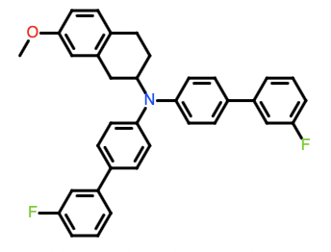
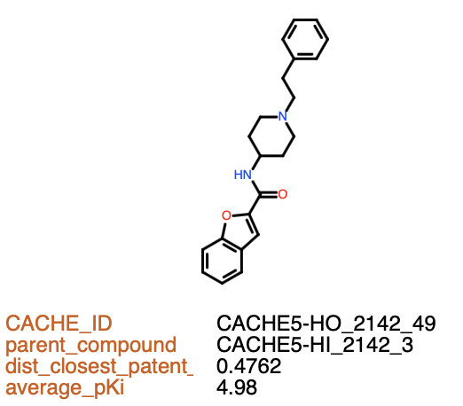
0 analogs with pKi > 5.
1 analogs with 5>pKi>4.5
23 inactive analogs
CACHE5-HI_2142_3
Ki N/A
PAM

Slide 26
CACHE 5
Participant 2144

Slide 27
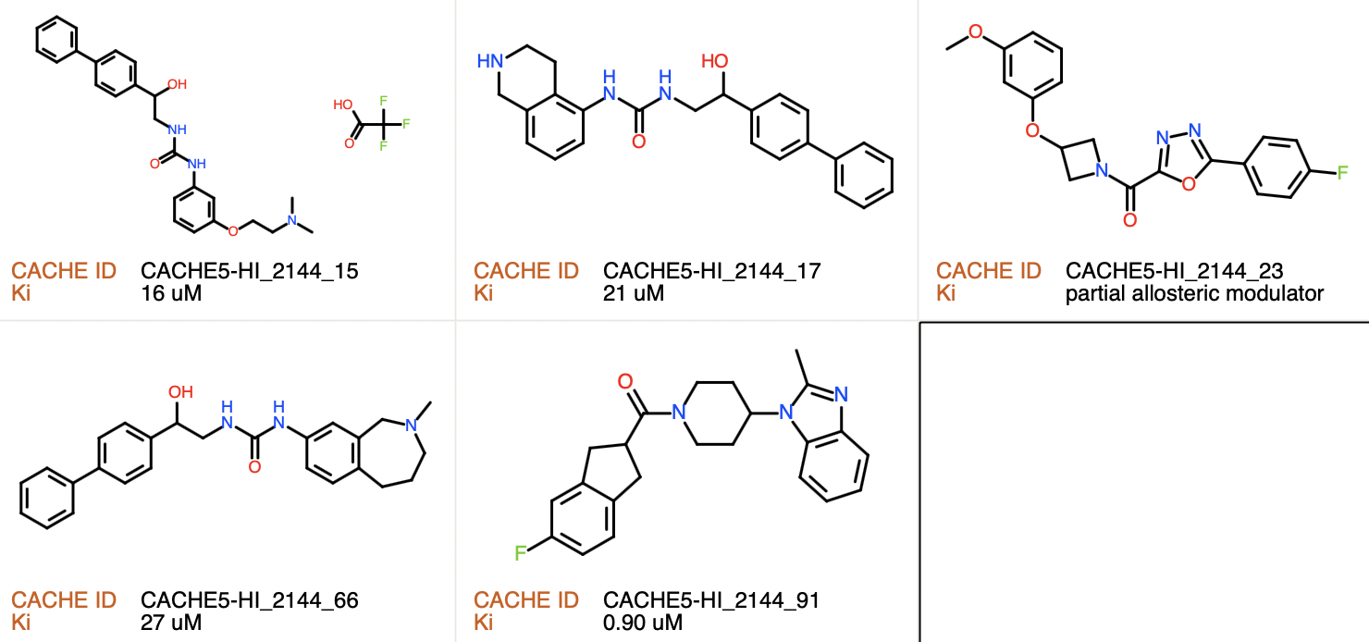
Round 1 hits

Slide 28
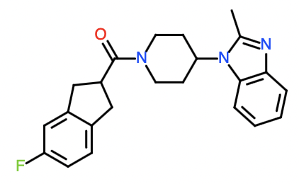
No analog on Round 2
CACHE5-HI_2144_91
Ki = 0.9 µM

Slide 29
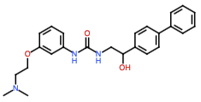
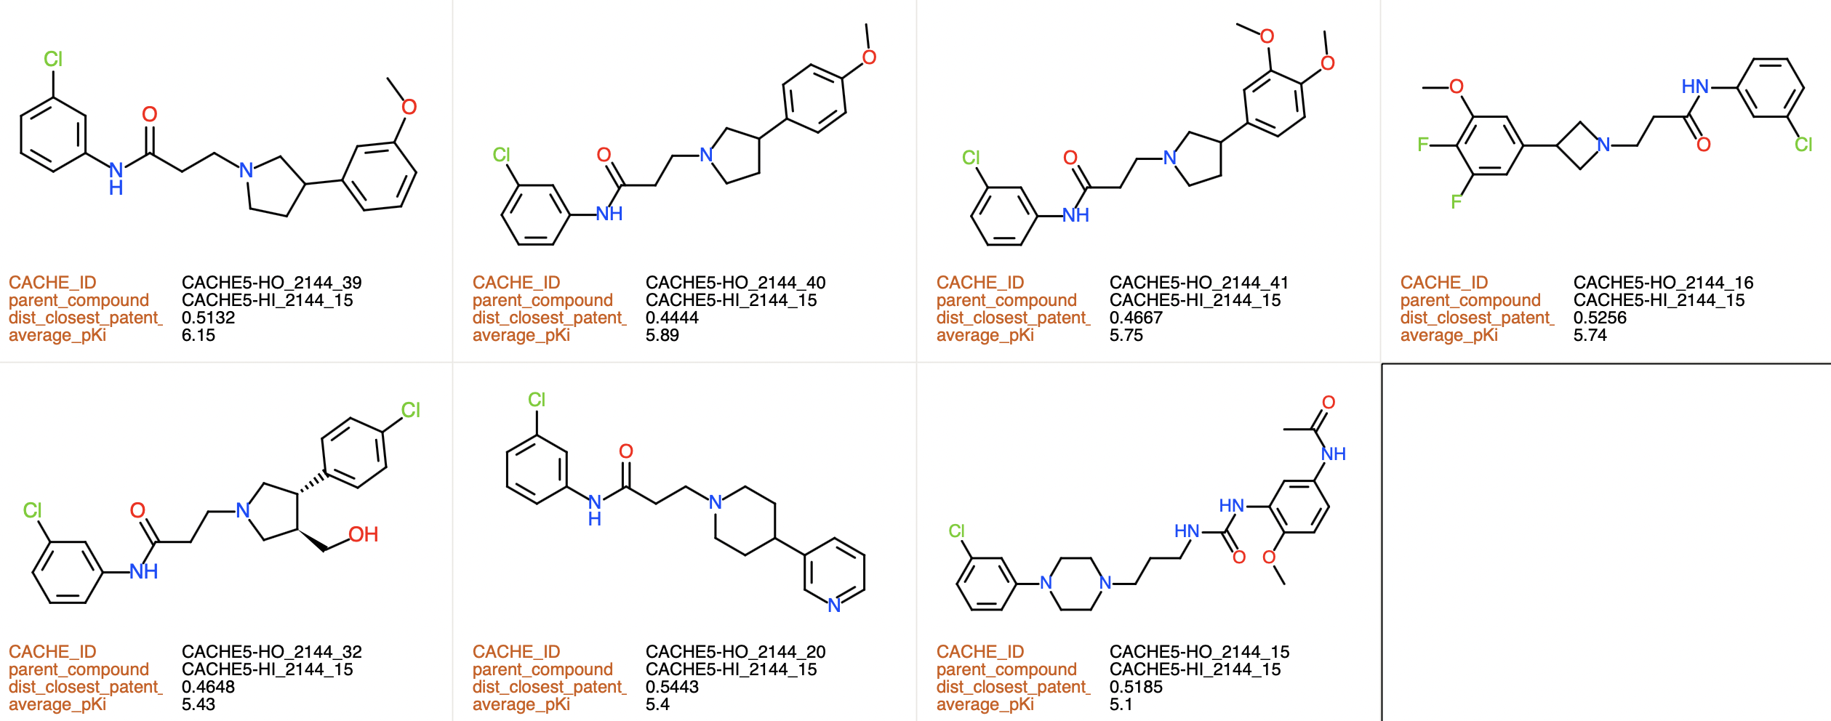
7 analogs with pKi > 5.
3 analogs with 5>pKi>4.5
31 inactive analogs
CACHE5-HI_2144_15
Ki = 16 µM
Antagonist activity confirmed

Slide 30
CACHE 5
Participant 2150

Slide 31
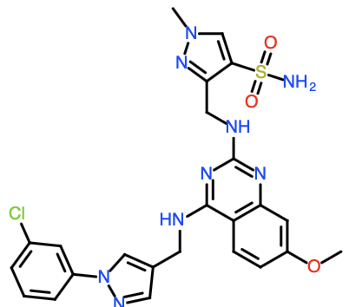
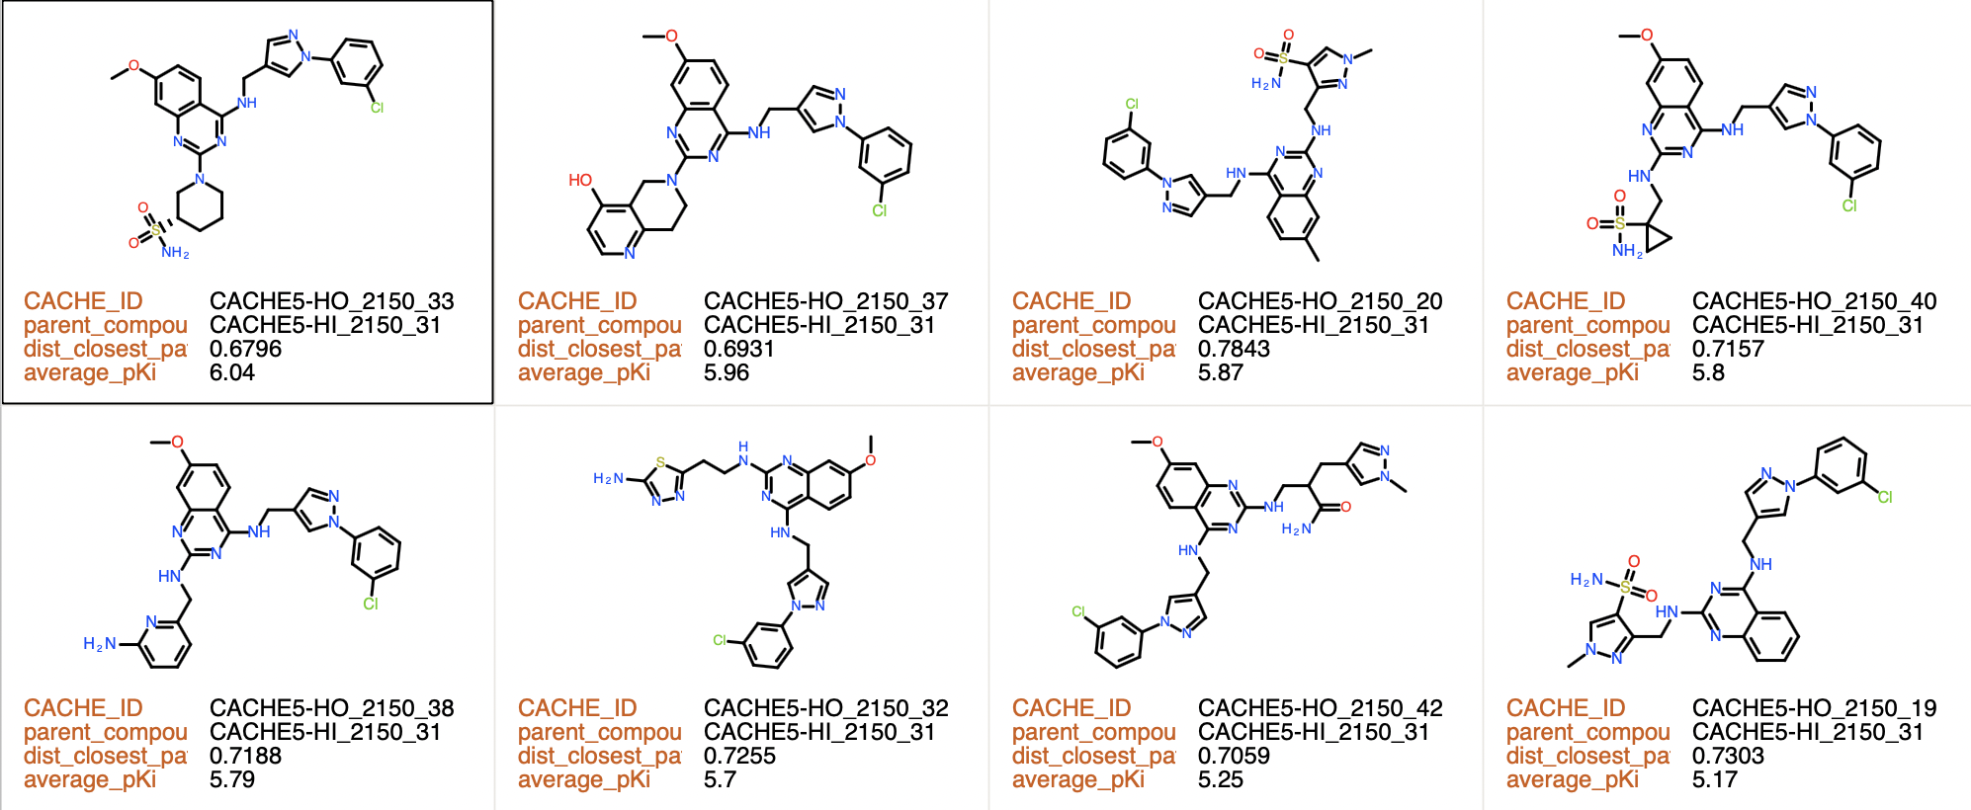
8 analogs with pKi > 5.
1 analogs with 5>pKi>4.5
20 inactive analogs
Antagonist activity confirmed
CACHE5-HI_2150_31
Competition: Ki = 2 µM
Antagonist activity: very weak

Slide 32
CACHE 5
Participant 2151

Slide 33
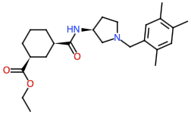
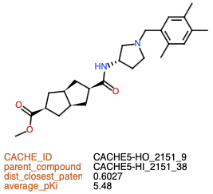
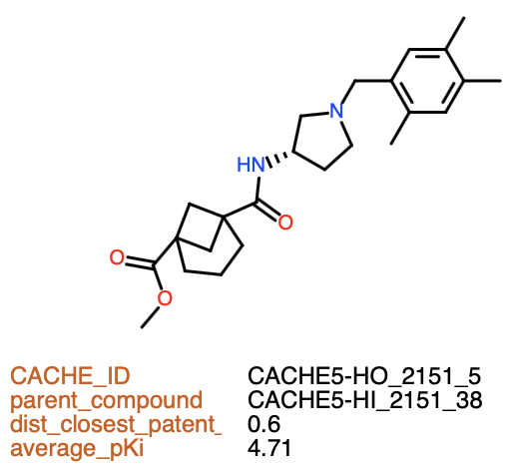
1 analogs with pKi > 5.
1 analogs with 5>pKi>4.5
22 inactive analogs
CACHE5-HI_2151_38
Ki = 10 µM
Antagonist activity confirmed

Slide 34
CACHE 5
Participant 2153

Slide 35
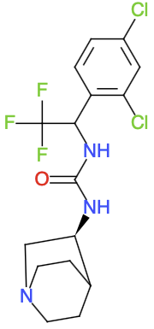
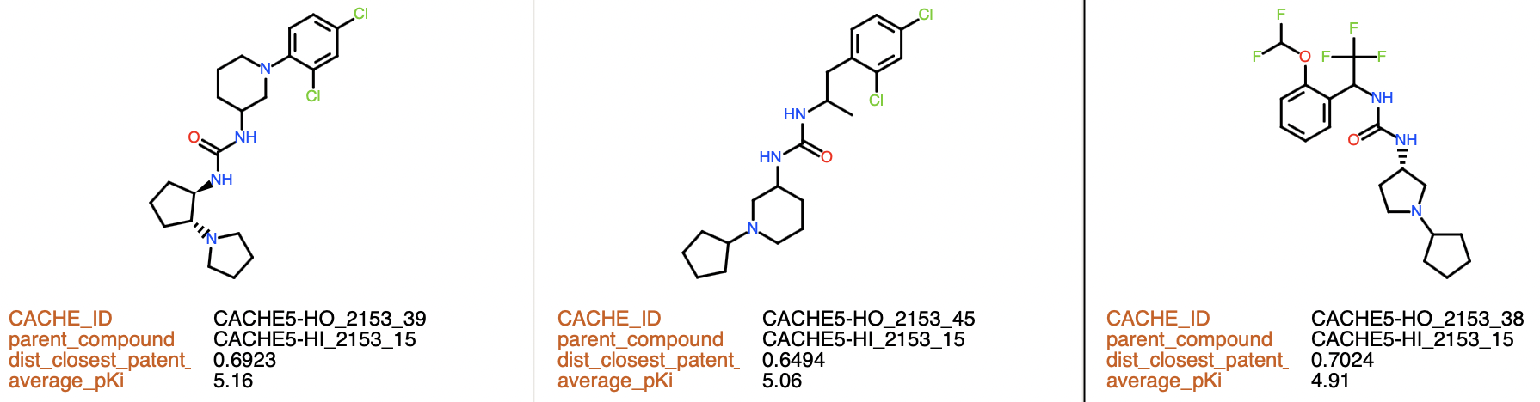
2 analogs with pKi > 5.
1 analogs with 5>pKi>4.5
43 inactive analogs
CACHE5-HI_2153_15
Ki = 13 µM
Antagonist activity confirmed

Slide 36
CACHE 5
Participant 2156

Slide 37
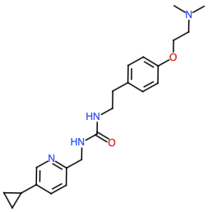
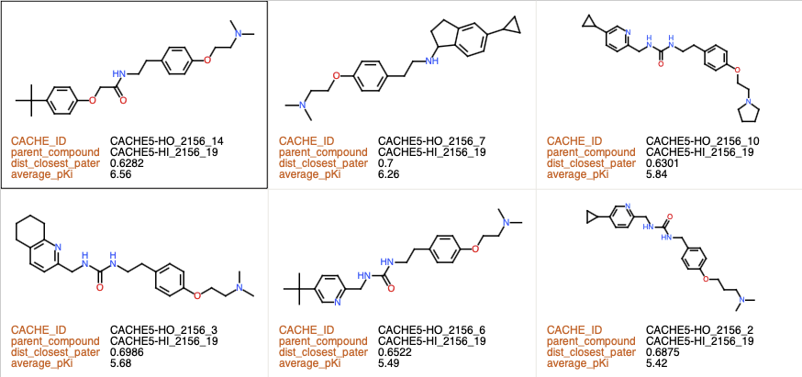
6 analogs with pKi > 5.
1 analogs with 5>pKi>4.5
8 inactive analogs
CACHE5-HI_2156_19
Competition: Ki = 24 µM
Antagonist activity: confirmed
Antagonist activity confirmed

Slide 38
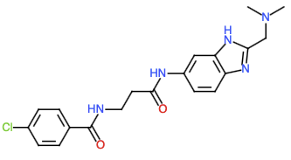
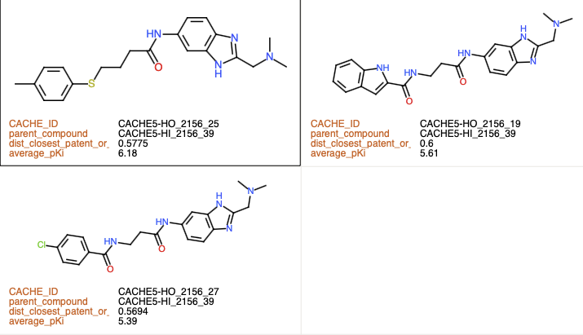
3 analogs with pKi > 5.
15 inactive analogs
Antagonist activity confirmed
CACHE5-HI_2156_39
Competition: Ki = 21 µM
Antagonist activity: confirmed

Slide 39
CACHE 5
Participant 2158

Slide 40
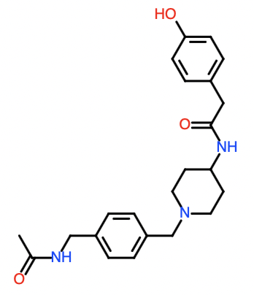
No analog in Round 2
CACHE5-HI_2158_27
Competition: Ki = 2.4 µM
Antagonist activity: confirmed

