Slide 1
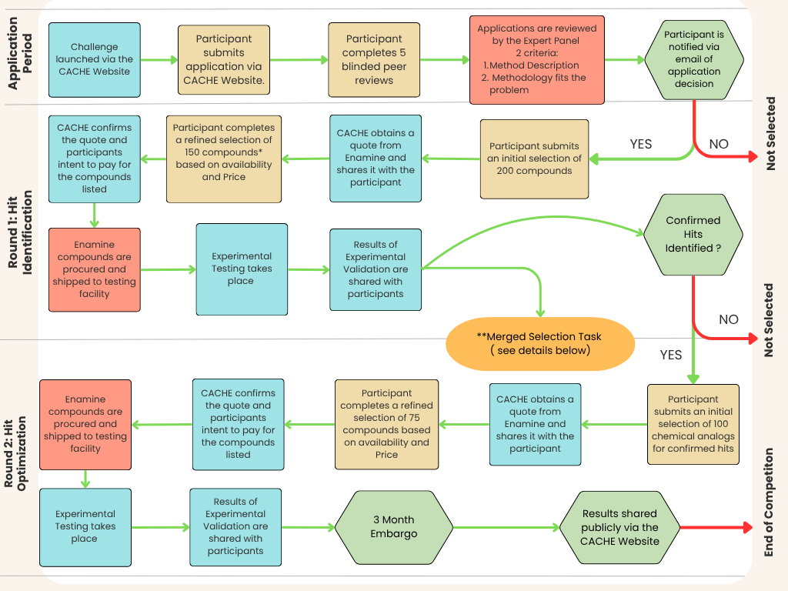




 | CACHE Responsible
 | Participant Responsible
 | End of Round
 | External Responsible
 | Continue in Competition
 | Not Selected/ End of Round
* Enamine will place an order for 150 compounds, but procurement will be stopped once 100 are successful. Participants will only pay for the 100 compounds that are shipped to the testing facility. This process is put in place to ensure 100 compounds per participant are synthesized successfully.
**All R1 participants are invited and encouraged to take part in the Merged Selection task. CACHE will provide a concatenated and anonymized list of all compounds ordered in R1. Participants are asked to predict up to 100 actives from this list**

