Slide 1
CACHE#3 – SARS-CoV2 Nsp3 macrodomain
Participant 1690

Slide 2
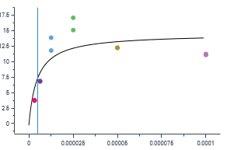
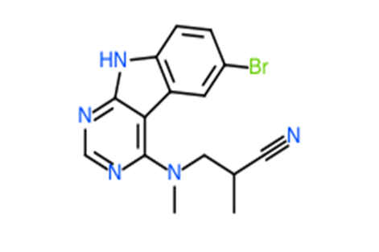
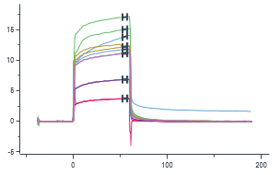
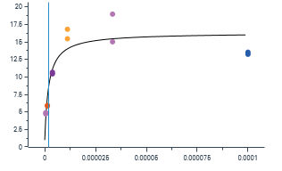
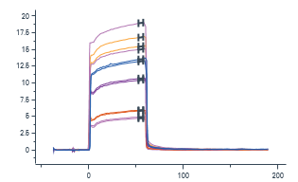
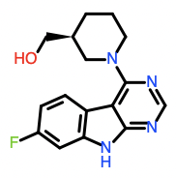
9 analogs, including parent molecule of CACHE3HI_1690_36 were submitted in round 2.
8 compounds, including a re-supplied parent molecule showed a dose dependent displacement of ADP-ribose peptide by HTRF. 5 compounds showed dose dependent binding by SPR.
PARENT MOLECULE
CACHE3-HO_1690_45
K_{D} = 2 µM – 37% binding
DLS (solub@100 µM)
HTRF_displacement hit confirmation (4% DMSO):
%inh@100 uM = 79
%inh@30 uM = 41
%inh@10 uM = 12
CACHE3HI_1690_36
K_{D} = 5 µM (poor fit) – 47% binding
Selectivity for NSP3 (against PARP14a protein) – Yes
DLS (solub@100 µM)
HTRF_displacement:
%inh@100 uM = 83
%inh@50 uM = 78
%inh@25 uM = 67
Closest PNAS published hit
dist: 0.22
Ki:78 µM
Closest analog published in PNAS before CACHE3 was launched

Slide 3
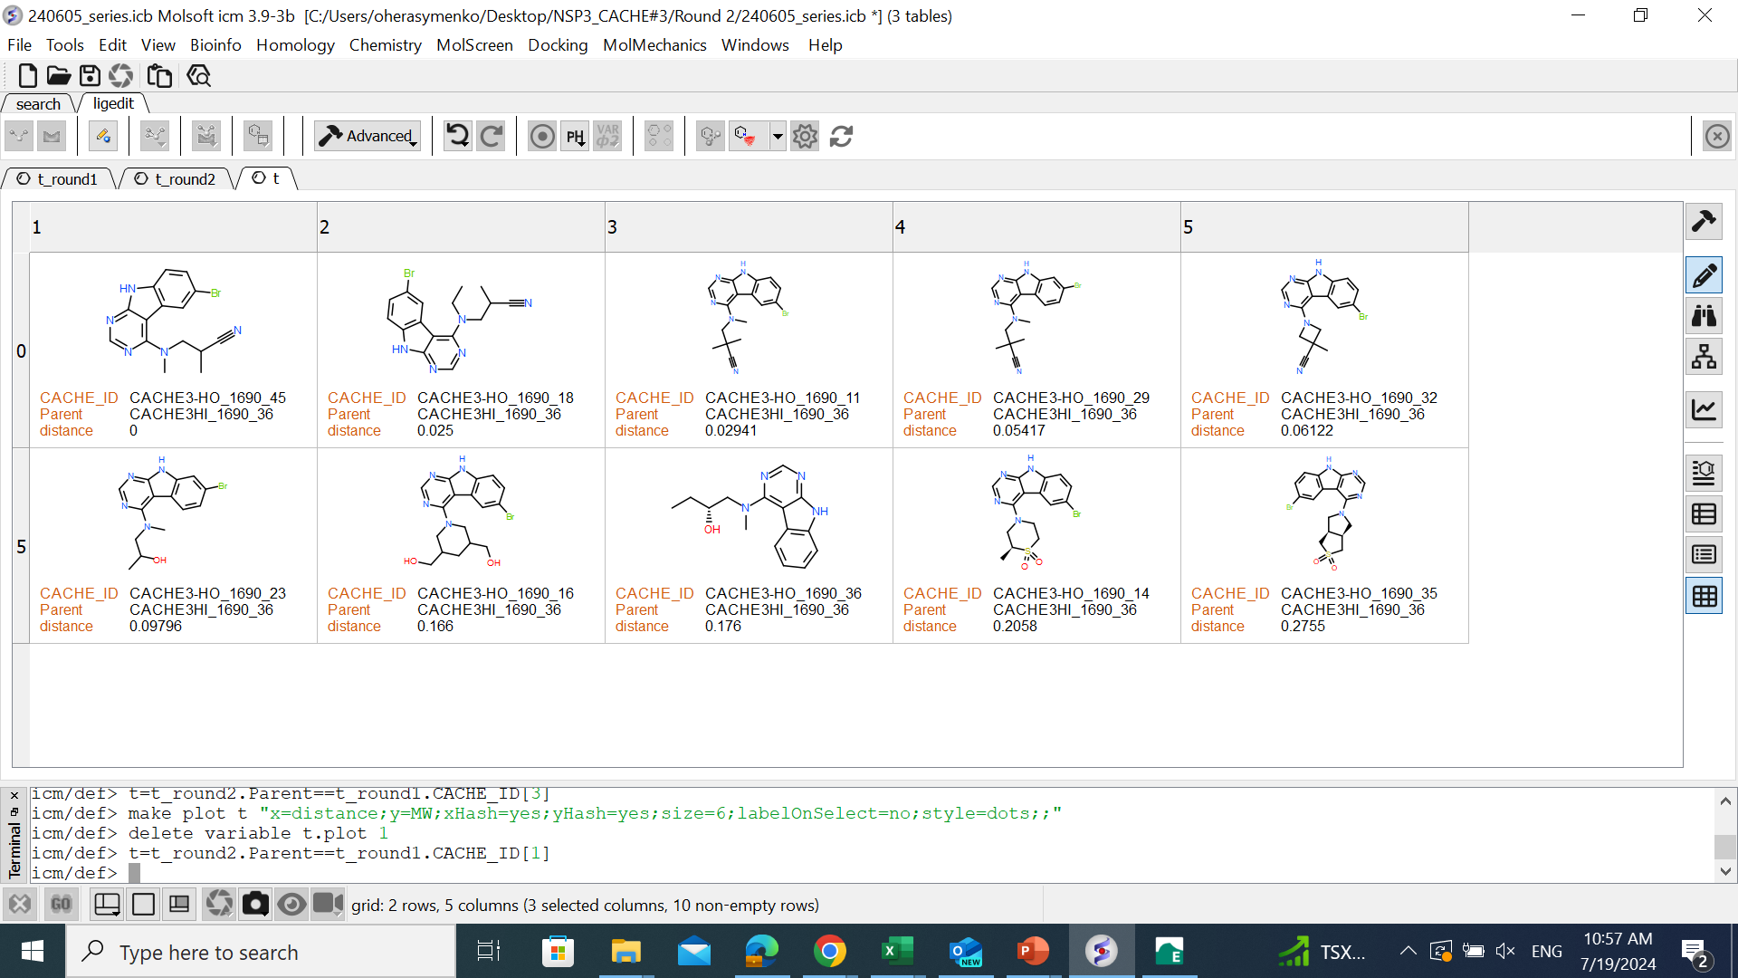
Tested analogs
confirmed
confirmed
slow on/off
confirmed
confirmed

Slide 4
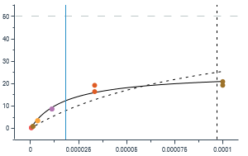
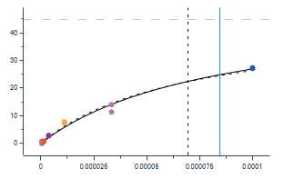
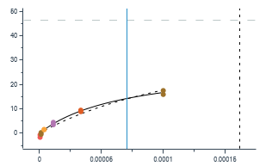
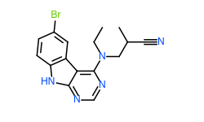
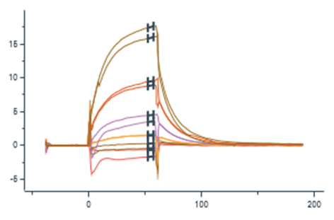
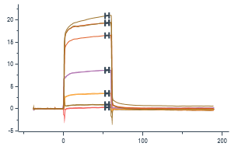
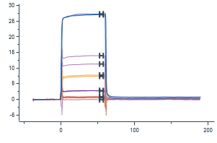
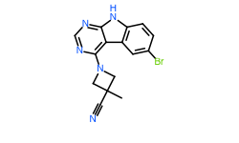
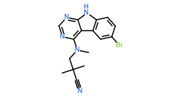
These inserts depict the closest published analogs (on all slides)
Closest PNAS published hit
dist: 0.22
Ki:78 µM
Closest PNAS published hit
dist: 0.21
Ki:78 µM
Closest PNAS published hit
dist: 0.2
Ki:78 µM
CACHE3-HO_1690_18
K_{D} = 18 µM – 50% binding
Selectivity for NSP3 (against PARP14a protein) – mild binding (slow off)
DLS (solub@100 µM)
HTRF_displacement hit confirmation (4% DMSO):
%inh@100 uM = 66
%inh@30 uM = 11
%inh@10 uM = 7
CACHE3-HO_1690_11
K_{D} = 85 µM – 111% binding/Saturation above 100 µM
Selectivity for NSP3 (against PARP14a protein) – Yes
DLS (solub@100 µM)
HTRF_displacement hit confirmation (4% DMSO):
%inh@100 uM = 82
%inh@30 uM = 66
%inh@10 uM = 20
CACHE3-HO_1690_32
K_{D} = 71 µM (slow on/off) – 62% binding
Selectivity for NSP3 (against PARP14a protein) – 21% binding
DLS (solub@100 µM)
HTRF_displacement hit confirmation (4% DMSO):
%inh@100 uM = 83
%inh@30 uM = 74
%inh@10 uM = 44

Slide 5
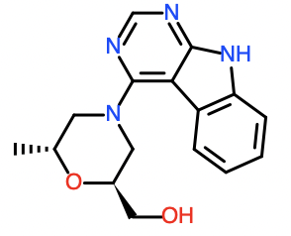
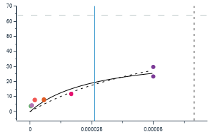
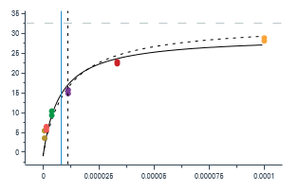
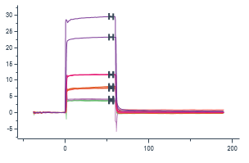
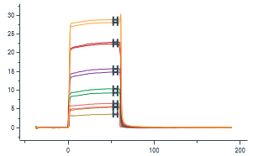
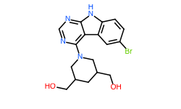
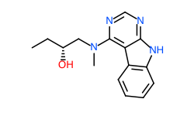
Closest PNAS published hit
dist: 0.08
Ki:78 µM
Closest PNAS published hit
dist:0.17
Ki:362 µM
CACHE3-HO_1690_16
K_{D} (run 1) = 26 µM – 61%
K_{D} (run 2) = 55 µM – 110% binding
Selectivity for NSP3 (against PARP14a protein) – Yes
DLS (solub@50 µM)
HTRF_displacement hit confirmation (4% DMSO):
%inh@100 uM = 29
%inh@30 uM = 12
%inh@10 uM = 9
CACHE3-HO_1690_36
K_{D} = 8 µM – 90% binding
Selectivity for NSP3 (against PARP14a protein) – Yes
DLS (solub@100 µM)
HTRF_displacement hit confirmation (4% DMSO):
%inh@100 uM = 58
%inh@30 uM = 28
%inh@10 uM = 26

Slide 6
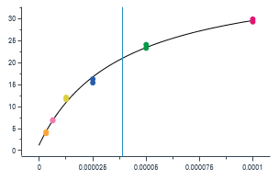
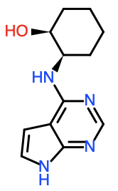
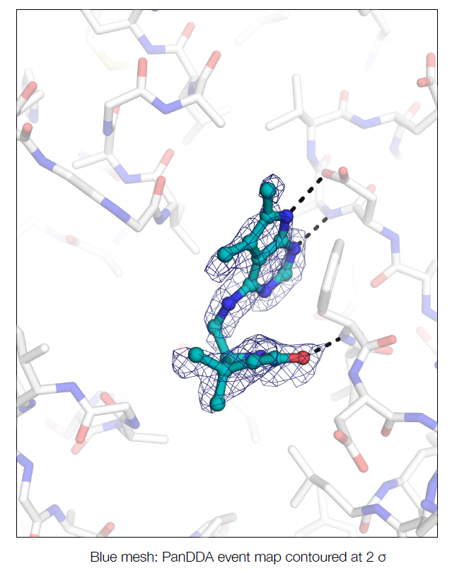
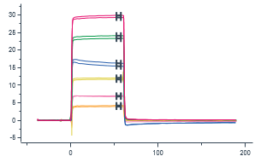
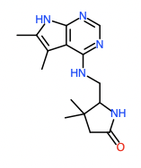
Round 1 HIT MOLECULE that was not followed up in round 2
Closest PNAS published hit
dist: 0.35
Ki:114 µM
CACHE3HI_1690_45
K_{D} (run 1) = 39 µM – 111% binding
K_{D} (run 2) = 33 µM – 105% binding
Selectivity for NSP3 (against PARP14a protein) – Yes
DLS (solub@100 µM)
HTRF_displacement:
%inh@100 uM = 60
%inh@50 uM = 40
%inh@25 uM = 28
Structure – Yes !

Slide 7
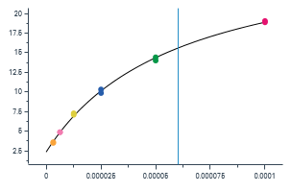
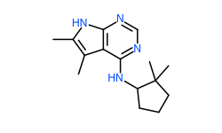
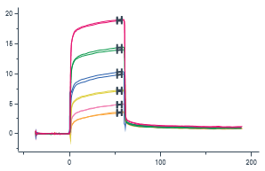
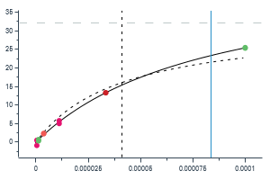
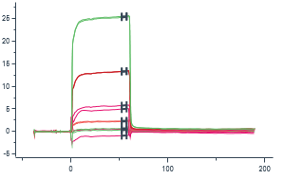
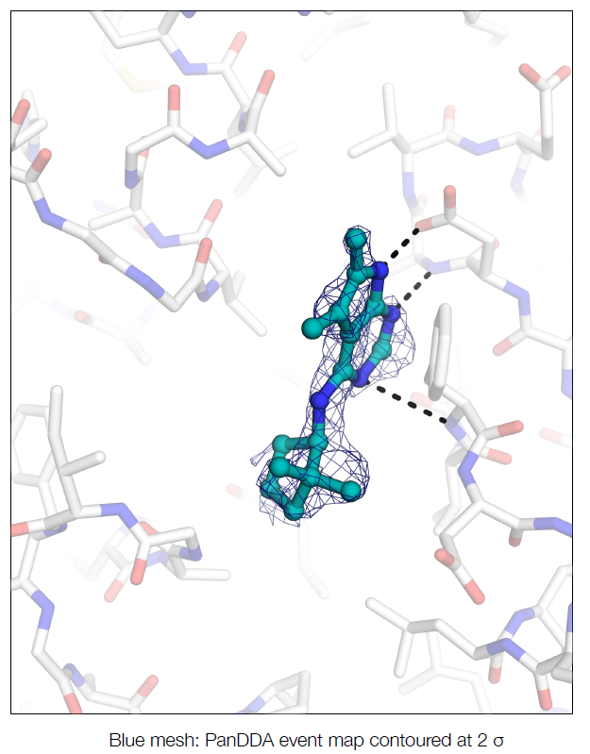
PARENT MOLECULE
19 analogs, including parent molecule, of CACHE3HI_1690_48 were submitted in round 2.
5 compounds, including a re-supplied parent molecule showed a dose dependent displacement of ADP-ribose peptide by HTRF. Among them 3 compounds confirmed by SPR.
CACHE3-HO_1690_46
K_{D} = 84 µM – 145% binding
DLS (solub@30 µM)
HTRF_displacement hit confirmation (4% DMSO):
%inh@100 uM = 58
%inh@30 uM = 29
%inh@10 uM = 15
CACHE3HI_1690_48
K_{D} = 60 µM – 87% binding
Selectivity for NSP3 (against PARP14a protein) – Yes
DLS (solub@100 µM)
HTRF_displacement:
%inh@100 uM = 47
%inh@50 uM = 34
%inh@25 uM = 18
Closest PNAS published hit
dist: 0.26
Ki:114 µM
Structure – Yes !

Slide 8
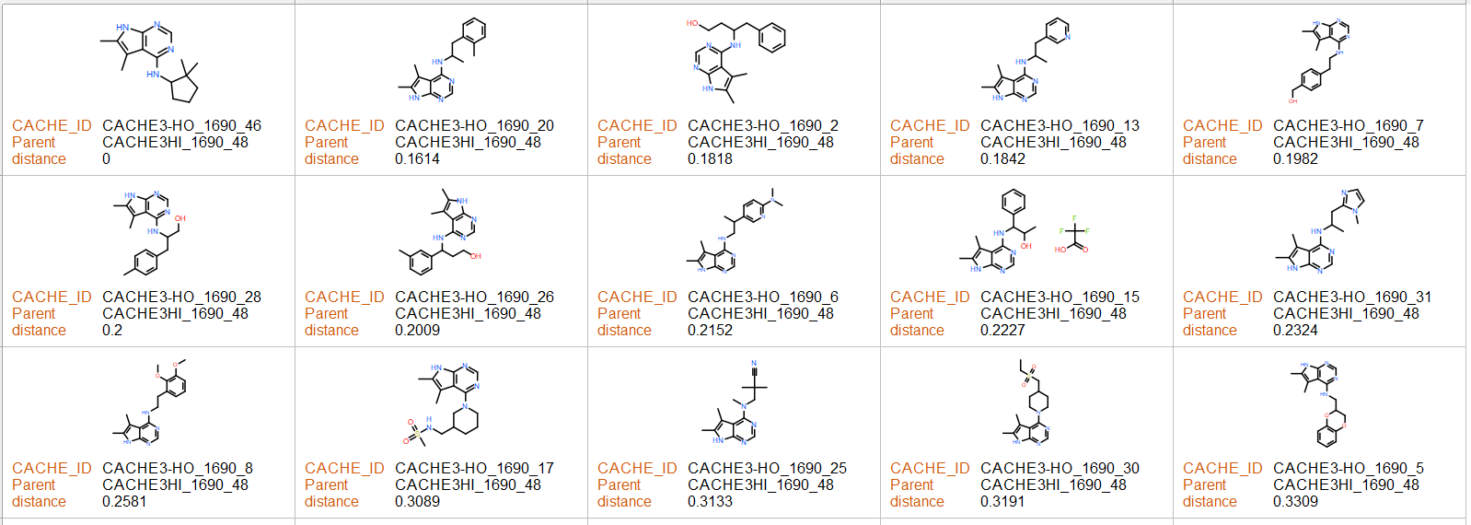
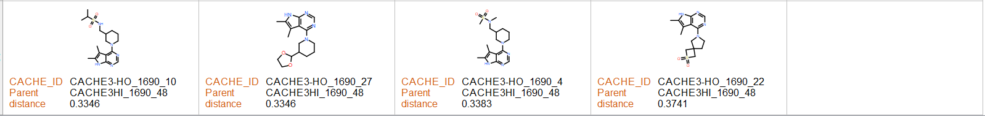
Tested analogs
confirmed
confirmed
confirmed

Slide 9
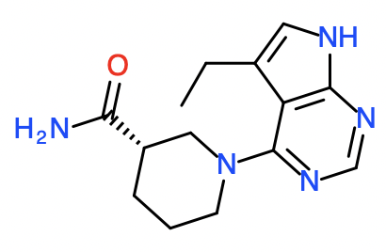
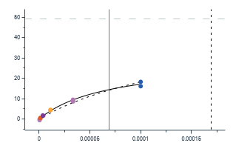
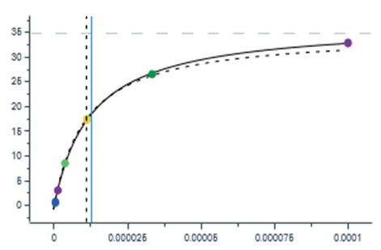
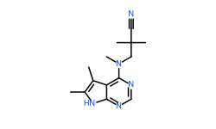
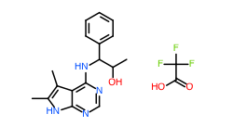
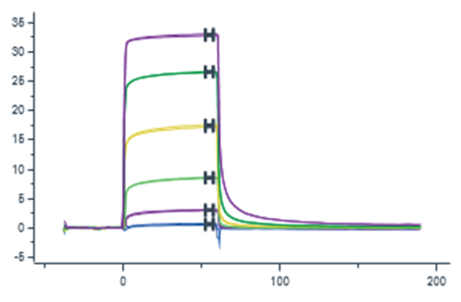
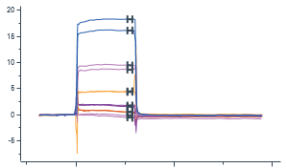
Closest PNAS published hit
dist: 0.28
Ki:177 µM
Closest PNAS published hit
dist: 0.28
Ki:114 µM
CACHE3-HO_1690_15
K_{D} = 69 µM – 59% binding
Selectivity for NSP3 (against PARP14a protein) – Yes
DLS (solub@100 µM)
HTRF_displacement hit confirmation (4% DMSO):
%inh@100 uM = 29
%inh@30 uM = 8
%inh@10 uM = 3
CACHE3-HO_1690_25
K_{D} (run 1) = 6 µM – 80% binding
K_{D} (run 2) = 13 µM – 106% binding
Selectivity for NSP3 (against PARP14a protein) – Yes
DLS (solub@100 µM)
HTRF_displacement hit confirmation (4% DMSO):
%inh@100 uM = 81
%inh@30 uM = 52
%inh@10 uM = 29

Slide 10
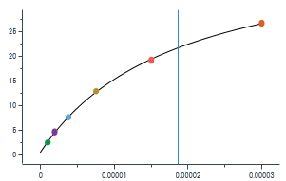
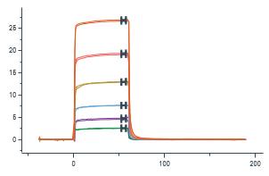
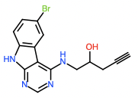
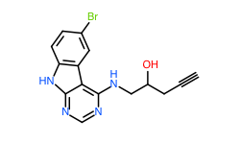
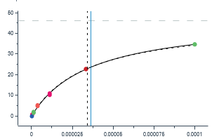
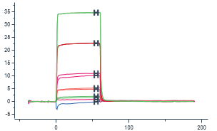
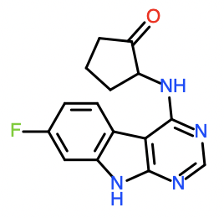
PARENT MOLECULE
10 analogs, including parent molecule, of CACHE3HI_1690_63 chemotype were submitted in round 2.
9 compounds, including a re-supplied parent molecule showed a dose dependent displacement of ADP-ribose peptide by HTRF and binding response by SPR. Among them 7 compounds confirmed by SPR.
CACHE3-HO_1690_47
K_{D} = 36 µM – 102% binding
DLS (solub@100 µM)
HTRF_displacement hit confirmation (4% DMSO):
%inh@100 uM = 44
%inh@30 uM = 13
%inh@10 uM = 9
CACHE3HI_1690_63
K_{D} = 19 µM – 98% binding
Selectivity for NSP3 (against PARP14a protein) – Yes
DLS (solub@100 µM)
HTRF_displacement:
%inh@100 uM = 87
%inh@50 uM = 43
%inh@25 uM = 20
Closest PNAS published hit
dist: 0.21
Ki:11 µM

Slide 11

Tested analogs
confirmed
confirmed
confirmed
confirmed
confirmed
confirmed
slow on/off

Slide 12










Closest PNAS published hit
dist: 0.2
Ki:12 µM
Closest PNAS published hit
dist: 0.2
Ki:12 µM
Closest PNAS published hit
dist: 0.2
Ki:12 µM
CACHE3-HO_1690_43
K_{D} = 3 µM – 75% binding
Selectivity for NSP3 (against PARP14a protein) – Yes
DLS (solub@100 µM)
HTRF_displacement hit confirmation (4% DMSO):
%inh@100 uM = 83
%inh@30 uM = 44
%inh@10 uM = 28
CACHE3-HO_1690_37
K_{D} (run 1) = 31 µM – 114% binding
K_{D} (run 2) = 42 µM – 137% binding
Selectivity for NSP3 (against PARP14a protein) – Yes
DLS (solub@100 µM)
HTRF_displacement hit confirmation (4% DMSO):
%inh@100 uM = 53
%inh@30 uM = 23
%inh@10 uM = 12
CACHE3-HO_1690_40
K_{D} (run 1) = 60 µM – 125% binding
K_{D} (run 2) = 51 µM – 96% binding
Selectivity for NSP3 (against PARP14a protein) – Yes
DLS (solub@100 µM)
HTRF_displacement hit confirmation (4% DMSO):
%inh@100 uM = 41
%inh@30 uM = 15
%inh@10 uM = 9

Slide 13










Closest PNAS published hit
dist: 0.2
Ki:12 µM
Closest PNAS published hit
dist: 0.2
Ki:1.5 µM
Closest PNAS published hit
dist: 0.2
Ki:1.5 µM
CACHE3-HO_1690_41
K_{D} (run 1) = 7 µM –93% binding
K_{D} (run 2) = 12 µM –108% binding
Selectivity for NSP3 (against PARP14a protein) – Yes
DLS (solub@50 µM)
HTRF_displacement hit confirmation (4% DMSO):
%inh@100 uM = 72
%inh@30 uM = 43
%inh@10 uM = 27
CACHE3-HO_1690_33
K_{D} = 10 µM (slow on/off) – 109% binding
Selectivity for NSP3 (against PARP14a protein) – Yes
DLS (solub@100 µM)
HTRF_displacement hit confirmation (4% DMSO):
%inh@100 uM = 46
%inh@30 uM = 28
%inh@10 uM = 19
CACHE3-HO_1690_42
K_{D} (run 1) = 38 µM – 57% binding
K_{D} (run 2) = 100 µM – 103% binding
Selectivity for NSP3 (against PARP14a protein) – Yes
DLS (solub@100 µM)
HTRF_displacement hit confirmation (4% DMSO):
%inh@100 uM = 31
%inh@30 uM = 17
%inh@10 uM = 17

Slide 14




HIT MOLECULE that was not followed up for round 2
Closest PNAS published hit
dist: 0.3
Ki:177 µM
CACHE3HI_1690_87
K_{D} (run 1) = 70 µM – 105% binding
K_{D} (run 2) = 103 µM – 109% binding
Selectivity for NSP3 (against PARP14a protein) – mild binding
DLS (solub@100 µM)
HTRF_displacement:
%inh@100 uM = 48
%inh@50 uM = 36
%inh@25 uM = 20

Slide 15







PARENT MOLECULE
6 analogs, including parent molecule, of CACHE3HI_1690_92
chemotype were submitted in round 2.
4 compounds, including the re-supplied parent molecule showed a dose dependent displacement of ADP-ribose peptide by HTRF. 3 compounds confirmed by SPR with a tendency to reach saturation (1 compound was sticky)
CACHE3-HO_1690_48
K_{D} = 92 µM – 97% binding
DLS (solub@100 µM)
HTRF_displacement hit confirmation (4% DMSO):
%inh@100 uM = 36
%inh@30 uM = 6
%inh@10 uM = 7
Closest PNAS published hit
dist: 0.3
Ki:114 µM
CACHE3HI_1690_92
K_{D} = 38 µM – 116% binding
Selectivity for NSP3 (against PARP14a protein) – Yes
DLS (solub@100 µM)
HTRF_displacement:
%inh@100 uM = 67
%inh@50 uM = 50
%inh@25 uM = 29
Structure – Yes !

Slide 16

Tested analogs
slow on/off
confirmed
confirmed

Slide 17








Closest PNAS published hit
dist: 0.4
Ki:114 µM
Closest PNAS published hit
dist: 0.4
Ki:119 µM
CACHE3-HO_1690_34
K_{D} = 85µM (slow on/off) – 112% binding
Selectivity for NSP3 (against PARP14a protein) – 147% binding
DLS (solub@100 µM)
HTRF_displacement hit confirmation (4% DMSO):
%inh@100 uM = 73
%inh@30 uM = 60
%inh@10 uM = 38
CACHE3-HO_1690_3
K_{D} (run 1) = 121 µM (poor fit) – 137% binding
K_{D} (run 2) = 14 µM (poor fit) – 65% binding
Selectivity for NSP3 (against PARP14a protein) – 25% binding
DLS (solub@100 µM)
HTRF_displacement hit confirmation (4% DMSO):
%inh@100 uM = 44
%inh@30 uM = 9
%inh@10 uM = 10

Slide 18
CACHE#3 – SARS-CoV2 Nsp3 macrodomain
Participant 1696

Slide 19






PARENT MOLECULE
14 analogs, including parent molecule, of CACHE3HI_1696_6
chemotype were submitted in round 2.
6 compounds, including the re-supplied parent molecule showed a dose dependent displacement of ADP-ribose peptide by HTRF. 3 compounds showed a dose dependent binding response by SPR, however, only 2 of them showed a tendency to reach saturation
CACHE3-HO_1696_45
K_{D} = 17 µM – 88% binding
DLS (solub@30 µM)
HTRF_displacement hit confirmation (4% DMSO):
%inh@100 uM = 38
%inh@30 uM = 16
%inh@10 uM = 14
Closest PNAS published hit
dist: 0.3
Ki:114 µM
CACHE3HI_1696_6
K_{D} = 51 µM – 73% binding
Selectivity for NSP3 (against PARP14a protein) – Yes
DLS (solub@100 µM)
HTRF_displacement:
%inh@100 uM = 45
%inh@50 uM = 25
%inh@25 uM = 10
Structure – Yes !

Slide 20

Tested analogs
confirmed
confirmed
confirmed

Slide 21






Closest PNAS published hit
dist: 0.3
Ki:114 µM
Closest PNAS published hit
dist: 0.37
Ki:114 µM
CACHE3-HO_1696_11
K_{D} (run 1) = 86 µM (predicted) – 94% binding
K_{D} (run 2) = 83 µM – 113% binding
Selectivity for NSP3 (against PARP14a protein) – 106% binding
DLS (solub@50 µM)
HTRF_displacement hit confirmation (4% DMSO):
%inh@100 uM = 51
%inh@30 uM = 21
%inh@10 uM = 8
CACHE3-HO_1696_4
K_{D} = 100 µM – 74% binding
Selectivity for NSP3 (against PARP14a protein) – linear response – 267% binding
DLS (solub@30 µM)
HTRF_displacement hit confirmation (4% DMSO):
%inh@100 uM = 30
%inh@30 uM = 37
%inh@10 uM = 16

Slide 22







PARENT MOLECULE
11 analogs, including parent molecule, of CACHE3HI_1696_50
chemotype were submitted for round 2.
6 compounds, including re-supplied parent molecule showed a dose dependent displacement of ADP-ribose peptide by HTRF. 2 compounds confirmed binding by SPR.
CACHE3-HO_1696_46
K_{D} = 87 µM –137% binding
DLS (solub@100 µM)
HTRF_displacement hit confirmation (4% DMSO):
%inh@100 uM = 43
%inh@30 uM = 15
%inh@10 uM = 5
Closest PNAS published hit
dist: 0.3
Ki:114 µM
CACHE3HI_1696_50
K_{D} = 45 µM – 104% binding
Selectivity for NSP3 (against PARP14a protein) – Yes
DLS (solub@100 µM)
HTRF_displacement:
%inh@100 uM = 57
%inh@50 uM = 40
%inh@25 uM = 26
Structure – Yes !

Slide 23

Tested analogs
confirmed
confirmed

Slide 24




Closest PNAS published hit
dist: 0.4
Ki:177 µM
CACHE3-HO_1696_18
K_{D} (run 1) = 44 µM – 121% binding
K_{D} (run 2) = 45 µM – 119% binding
Selectivity for NSP3 (against PARP14a protein) – Yes
DLS (solub@100 µM)
HTRF_displacement hit confirmation (4% DMSO):
%inh@100 uM = 60
%inh@30 uM = 25
%inh@10 uM = 7

Slide 25






PARENT MOLECULE
7 analogs, including parent molecule, of CACHE3HI_1696_67
chemotype were submitted in round 2.
5 compounds, including a re-supplied parent molecule showed a dose dependent displacement of ADP-ribose peptide by HTRF. 1 analog and the parent compound showed dose dependent binding by SPR
CACHE3-HO_1696_47
K_{D} = 64 µM – 111% binding
DLS (solub@30 µM)
HTRF_displacement hit confirmation (4% DMSO):
%inh@100 uM = 52
%inh@30 uM = 17
%inh@10 uM = 11
Closest PNAS published hit
dist: 0.4
Ki:114 µM
CACHE3HI_1696_67
K_{D} = 42 µM – 103% binding
Selectivity for NSP3 (against PARP14a protein) – Yes
DLS (solub@100 µM)
HTRF_displacement:
%inh@100 uM = 56
%inh@50 uM = 40
%inh@25 uM = 26
Structure – Yes !

Slide 26

Tested analogs
confirmed
confirmed

Slide 27



Closest PNAS published hit
dist: 0.3
Ki:114 µM
CACHE3-HO_1696_30
K_{D} (run 1) = 44 µM (predicted) – 49% binding
K_{D} (run 2) = 35 µM – 53% binding
Selectivity for NSP3 (against PARP14a protein) – 22% binding (slow off)
DLS (solub@50 µM)
HTRF_displacement hit confirmation (4% DMSO):
%inh@100 uM = 35
%inh@30 uM = 16
%inh@10 uM = 2

Slide 28






PARENT MOLECULE
6 analogs, including a parent molecule, of CACHE3HI_1696_78
chemotype were submitted for round 2.
2 compounds, including a re-supplied parent molecule showed a dose dependent displacement of ADP-ribose peptide by HTRF and confirmed binding affinity by SPR.
CACHE3-HO_1696_48
K_{D} = 17 µM – 73% binding
DLS (solub@100 µM)
HTRF_displacement hit confirmation (4% DMSO):
%inh@100 uM = 54
%inh@30 uM = 21
%inh@10 uM = 8
Closest PNAS published hit
dist: 0.4
Ki:114 µM
CACHE3HI_1696_78
K_{D} = 14 µM – 83% binding
Selectivity for NSP3 (against PARP14a protein) – Yes
DLS (solub@100 µM)
HTRF_displacement:
%inh@100 uM = 78
%inh@50 uM = 66
%inh@25 uM = 48
Structure – Yes !

Slide 29

Tested analogs
confirmed
confirmed

Slide 30




Closest PNAS published hit
dist: 0.3
Ki:118 µM
CACHE3-HO_1696_38
K_{D} (run 1) = 11µM – 60% binding
K_{D} (run 2) = 19µM – 69% binding
Selectivity for NSP3 (against PARP14a protein) – Yes
DLS (solub@50 µM)
HTRF_displacement hit confirmation (4% DMSO):
%inh@100 uM = 50
%inh@30 uM = 21
%inh@10 uM = 8

Slide 31
CACHE#3 – SARS-CoV2 Nsp3 macrodomain
Participant 1700

Slide 32






PARENT MOLECULE
31 analogs, including parent molecule, of CACHE3HI_1700_52
were submitted for round 2.
9 compounds, including re-supplied parent molecule showed a dose dependent displacement of ADP-ribose peptide by HTRF and binding response by SPR. 4 compounds showed a dose dependent binding response by SPR (re-supplied molecule showed a low binding response)
CACHE3-HO_1700_36
K_{D} = 19 µM (low binding/ slow on/off) – 23% binding
DLS (solub@100 µM)
HTRF_displacement hit confirmation (4% DMSO):
%inh@100 uM = 73
%inh@30 uM = 22
%inh@10 uM = 5
Closest PNAS published hit
dist: 0.5
Ki:1.1 µM
CACHE3HI_1700_52
K_{D} = 28 µM (slow on/off) – 94% binding
Selectivity for NSP3 (against PARP14a protein) – Yes
DLS (solub@100 µM)
HTRF_displacement:
%inh@100 uM = 81
%inh@50 uM = 69
%inh@25 uM = 32

Slide 33


confirmed
slow on/off
confirmed
Tested analogs
confirmed

Slide 34












Closest PNAS published hit
dist: 0.4
Ki:1.1 µM
Closest PNAS published hit
dist: 0.4
Ki:21 µM
Closest PNAS published hit
dist: 0.2
Ki:0.4 µM
CACHE3-HO_1700_3
K_{D} = 76µM (slow on/off) – 49% binding
Selectivity for NSP3 (against PARP14a protein) – 26% binding
DLS (solub@100 µM)
HTRF_displacement hit confirmation (4% DMSO):
%inh@100 uM = 80
%inh@30 uM = 32
%inh@10 uM = 22
CACHE3-HO_1700_22
K_{D} (run 1) = 36 µM– 114% binding
K_{D} (run 2) = 21 µM (low binding) – 23% binding
Selectivity for NSP3 (against PARP14a protein) – Yes
DLS (solub@100 µM)
HTRF_displacement hit confirmation (4% DMSO):
%inh@100 uM = 55
%inh@30 uM = 18
%inh@10 uM = 7
CACHE3-HO_1700_2
K_{D} = 17 µM– 92% binding
Selectivity for NSP3 (against PARP14a protein) – Yes
DLS (solub@100 µM)
HTRF_displacement hit confirmation (4% DMSO):
%inh@100 uM = 73
%inh@30 uM = 45
%inh@10 uM = 25

Slide 35
CACHE#3 – SARS-CoV2 Nsp3 macrodomain
Participant 1705

Slide 36














PARENT MOLECULE
35 analogs of CACHE3HI_1705_4 chemotype were submitted for round 2.
9 compounds showed a dose dependent displacement of ADP-ribose peptide by HTRF. Among them 3 compounds showed very low binding response by SPR.
Closest PNAS published hit
dist: 0.2
Ki:438 µM
CACHE3HI_1705_4
K_{D} = 93 µM – 109% binding
Selectivity for NSP3 (against PARP14a protein) – Yes
DLS (solub@100 µM)
HTRF_displacement:
%inh@100 uM = 38
%inh@50 uM = 20
%inh@25 uM = 10
CACHE3-HO_1705_11
K_{D} = 52 µM (low binding) – 11% binding
DLS (solub@100 µM)
HTRF_displacement hit confirmation(4% DMSO):
%inh@100 uM = 39
%inh@30 uM = 20
%inh@10 uM = 6
CACHE3-HO_1705_40
K_{D} = 87 µM (low binding) – 9% binding
DLS (solub@100 µM)
HTRF_displacement hit confirmation (4% DMSO):
%inh@100 uM = 25
%inh@30 uM = 11
%inh@10 uM = 7
CACHE3-HO_1705_32
K_{D} = 4 µM (low binding) – 9% binding
DLS (solub@100 µM)
HTRF_displacement hit confirmation (4% DMSO):
%inh@100 uM = 81
%inh@30 uM = 72
%inh@10 uM = 64
Structure – Yes !

Slide 37


Tested analogs

Slide 38
CACHE#3 – SARS-CoV2 Nsp3 macrodomain
Participant 1706

Slide 39






PARENT MOLECULE
18 analogs, including parent molecule, of CACHE3HI_1706_56 chemotype were submitted for round 2.
17 compounds, including a re-supplied parent molecule, showed a dose dependent displacement of ADP-ribose peptide by HTRF. Among them 12 compounds confirmed a dose dependent binding response by SPR, reaching saturation. 1 compound did not reach saturation.
CACHE3-HO_1706_20
K_{D} = 10 µM (poor fit) – 98% binding
DLS (solub@100 µM)
HTRF_displacement hit confirmation (4% DMSO):
%inh@100 uM = 81
%inh@30 uM = 47
%inh@10 uM = 29
Closest PNAS published hit
dist: 0.3
Ki:114 µM
CACHE3HI_1706_56
K_{D} = 20 µM – 89% binding
Selectivity for NSP3 (against PARP14a protein) – Yes
DLS (solub@100 µM)
HTRF_displacement:
%inh@100 uM = 84
%inh@50 uM = 72
%inh@25 uM = 54
Structure – Yes !

Slide 40
WF1706 - CACHE3HI_1706_56
17 analogs and a resupply of the parent molecule were tested in round 2.
All 18 compounds displaced of ADP-ribose peptide by HTRF.
12 compounds were confirmed by SPR
SPR sensorgram
Crystal structure
Closest hit in PNAS dist: 0.3
Ki:114 µM
K_{D} = 20 µM
CACHE3HI_1706_56
K_{D} = 20 µM – 89% binding
Selectivity for NSP3 (against PARP14a protein) – Yes
DLS (solub@100 µM)
HTRF displacement:
%inh@100 µM = 84
%inh@50 µM = 72
%inh@25 µM = 54

Slide 41

Tested analogs
confirmed
confirmed
confirmed
confirmed
confirmed
confirmed
confirmed
does not reach saturation
confirmed
confirmed
confirmed
confirmed
confirmed

Slide 42









Closest PNAS published hit
dist: 0.2
Ki:114 µM
Closest PNAS published hit
dist: 0.3
Ki:114 µM
Closest PNAS published hit
dist: 0.4
Ki:114 µM
CACHE3-HO_1706_11
K_{D} (run 1) = 20 µM – 100% binding
K_{D} (run 2) = 34 µM – 116% binding
Selectivity for NSP3 (against PARP14a protein) – 45 µM – 87% binding
DLS (solub@100 µM)
HTRF_displacement hit confirmation (4% DMSO):
%inh@100 uM = 63
%inh@30 uM = 26
%inh@10 uM = 18
CACHE3-HO_1706_12
K_{D} (run 1) = 40 µM – 88% binding
K_{D} (run 2) = 59 µM – 134% binding
Selectivity for NSP3 (against PARP14a protein) – Yes
DLS (solub@100 µM)
HTRF_displacement hit confirmation (4% DMSO):
%inh@100 uM = 57
%inh@30 uM = 24
%inh@10 uM = 17
CACHE3-HO_1706_8
K_{D} = 45 µM – 80% binding
Selectivity for NSP3 (against PARP14a protein) – mild binding (linear response)
DLS (solub@100 µM)
HTRF_displacement hit confirmation (4% DMSO):
%inh@100 uM = 50
%inh@30 uM = 22
%inh@10 uM = 13

Slide 43






Closest PNAS published hit
dist: 0.3
Ki:114 µM
Closest PNAS published hit
dist: 0.3
Ki:114 µM
CACHE3-HO_1706_16
K_{D} (run 1) = 51 µM – 70% binding
K_{D} (run 2) = 66 µM – 108% binding
Selectivity for NSP3 (against PARP14a protein) – Yes
DLS (solub@100 µM)
HTRF_displacement hit confirmation (4% DMSO):
%inh@100 uM = 53
%inh@30 uM = 23
%inh@10 uM = 15
CACHE3-HO_1706_9
K_{D} = 99 µM – 85% binding
Selectivity for NSP3 (against PARP14a protein) – Yes
DLS (solub@100 µM)
HTRF_displacement hit confirmation (4% DMSO):
%inh@100 uM = 25
%inh@30 uM = 10
%inh@10 uM = 8

Slide 44









Closest PNAS published hit
dist: 0.3
Ki:114 µM
Closest PNAS published hit
dist: 0.26
Ki:114 µM
Closest PNAS published hit
dist: 0.3
Ki:114 µM
CACHE3-HO_1706_3
K_{D} (run 1) = 60 µM – 143% binding
K_{D} (run 2) = 43 µM – 129% binding
Selectivity for NSP3 (against PARP14a protein) – Yes
DLS (solub@50 µM)
HTRF_displacement hit confirmation (4% DMSO):
%inh@100 uM = 61
%inh@30 uM = 30
%inh@10 uM = 6
CACHE3-HO_1706_2
K_{D} = 34 µM – 110% binding
Selectivity for NSP3 (against PARP14a protein) – Yes
DLS (solub@50 µM)
HTRF_displacement hit confirmation (4% DMSO):
%inh@100 uM = 67
%inh@30 uM = 34
%inh@10 uM = 14
CACHE3-HO_1706_10
K_{D} (run 1) = 81 µM (predicted) – 146% binding
K_{D} (run 2) = 79 µM – 169% binding
Selectivity for NSP3 (against PARP14a protein) – Yes
DLS (solub@50 µM)
HTRF_displacement hit confirmation (4% DMSO):
%inh@100 uM = 49
%inh@30 uM = 20
%inh@10 uM = 16

Slide 45












Closest PNAS published hit
dist: 0.2
Ki:114 µM
Closest PNAS published hit
dist: 0.3
Ki:114 µM
Closest PNAS published hit
dist: 0.2
Ki:114 µM
Closest PNAS published hit
dist: 0.3
Ki:114 µM
CACHE3-HO_1706_7
K_{D} (run 1) = 24 µM – 108% binding
K_{D} (run 1) = 21 µM – 125% binding
Selectivity for NSP3 (against PARP14a protein) – Yes
DLS (solub@50 µM)
HTRF_displacement hit confirmation (4% DMSO):
%inh@100 uM = 75
%inh@30 uM = 39
%inh@10 uM = 26
CACHE3-HO_1706_1
K_{D} = 12 µM – 53% binding
Selectivity for NSP3 (against PARP14a protein) – Yes
DLS (solub@50 µM)
HTRF_displacement hit confirmation (4% DMSO):
%inh@100 uM = 54
%inh@30 uM = 22
%inh@10 uM = 11
CACHE3-HO_1706_4
K_{D} (run 1) = 16 µM – 92% binding
K_{D} (run 2) = 25 µM – 128% binding
Selectivity for NSP3 (against PARP14a protein) – Yes
DLS (solub@50 µM)
HTRF_displacement hit confirmation (4% DMSO):
%inh@100 uM = 76
%inh@30 uM = 42
%inh@10 uM = 29
CACHE3-HO_1706_18
K_{D} = 134 µM (does not reach saturation) – 122% binding
DLS (solub@50 µM)
HTRF_displacement hit confirmation (4% DMSO):
%inh@100 uM = 40
%inh@30 uM = 19
%inh@10 uM = 4

Slide 46
CACHE#3 – SARS-CoV2 Nsp3 macrodomain
Participant 1708

Slide 47






PARENT MOLECULE
40 analogs, including parent molecule, of CACHE3HI_1708_42 chemotype were submitted for round 2.
23 compounds, including a re-supplied parent molecule, showed a dose dependent displacement of ADP-ribose peptide by HTRF. Among them 11 compounds confirmed a dose dependent binding response by SPR with a tendency to reach saturation
CACHE3-HO_1708_1
K_{D} = 11 µM (poor fit) – 83% binding
DLS (solub@100 µM)
HTRF_displacement hit confirmation (4% DMSO):
%inh@100 uM = 71
%inh@30 uM = 42
%inh@10 uM = 17
Closest PNAS published hit
dist: 0.2
Ki:114 µM
CACHE3HI_1708_42
K_{D} = 25 µM – 114% binding
Selectivity for NSP3 (against PARP14a protein) – Yes
DLS (solub@100 µM)
HTRF_displacement:
%inh@100 uM = 66
%inh@50 uM = 46
%inh@25 uM = 34
Structure – Yes !

Slide 48



confirmed
confirmed
confirmed
confirmed
confirmed
confirmed
confirmed
confirmed
Tested analogs
confirmed
confirmed
confirmed

Slide 49






Closest PNAS published hit
dist: 0.2
Ki:114 µM
Closest PNAS published hit
dist: 0.3
Ki:12 µM
CACHE3-HO_1708_41
K_{D} (run 1) = 64 µM – 112% binding
K_{D} (run 2) = 61 µM – 138% binding
Selectivity for NSP3 (against PARP14a protein) – Linear response (slow off)
DLS (solub@100 µM)
HTRF_displacement hit confirmation (4% DMSO):
%inh@100 uM = 45
%inh@30 uM = 15
%inh@10 uM = 14
CACHE3-HO_1708_36
K_{D} = 6 µM – 54% binding
Selectivity for NSP3 (against PARP14a protein) – Yes
DLS (solub@100 µM)
HTRF_displacement hit confirmation (4% DMSO):
%inh@100 uM = 86
%inh@30 uM = 39
%inh@10 uM = 13

Slide 50









Closest PNAS published hit
dist: 0.4
Ki:114 µM
Closest PNAS published hit
dist: 0.3
Ki:114 µM
Closest PNAS published hit
dist: 0.3
Ki:114 µM
CACHE3-HO_1708_45
K_{D} (run 1) = 63 µM – 94% binding
K_{D} (run 2) = 95 µM – 119% binding
Selectivity for NSP3 (against PARP14a protein) – Yes
DLS (solub@100 µM)
HTRF_displacement hit confirmation (4% DMSO):
%inh@100 uM = 25
%inh@30 uM = 10
%inh@10 uM = 6
CACHE3-HO_1708_35
K_{D} (run 1) = 24 µM (poor fit) – 100% binding
K_{D} (run 2) = 31 µM – 109% binding
Selectivity for NSP3 (against PARP14a protein) – mild binding
DLS (solub@100 µM)
HTRF_displacement hit confirmation (4% DMSO):
%inh@100 uM = 58
%inh@30 uM = 28
%inh@10 uM = 17
CACHE3-HO_1708_26
K_{D} (run 1) = 33 µM – 68% binding
K_{D} (run 2) = 48 µM – 75% binding
Selectivity for NSP3 (against PARP14a protein) – mild binding
DLS (solub@100 µM)
HTRF_displacement hit confirmation (4% DMSO):
%inh@100 uM = 36
%inh@30 uM = 8
%inh@10 uM = 9

Slide 51






Closest PNAS published hit
dist: 0.3
Ki:114 µM
Closest PNAS published hit
dist: 0.2
Ki:12 µM
CACHE3-HO_1708_5
K_{D} = 18 µM – 114% binding
Selectivity for NSP3 (against PARP14a protein) – Yes
DLS (solub@30 µM)
HTRF_displacement hit confirmation (4% DMSO):
%inh@100 uM = 74
%inh@30 uM = 38
%inh@10 uM = 18
CACHE3-HO_1708_39
K_{D} (run 1) = 27 µM – 50% binding
K_{D} (run 2) = 70 µM – 124% binding
Selectivity for NSP3 (against PARP14a protein) – Yes
DLS (solub@30 µM)
HTRF_displacement hit confirmation (4% DMSO):
%inh@100 uM = 27
%inh@30 uM = 6
%inh@10 uM = 2

Slide 52









Closest PNAS published hit
dist: 0.2
Ki:1.5 µM
Closest PNAS published hit
dist: 0.2
Ki:114 µM
Closest PNAS published hit
dist: 0.2
Ki:114 µM
CACHE3-HO_1708_15
K_{D} (run 1) = 7 µM (poor fit) – 35% binding
K_{D} (run 2) = 7 µM (poor fit) – 36% binding
Selectivity for NSP3 (against PARP14a protein) – Yes
DLS (solub@50 µM)
HTRF_displacement hit confirmation (4% DMSO):
%inh@100 uM = 74
%inh@30 uM = 24
%inh@10 uM = 15
CACHE3-HO_1708_32
K_{D} (run 1) = 9 µM (poor fit) – 52% binding
K_{D} (run 2) = 20 µM – 74% binding
Selectivity for NSP3 (against PARP14a protein) – Yes
DLS (solub@50 µM)
HTRF_displacement hit confirmation (4% DMSO):
%inh@100 uM = 59
%inh@30 uM = 21
%inh@10 uM = 13
CACHE3-HO_1708_11
K_{D} = 43 µM – 84% binding
Selectivity for NSP3 (against PARP14a protein) – 43% binding
DLS (solub@50 µM)
HTRF_displacement hit confirmation (4% DMSO):
%inh@100 uM = 55
%inh@30 uM = 26
%inh@10 uM = 13

Slide 53



HIT MOLECULE that was not followed up for round 2
Closest PNAS published hit
dist: 0.1
Ki:439 µM
CACHE3HI_1708_87
K_{D} = 53 µM – 106% binding
Selectivity for NSP3 (against PARP14a protein) – Yes
DLS (solub@100 µM)
HTRF_displacement:
%inh@100 uM = 52
%inh@50 uM = 38
%inh@25 uM = 20
Structure – Yes !

Slide 54
CACHE#3 – SARS-CoV2 Nsp3 macrodomain
Participant 1709

Slide 55



Crystallized molecule that was not advanced to round 2
CACHE3HI_1709_75
K_{D} (4% DMSO) = 28 µM (solubility issues) – 76% binding
K_{D} (2% DMSO) = N/A
Selectivity for NSP3 (against PARP14a protein) – Yes
Solubility (DLS) – 100 uM
HTRF_displacement hit confirmation (2% DMSO):
%inh@100 uM = 71
%inh@50 uM = 52
%inh@25 uM = 23
Closest PNAS published hit
dist: 0.4
Ki:114 µM
Structure – Yes !

Slide 56
CACHE#3 – SARS-CoV2 Nsp3 macrodomain
Participant 1714

Slide 57






PARENT MOLECULE
27 analogs, including parent molecule, of CACHE3HI_1714_34 chemotype were submitted for round 2.
5 compounds, including a re-supplied parent molecule, showed a dose dependent displacement of ADP-ribose peptide by HTRF and did not confirm binding by SPR (less than 10% binding response).
CACHE3-HO_1714_1
K_{D} = N/A (Low binding) – 1% binding
DLS (solub@100 µM)
HTRF_displacement hit confirmation (4% DMSO):
%inh@100 uM = 78
%inh@30 uM = 3
%inh@10 uM = 10
Closest PNAS published hit
dist: 0.5
Ki:4.7 µM
CACHE3HI_1714_34
K_{D} = 46 µM (low binding) – 25% binding
Selectivity for NSP3 (against PARP14a protein) – 43 µM – 27% binding
DLS (solub@100 µM)
HTRF_displacement:
%inh@100 uM = 40
%inh@50 uM = 15
%inh@25 uM = 1

Slide 58


Tested analogs

Slide 59
CACHE#3 – SARS-CoV2 Nsp3 macrodomain
Participant 1715

Slide 60






PARENT MOLECULE
12 analogs, including parent molecule, of CACHE3HI_1715_71 chemotype were submitted for round 2.
12 compounds, including a re-supplied parent molecule, showed a dose dependent displacement of ADP-ribose peptide by HTRF. Among them 6 compounds confirmed a dose dependent binding response reaching saturation (1 compounds does not reach saturation)
CACHE3-HO_1715_45
K_{D} = 18 µM – 89% binding
DLS (solub@50 µM)
HTRF_displacement hit confirmation (4% DMSO):
%inh@100 uM = 56
%inh@30 uM = 23
%inh@10 uM = 14
CACHE3HI_1715_71
K_{D} = 28 µM – 128% binding
Selectivity for NSP3 (against PARP14a protein) – Yes
DLS (solub@50 µM)
HTRF_displacement (2% DMSO):
%inh@100 uM = 66
%inh@50 uM = 93
%inh@25 uM = 23
Closest PNAS published hit
dist: 0.2
Ki:12 µM

Slide 61

Tested analogs
does not reach saturation
confirmed
confirmed
confirmed
confirmed
confirmed

Slide 62









Closest PNAS published hit
dist: 0.2
Ki:1.5 µM
Closest PNAS published hit
dist: 0.2
Ki:1.5 µM
Closest PNAS published hit
dist: 0.2
Ki:12 µM
CACHE3-HO_1715_30
K_{D} (run 1) = 36 µM – 97% binding
K_{D} (run 2) = 51 µM – 119% binding
Selectivity for NSP3 (against PARP14a protein) – Yes
DLS (solub@100 µM)
HTRF_displacement hit confirmation (4% DMSO):
%inh@100 uM = 46
%inh@30 uM = 16
%inh@10 uM = 12
CACHE3-HO_1715_18
K_{D} (run 1) = 74 µM – 84% binding
K_{D} (run 2) = 82 µM – 108% binding
Selectivity for NSP3 (against PARP14a protein) – Yes
DLS (solub@100 µM)
HTRF_displacement hit confirmation (4% DMSO):
%inh@100 uM = 23
%inh@30 uM = 8
%inh@10 uM = 10
CACHE3-HO_1715_28
K_{D} = 58 µM (does not reach saturation) – 130% binding
Selectivity for NSP3 (against PARP14a protein) – Yes
DLS (solub@100 µM)
HTRF_displacement hit confirmation (4% DMSO):
%inh@100 uM = 82
%inh@30 uM = 19
%inh@10 uM = 15

Slide 63





Closest PNAS published hit
dist: 0.2
Ki:1.5 µM
Closest PNAS published hit
dist: 0.2
Ki:12 µM
CACHE3-HO_1715_23
K_{D} = 20 µM – 71% binding
Selectivity for NSP3 (against PARP14a protein) – Yes
DLS (solub@50 µM)
HTRF_displacement hit confirmation (4% DMSO):
%inh@100 uM = 47
%inh@30 uM = 16
%inh@10 uM = 9
CACHE3-HO_1715_27
K_{D} (run 1) = 14 µM – 92% binding
K_{D} (run 2) = 27 µM – 151% binding
Selectivity for NSP3 (against PARP14a protein) – Yes
DLS (solub@50 µM)
HTRF_displacement hit confirmation (4% DMSO):
%inh@100 uM = 66
%inh@30 uM = 27
%inh@10 uM = 17

Slide 64







PARENT MOLECULE
1 analog of CACHE3HI_1715_76 chemotype were submitted for round 2.
CACHE3-HO_1715_36 showed a mild displacement of ADP-ribose peptide by HTRF and no binding response by SPR.
CACHE3-HO_1715_36
K_{D} = N/A µM – N/A% binding (low binding, does not reach saturation)
DLS (solub@100 µM)
HTRF_displacement hit confirmation (4% DMSO):
%inh@100 uM = 20
%inh@30 uM = 7
%inh@10 uM = 3
Closest PNAS published hit
dist: 0.1
Ki:12 µM
CACHE3HI_1715_76
K_{D} = 19 µM – 103% binding
Selectivity for NSP3 (against PARP14a protein) – Yes
DLS (solub@50 µM)
HTRF_displacement (2% DMSO):
%inh@100 uM = 48
%inh@50 uM = 37
%inh@25 uM = 24
Structure – Yes !

Slide 65



Crystallized molecule that was not advanced to round 2
CACHE3HI_1715_78
K_{D} = 1 µM – 105% binding
Selectivity for NSP3 (against PARP14a protein) – Yes
HTRF_displacement hit confirmation (2% DMSO):
%inh@100 uM = NA
%inh@50 uM = 47
%inh@25 uM = 25
-showed fluorescence interference
Closest PNAS published hit
dist: 0.3
Ki:12 µM
Structure – Yes !

Slide 66






PARENT MOLECULE
1 analog of CACHE3HI_1715_82 chemotype were submitted for round 2.
CACHE3-HO_1715_41 showed a mild displacement of ADP-ribose peptide by HTRF and low binding response by SPR.
CACHE3-HO_1715_41
K_{D} =47 µM– Low binding (30%)
DLS (solub@100 µM)
HTRF_displacement hit confirmation (4% DMSO):
%inh@100 uM = 45
%inh@30 uM = 3
%inh@10 uM = 2
Closest PNAS published hit
dist: 0.3
Ki:12 µM
CACHE3HI_1715_82
K_{D} = 48 µM – 64% binding
Selectivity for NSP3 (against PARP14a protein) – weak binding
DLS (solub@100 µM)
HTRF_displacement (2% DMSO):
%inh@100 uM = 68
%inh@50 uM = 25
%inh@25 uM = 9
Closest PNAS published hit
dist: 0.3
Ki:12 µM

Slide 67







PARENT MOLECULE
2 analogs of CACHE3HI_1715_83 chemotype were submitted for round 2.
2 compounds showed a mild displacement of ADP-ribose peptide by HTRF. Among them 1 compound confirmed a dose dependent binding affinity reaching saturation by SPR.
CACHE3-HO_1715_40
K_{D} = 20 µM – 97% binding
Selectivity for NSP3 (against PARP14a protein) – weak binding
DLS (solub@100 µM)
HTRF_displacement hit confirmation (4% DMSO):
%inh@100 uM = 35
%inh@30 uM = 10
%inh@10 uM = 7
Closest PNAS published hit
dist: 0.15
Ki:1.5 µM
Closest PNAS published hit
dist: 0.2
Ki:1.5 µM
CACHE3HI_1715_83
K_{D} = 35 µM – 61% binding
Selectivity for NSP3 (against PARP14a protein) – weak binding
DLS (solub@100 µM)
HTRF_displacement (2% DMSO):
%inh@100 uM = 82
%inh@50 uM = 37
%inh@25 uM = 15

Slide 68

Tested analogs
confirmed

Slide 69


HIT MOLECULE that was not followed up for round 2
Closest PNAS published hit
dist: 0.1
Ki:1.5 µM
CACHE3HI_1715_85
K_{D} (run 1) = 44 µM – 124% binding
Selectivity for NSP3 (against PARP14a protein) – Yes
DLS (solub@100 µM)
HTRF_displacement:
%inh@100 uM = 67
%inh@50 uM = 47
%inh@25 uM = 32
Structure – Yes !

Slide 70





PARENT MOLECULE
12 analogs, including parent molecule, of CACHE3HI_1715_88 chemotype were submitted for round 2.
6 compounds, including a re-supplied parent molecule, showed a dose dependent displacement of ADP-ribose peptide by HTRF and 2 compounds confirmed a dose dependent binding affinity by SPR (1 compound did not reach saturation).
CACHE3-HO_1715_46
K_{D} = 1.4 µM (low binding/poor fit) – 19% binding
DLS (solub@100 µM)
HTRF_displacement hit confirmation (4% DMSO):
%inh@100 uM = 82
%inh@30 uM = 32
%inh@10 uM = 17
CACHE3HI_1715_88
K_{D} = 49 µM (poor fit) – 35% binding
Selectivity for NSP3 (against PARP14a protein) – Yes
DLS (solub@50 µM)
HTRF_displacement (2% DMSO):
%inh@100 uM = 80
%inh@50 uM = 65
%inh@25 uM = 22
Closest PNAS published hit
dist: 0.15
Ki:12 µM

Slide 71

Tested analogs
does not reach saturation
confirmed

Slide 72






Closest PNAS published hit
dist: 0.5
Ki:114 µM
Closest PNAS published hit
dist: 0.2
Ki:12 µM
CACHE3-HO_1715_7
K_{D} = 17 µM – 89% binding
DLS (solub@100 µM)
HTRF_displacement hit confirmation (4% DMSO):
%inh@100 uM = 17
%inh@30 uM = 7
%inh@10 uM = 0
CACHE3-HO_1715_2
K_{D} = 57 µM (does not reach saturation) – 116% binding
Selectivity for NSP3 (against PARP14a protein) – Yes
DLS (solub@50 µM)
HTRF_displacement hit confirmation (4% DMSO):
%inh@100 uM = 79
%inh@30 uM = 34
%inh@10 uM = 15

Slide 73





PARENT MOLECULE
3 analogs, including parent molecule, of CACHE3HI_1715_89 chemotype were submitted for round 2.
3 compounds, including a re-supplied parent molecule, showed a dose dependent displacement of ADP-ribose peptide by HTRF and confirmed binding affinity by SPR.
CACHE3-HO_1715_47
K_{D} = 14 µM (poor fit) – 69% binding
DLS (solub@100 µM)
HTRF_displacement hit confirmation (4% DMSO):
%inh@100 uM = 55
%inh@30 uM = 19
%inh@10 uM = 15
CACHE3HI_1715_89
K_{D} = 12 µM – 87% binding
Selectivity for NSP3 (against PARP14a protein) – Yes
DLS (solub@100 µM)
HTRF_displacement (2% DMSO):
%inh@100 uM = 82
%inh@50 uM = 48
%inh@25 uM = 31
Closest PNAS published hit
dist: 0.2
Ki:1.5 µM

Slide 74

Tested analogs
confirmed
confirmed
confirmed

Slide 75






Closest PNAS published hit
dist: 0.2
Ki:12 µM
Closest PNAS published hit
dist: 0.2
Ki:12 µM
CACHE3-HO_1715_29
K_{D} (run 1) = 12 µM – 111% binding
K_{D} (run 2) = 18 µM – 118% binding
Selectivity for NSP3 (against PARP14a protein) – Yes
DLS (solub@100 µM)
HTRF_displacement hit confirmation (4% DMSO):
%inh@100 uM = 65
%inh@30 uM = 31
%inh@10 uM = 15
CACHE3-HO_1715_16
K_{D} = 140 µM – 133% binding
Selectivity for NSP3 (against PARP14a protein) – weak binding (slow on/off)
DLS (solub@100 µM)
HTRF_displacement hit confirmation (4% DMSO):
%inh@100 uM = 19
%inh@30 uM = 6
%inh@10 uM = 0

Slide 76







PARENT MOLECULE
9 analogs of CACHE3HI_1715_91 chemotype were submitted for round 2.
7 compounds showed a dose dependent displacement of ADP-ribose peptide by HTRF. 3 compounds showed a dose dependent binding response by SPR (1 compound may reach saturation at higher tested top concentration)
Closest PNAS published hit
dist: 0.1
Ki:1.5 µM
CACHE3HI_1715_91
K_{D} = 31 µM – 124% binding
Selectivity for NSP3 (against PARP14a protein) – Yes
DLS (solub@100 µM)
HTRF_displacement (2% DMSO):
%inh@100 uM = 57
%inh@50 uM = 40
%inh@25 uM = 23
CACHE3-HO_1715_20
K_{D} = 2 µM –39% binding
Selectivity for NSP3 (against PARP14a protein) – Yes
DLS (solub@100 µM)
HTRF_displacement hit confirmation (4% DMSO):
%inh@100 uM = 80
%inh@30 uM = 52
%inh@10 uM = 40
Structure – Yes !
Closest PNAS published hit
dist: 0.1
Ki:1.5 µM

Slide 77

Tested analogs
confirmed
confirmed
does not reach saturation

Slide 78






Closest PNAS published hit
dist: 0.3
Ki:12 µM
Closest PNAS published hit
dist: 0.2
Ki:12 µM
CACHE3-HO_1715_33
K_{D} = 89 µM (does not reach saturation) – 134% binding
Selectivity for NSP3 (against PARP14a protein) – Yes
DLS (solub@ 30 µM)
HTRF_displacement hit confirmation (4% DMSO):
%inh@100 uM = 44
%inh@30 uM = 20
%inh@10 uM = 1
CACHE3-HO_1715_42
K_{D} (run 1) = 31 µM – 46% binding
K_{D} (run 2) = 7 µM (low response) – 15% binding
Selectivity for NSP3 (against PARP14a protein) – 5% binding
DLS (solub@100 µM)
HTRF_displacement hit confirmation (4% DMSO):
%inh@100 uM = 50
%inh@30 uM = 8
%inh@10 uM = 7

Slide 79






PARENT MOLECULE
2 analogs of CACHE3HI_1715_92 chemotype were submitted for round 2.
1 compound showed a dose dependent displacement of ADP-ribose peptide by HTRF and binding affinity by SPR.
CACHE3-HO_1715_39
K_{D} = 10 µM – 89% binding
DLS (solub@100 µM)
HTRF_displacement hit confirmation (4% DMSO):
%inh@100 uM = 45
%inh@30 uM = 17
%inh@10 uM = 13
Closest PNAS published hit
dist: 0.3
Ki:12 µM
CACHE3HI_1715_92
K_{D} = 34 µM – 64% binding
Selectivity for NSP3 (against PARP14a protein) – 31% binding
DLS (solub@100 µM)
HTRF_displacement (2% DMSO):
%inh@100 uM = 47
%inh@50 uM = 27
%inh@25 uM = 16
Closest PNAS published hit
dist: 0.3
Ki:12 µM
Structure – Yes !

Slide 80

Tested analogs
confirmed

Slide 81







PARENT MOLECULE
1 analog of CACHE3HI_1715_95 chemotype were submitted for round 2.
CACHE3-HO_1715_31 showed a dose dependent displacement of ADP-ribose peptide by HTRF and a weak binding affinity by SPR.
CACHE3-HO_1715_31
K_{D} = 84 (poor fit) – 49% binding
DLS (solub@100 µM)
HTRF_displacement hit confirmation (4% DMSO):
%inh@100 uM = 86
%inh@30 uM = 43
%inh@10 uM = 2
Closest PNAS published hit
dist: 0.15
Ki:12 µM
CACHE3HI_1715_95
K_{D} = 93 µM – 129% binding
Selectivity for NSP3 (against PARP14a protein) – Yes
DLS (solub@100 µM)
HTRF_displacement (2% DMSO):
%inh@100 uM = 35
%inh@50 uM = 21
%inh@25 uM = 11
Closest PNAS published hit
dist: 0.2
Ki:79 µM
Structure – Yes !

Slide 82
CACHE#3 – SARS-CoV2 Nsp3 macrodomain
Participant 1716

Slide 83



Crystallized molecule that was not advanced to round 2
CACHE3HI_1716_34
K_{D} = 15 µM – 133% binding
Selectivity for NSP3 (against PARP14a protein) – mild binding
HTRF_displacement hit confirmation (2% DMSO):
%inh@100 uM = NA
%inh@50 uM = NA
%inh@25 uM = 72
-showed fluorescence interference
Structure – Yes !
Closest PNAS published hit
dist: 0.4
Ki:114 µM

Slide 84
CACHE#3 – SARS-CoV2 Nsp3 macrodomain
Participant 1718

Slide 85









PARENT MOLECULE
6 analogs, including parent molecule, of CACHE3HI_1718_58 chemotype were submitted for round 2.
2 compounds showed a dose dependent displacement of ADP-ribose peptide by HTRF and binding affinity by SPR.
Closest PNAS published hit
dist: 0.1
Ki:12 µM
Closest PNAS published hit
dist: 0.1
Ki:12 µM
CACHE3HI_1718_58
K_{D} = 92 µM – 139% binding
Selectivity for NSP3 (against PARP14a protein) – Yes
DLS (solub@100 µM)
HTRF_displacement (2% DMSO):
%inh@100 uM = 36
%inh@50 uM = 17
%inh@25 uM = 10
Closest PNAS published hit
dist: 0.1
Ki:12 µM
CACHE3-HO_1718_6
K_{D} = 38 µM – 133% binding
Selectivity for NSP3 (against PARP14a protein) – mild binding
DLS (solub@50 µM)
HTRF_displacement hit confirmation (4% DMSO):
%inh@100 uM = 61
%inh@30 uM = 27
%inh@10 uM = 21
CACHE3-HO_1718_5
K_{D} (run 1) = 3 µM – 97% binding
K_{D} (run 1) = 3 µM – 81% binding
Selectivity for NSP3 (against PARP14a protein) – 14% binding
DLS (solub@100 µM)
HTRF_displacement hit confirmation (4% DMSO):
%inh@100 uM = 82
%inh@30 uM = 60
%inh@10 uM = 45

Slide 86

Tested analogs
confirmed
confirmed

Slide 87





PARENT MOLECULE
13 analogs, including parent molecule, of CACHE3HI_1718_59 chemotype were submitted for round 2.
5 compounds, including a re-supplied parent molecule, showed a dose dependent displacement of ADP-ribose peptide by HTRF and binding affinity by SPR.
CACHE3-HO_1718_22
K_{D} = 69 µM – 128% binding
DLS (solub@100 µM)
HTRF_displacement hit confirmation (4% DMSO):
%inh@100 uM = 34
%inh@30 uM = 12
%inh@10 uM = 7
CACHE3HI_1718_59
K_{D} = 75 µM – 125% binding
Selectivity for NSP3 (against PARP14a protein) – 41% binding
DLS (solub@100 µM)
HTRF_displacement (2% DMSO):
%inh@100 uM = 44
%inh@50 uM = 19
%inh@25 uM = 9
Closest PNAS published hit
dist: 0.1
Ki:12 µM

Slide 88


confirmed
confirmed
confirmed
confirmed
confirmed
Tested analogs

Slide 89












Closest PNAS published hit
dist: 0.1
Ki:12 µM
Closest PNAS published hit
dist: 0.1
Ki:12 µM
Closest PNAS published hit
dist: 0.2
Ki:1.5 µM
Closest PNAS published hit
dist: 0.1
Ki:12 µM
CACHE3-HO_1718_4
K_{D} = 7 µM – 131% binding
Selectivity for NSP3 (against PARP14a protein) – 44% binding
DLS (solub@50 µM)
HTRF_displacement hit confirmation (4% DMSO):
%inh@100 uM = 82
%inh@30 uM = 52
%inh@10 uM = 37
CACHE3-HO_1718_16
K_{D} (run 1) = 23 µM – 154% binding
K_{D} (run 1) = 19 µM – 122% binding
Selectivity for NSP3 (against PARP14a protein) – weak binding
DLS (solub@100 µM)
HTRF_displacement hit confirmation (4% DMSO):
%inh@100 uM = 63
%inh@30 uM = 34
%inh@10 uM = 18
CACHE3-HO_1718_7
K_{D} = 13 µM – 79% binding
Selectivity for NSP3 (against PARP14a protein) – Yes
DLS (solub@100 µM)
HTRF_displacement hit confirmation (4% DMSO):
%inh@100 uM = 74
%inh@30 uM = 43
%inh@10 uM = 31
CACHE3-HO_1718_17
K_{D} (run 1) = 20 µM – 131% binding
K_{D} (run 2) = 22 µM – 129% binding
Selectivity for NSP3 (against PARP14a protein) – Yes
DLS (solub@100 µM)
HTRF_displacement hit confirmation (4% DMSO):
%inh@100 uM = 66
%inh@30 uM = 28
%inh@10 uM = 21

