Slide 1
CACHE#4 – Casitas B-lineage Lymphoma B (CBL-B)
Participant 1946

Slide 2
CACHE4HI_1946_25
PARENT MOLECULE
Round1
23 analogs, of the CACHE4HI_1946_25 chemotype, and parent molecule were submitted for round 2.
2 compounds, including a re-supplied parent molecule, displaced the BODIPY FL-MSC2787102A-1 in FP assays. The analog CACHE4-HO_1946_15 confirms its binding by NMR while showing a weak binding response by SPR.
Primary Screen (% FP at 50 μM)
Trial 1- 49.0
Trial 2- 56.4
FP dose response/counter-screen
(round 1 data at 2% DMSO)
CACHE4-HO_1946_1/resupplied parent
 | CBL-B (FP assay) run1 | CBL-B (FP assay) run2 | GID4 (FP assay)
Hill Slope | -1.2 | -1.2 | N/A
K_{disp} (µM) | 67 | 90 | >>1000
Primary Screen (FP %Control)
100 µM – 35
30 µM – 68
10 µM – 91
FP dose response/counter screen
 | CBL-B (FP assay) | GID4 (FP assay)
Hill Slope | -1.1 | -1.4
K_{disp} (µM) | 113 | 271
No evidence of binding by SPR
*SPR was done with the re-supplied parent batch.
Binds to GID4
¹⁹F NMR - no clear evidence of binding was identified

Slide 3
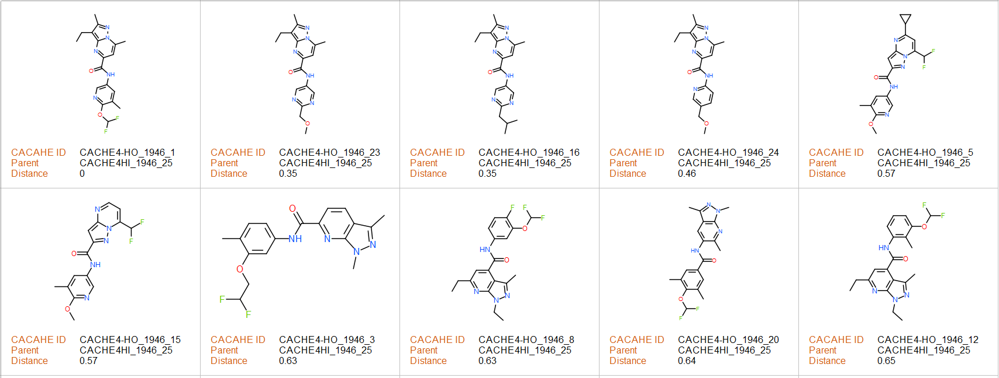
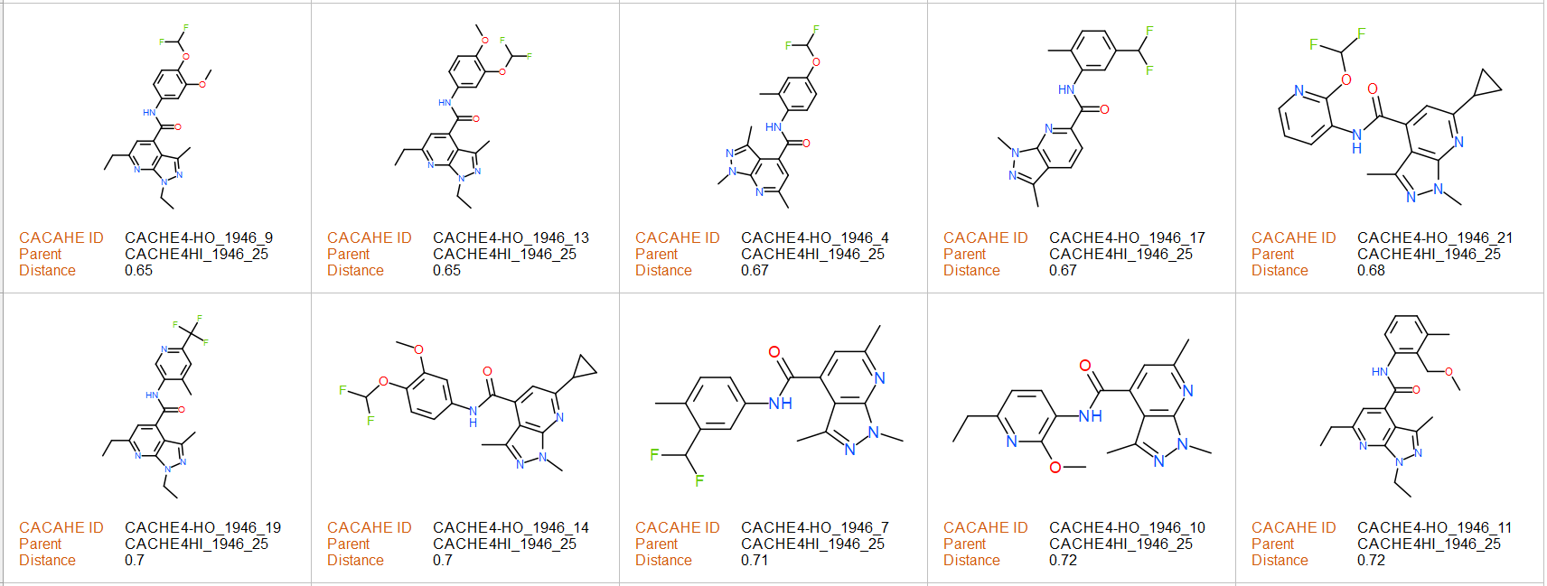
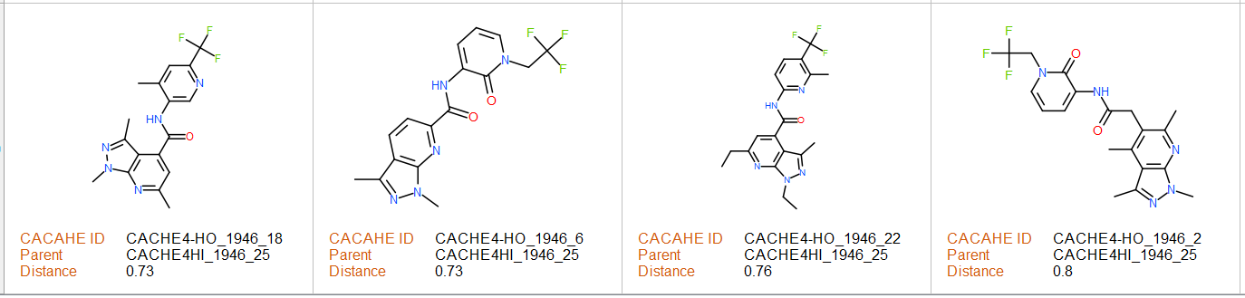
FP binding
confirmed
CACHE4HI_1946_25
Tested analogs
FP, NMR and weak SPR binding
confirmed

Slide 4
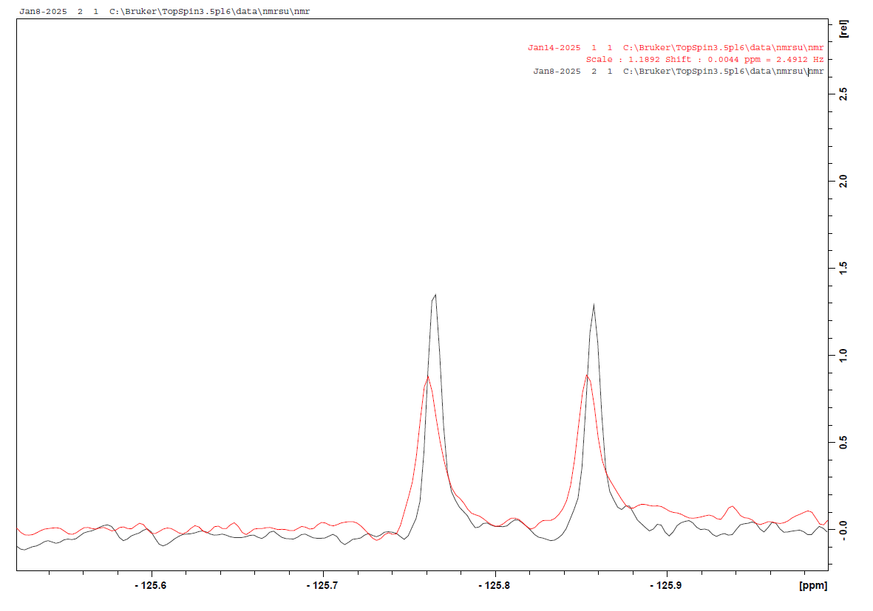
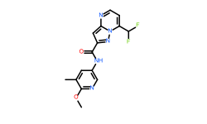
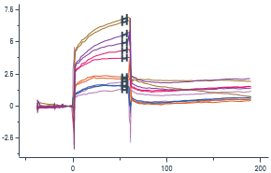
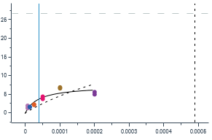
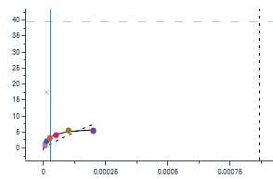
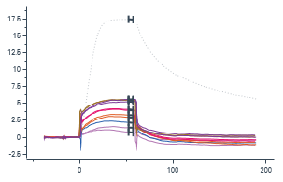
CACHE4-HO_1946_15
black - control 15 μM compound
red - 15 μM compound + 25 μM protein
Binding confirmed!
Primary Screen (FP %Control)
100 µM – Overflow
30 µM – 26
10 µM – 63
¹⁹F NMR confirmation
Dose response/counter screen
 | CBL-B (FP assay) | GID4 (FP assay)
Hill Slope | -1.2 | -1.4
K_{disp} (µM) | 16 | 42
CBLB
GID4
Non-specific binding to non-related target is observed.
SPR K_{D} – 38 µM
Binding percentage – 27% (low binder)
CBLB Specificity – N/A
Binding to non-related target (GID4):
SPR K_{D} – 27 µM – 16% binding (low binder)
A dubious SPR binding behavior is observed.
Binds to GID4

Slide 5
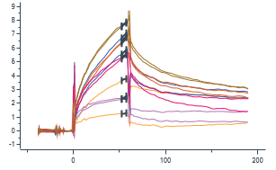
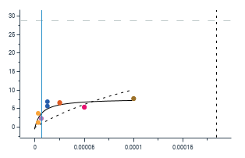
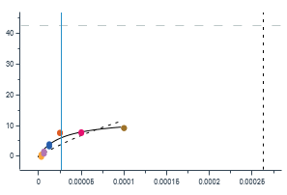
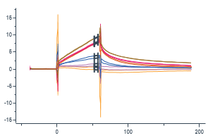
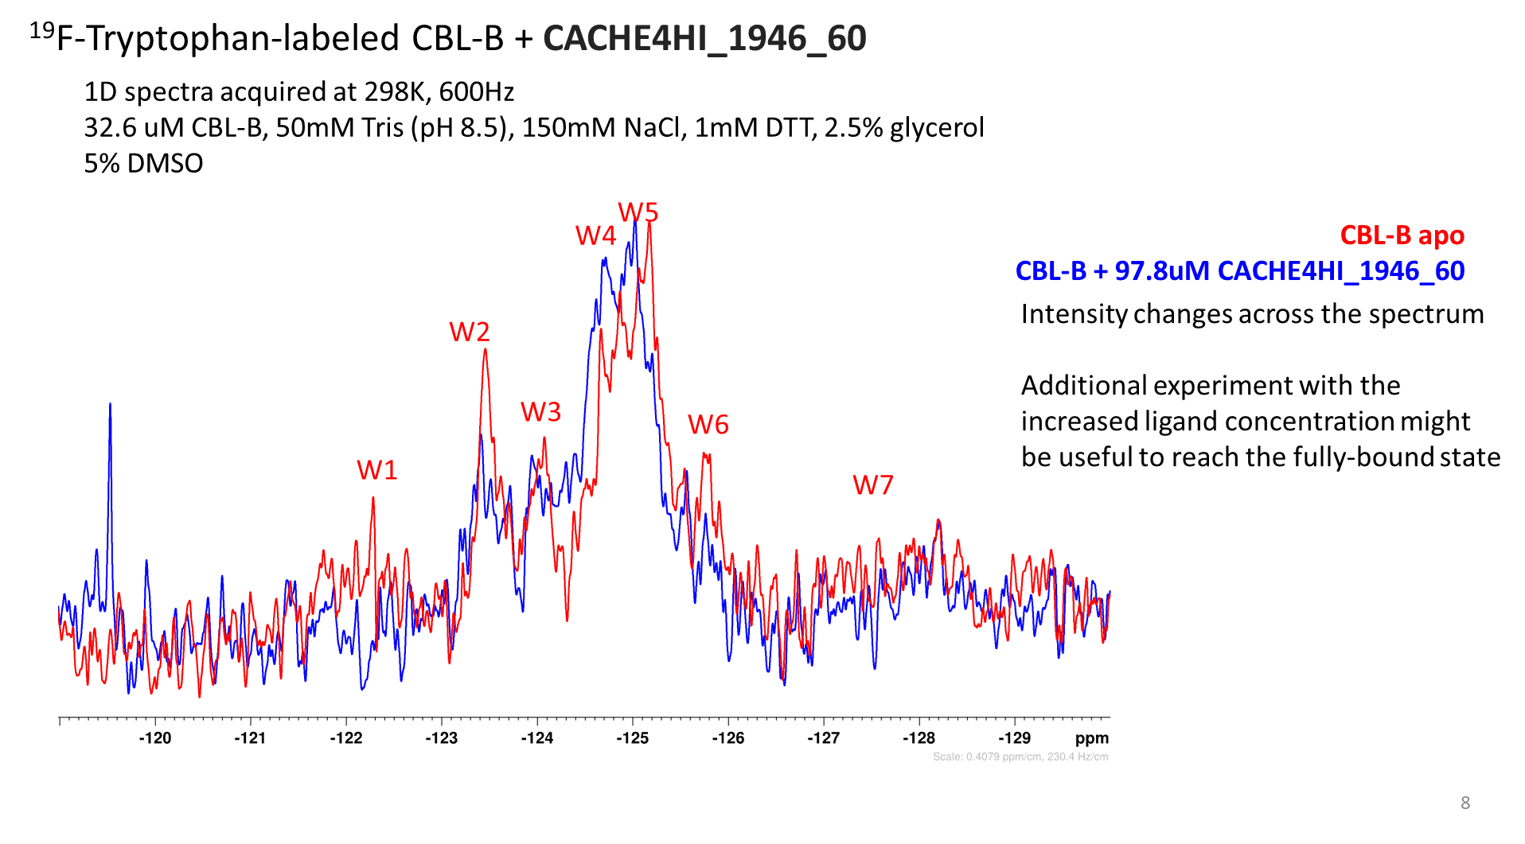
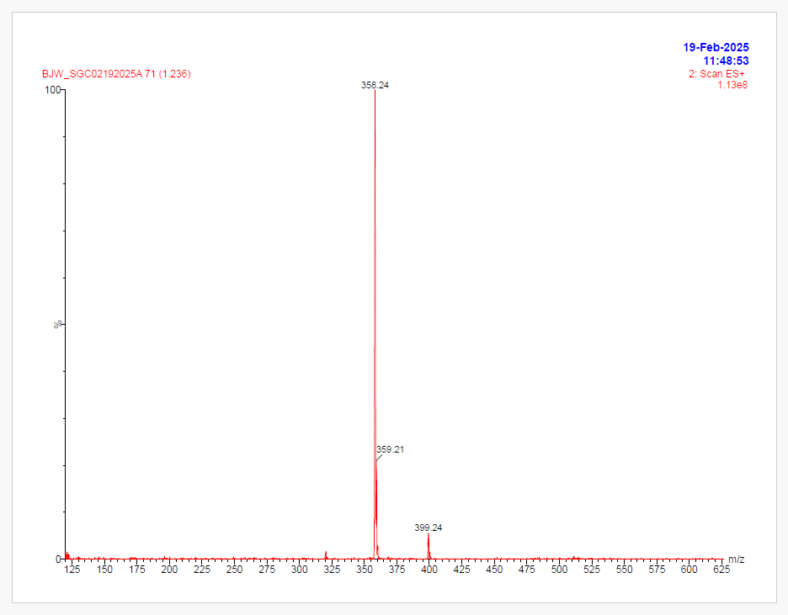
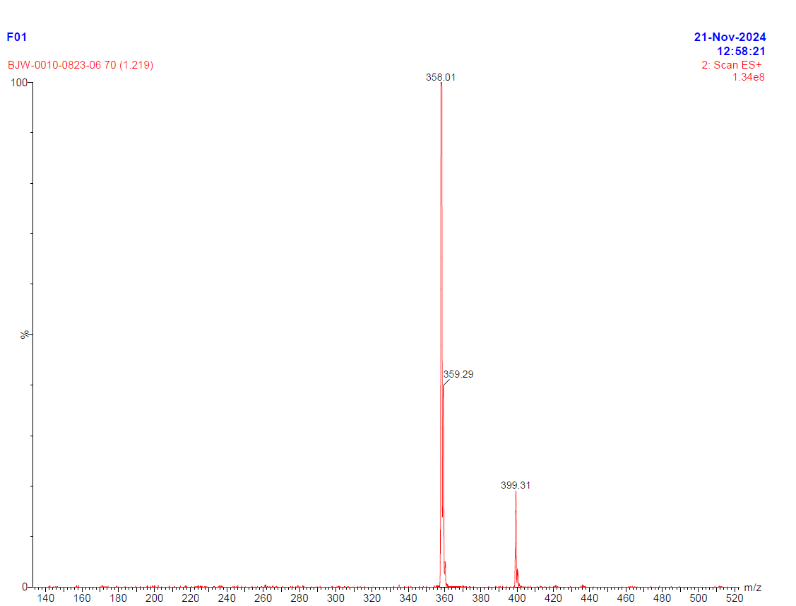
CACHE4HI_1946_60
PARENT MOLECULE
Round1
17 analogs, of the CACHE4HI_1946_60 chemotype and the parent molecule were submitted for round 2.
Seven compounds including the parent molecule initially displaced the BODIPY FL-MSC2787102A-1 in FP assays. CACHE4-HO_1946_35 and CACHE4-HO_1946_28 demonstrated ≤50% displacement of BODIPY-tracer. CACHE4-HO_1946_33 and CACHE4-HO_1946_26 demonstrated ≥50% displacement of the BODIPY-tracer.
CACHE4-HO_1946_36, CACHE4-HO_1946_41 and the parent displace the BODIPY-tracer in FP assay and confirm binding by NMR and weak binding by SPR.
Primary Screen (% FP at 50 μM)
Trial 1-29.9
Trial 2- 7.4
FP dose response/counter-screen
 | CBL-B (FP assay) | GID4 (FP assay)
Hill Slope | -0.9 | -1.5
K_{disp} (µM) | 3.5 | 118
Primary Screen (FP %Control)
100 µM – 18
30 µM – 72
10 µM – 95
CACHE4-HO_1946_25/resupplied parent
*SPR was done with CACHE4HI_1946_60 due to the contamination observed withCACHE3-HO_1946_25/resupplied parent.
. | CBL-B (FP assay) run1 | CBL-B (FP assay) run2 | GID4 (FP assay)
Hill Slope | -1.4 | -2.5 | N/A
K_{disp} (µM) | 138 | 108 | N/A
CBLB
GID4
NMR binding with ¹⁹F-Trp-labeled CBLB confirmed!
QC data (UPLC-MS analysis)
CACHE4HI_1946_60
CACHE4-HO_1946_25
Impurity % is higher
SPR K_{D}– 7 µM
Binding percentage – 27% (low binder)
Binding to non-related target (GID4):
SPR K_{D} – 26 µM, 29% binding (low binder)
A dubious SPR binding behavior is observed.

Slide 6
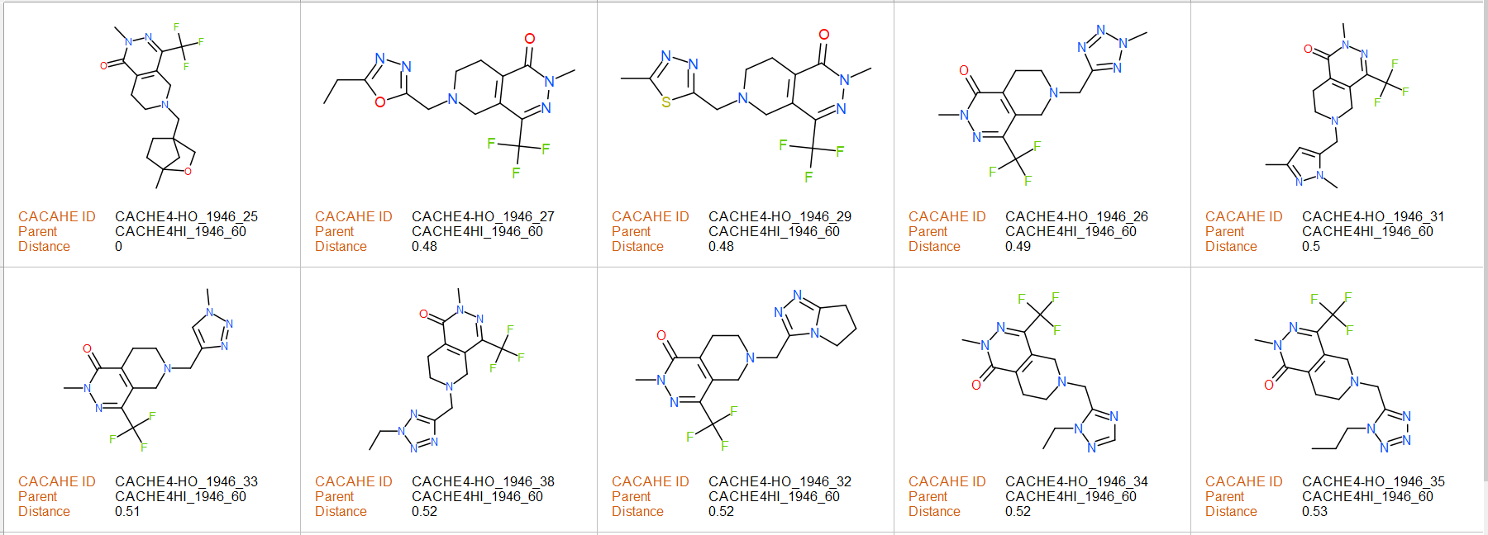
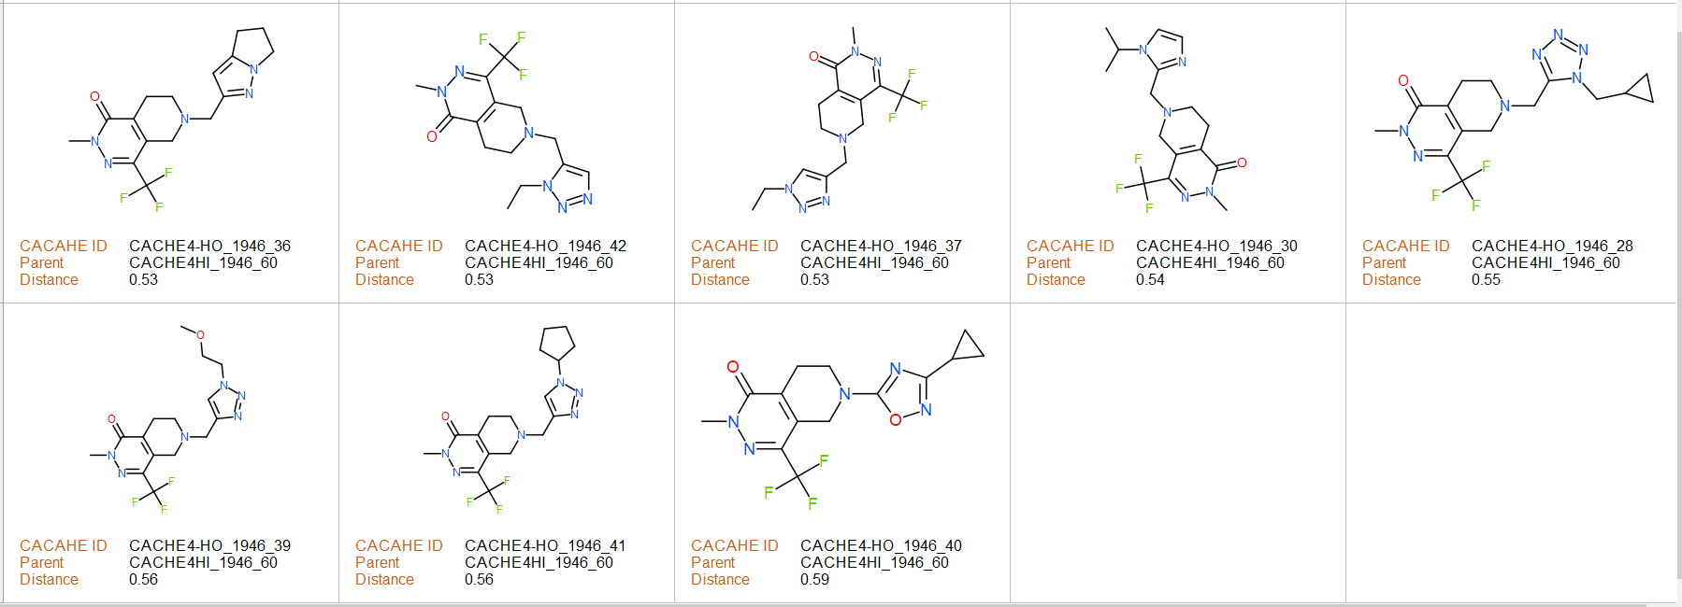
FP, NMR and weak SPR
binding
confirmed
CACHE4HI_1946_60
Tested analogs
FP binding
observed
FP binding
observed
FP, NMR and weak SPR
binding
confirmed
FP, NMR and weak SPR
binding
confirmed

Slide 7
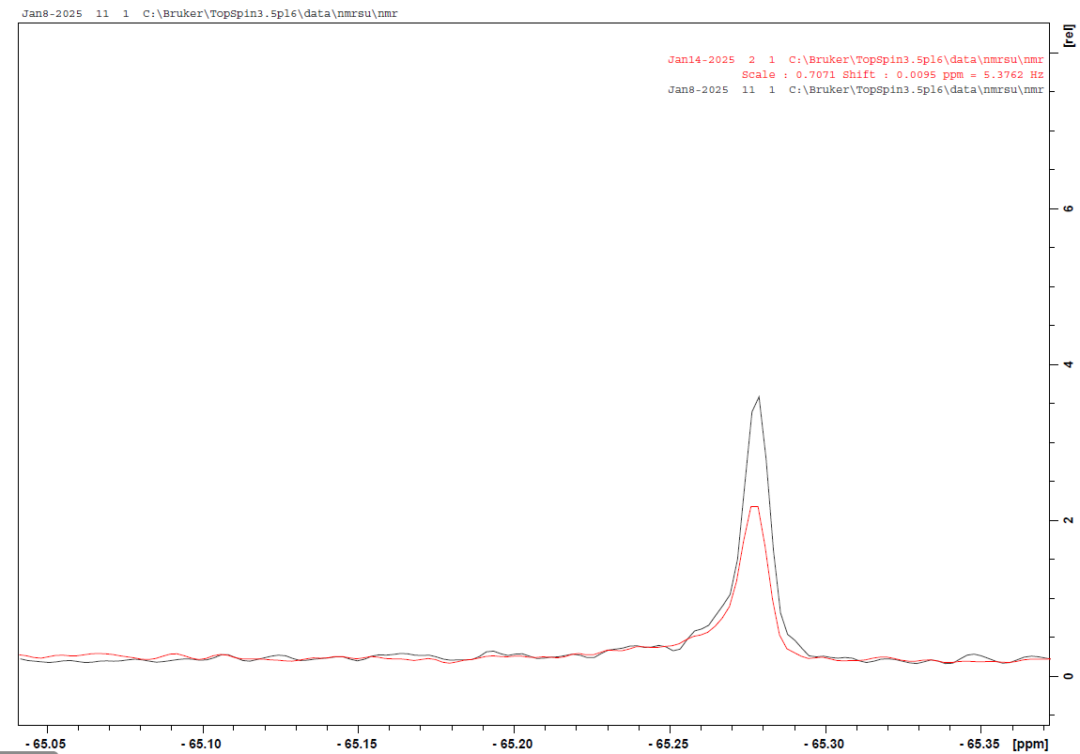
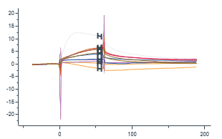
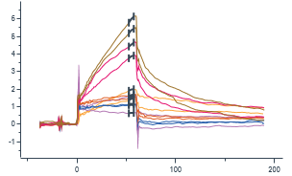
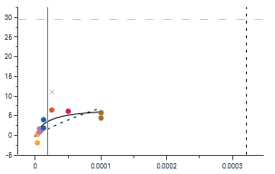
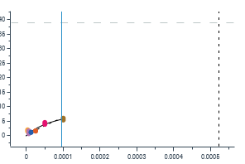
CACHE4-HO_1946_36
black - control 15 μM compound
red - 15 μM compound + 25 μM protein
Binding confirmed!
Primary Screen (FP %Control)
100 µM – 58
30 µM – 88
10 µM – 102
¹⁹F NMR confirmation
FP dose response/counter screen
 | CBL-B (FP assay) | GID4 (FP assay)
Hill Slope | -1.3 | -1.4
K_{disp} (µM) | 61 | >100
CBLB
GID4
SPR K_{D} – 19 µM
Binding percentage – 24% (low binder)
CBLB Specificity – No
Binding percentage to non-related target (GID4) - SPR K_{D} – 96 µM - 29% binding (low binder)
A dubious SPR binding behavior is observed.

Slide 8
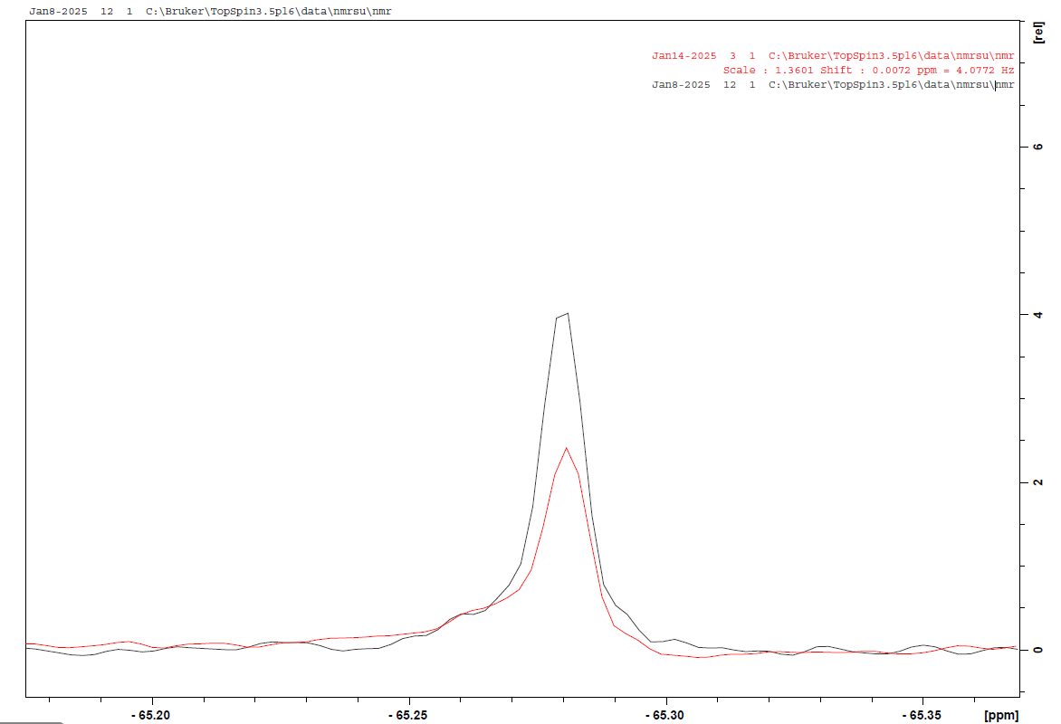
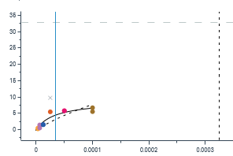
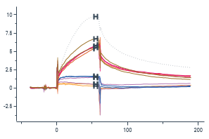
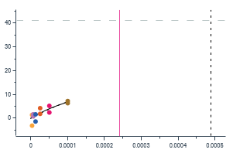
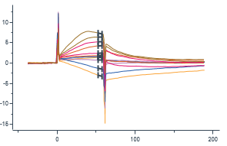
CACHE4-HO_1946_41
black - control 15 μM compound
red - 15 μM compound + 25 μM protein
Binding confirmed!
Primary Screen (FP %Control)
100 µM – 79
30 µM – 93
10 µM – 93
¹⁹F NMR confirmation
FP dose response/counter screen
 | CBL-B (FP assay) | GID4 (FP assay)
Hill Slope | -1.3 | -1.6
K_{disp} (µM) | 35 | 359
CBLB
GID4
SPR K_{D}– 34 μM
Binding percentage – 27% (low binder)
CBLB Specificity – N/A
Binding percentage to non-related target (GID4) - SPR K_{D} – 241 µM –56% binding.
A dubious SPR binding behavior is observed.

Slide 9
CACHE4-HO_1946_33
CACHE4-HO_1946_26
Primary Screen (FP %Control)
100 µM – 71
30 µM – 79
10 µM – 95
Primary Screen (FP %Control)
100 µM – 71
30 µM – 95
10 µM – 95
FP dose response/counter screen
FP dose response/counter screen
 | CBL-B (FP assay) | GID4 (FP assay)
Hill Slope | -1.1 | -2.3
K_{disp} (µM) | 92 | 230
 | CBL-B (FP assay) | GID4 (FP assay)
Hill Slope | -1.2 | NA
K_{disp} (µM) | 118 | No DR
No evidence of binding by SPR
No evidence of binding by SPR

Slide 10
CACHE#4 – Casitas B-lineage Lymphoma B (CBL-B)
Participant 1948

Slide 11
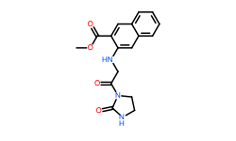
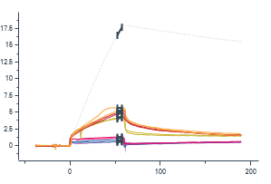
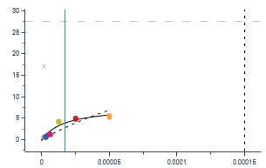
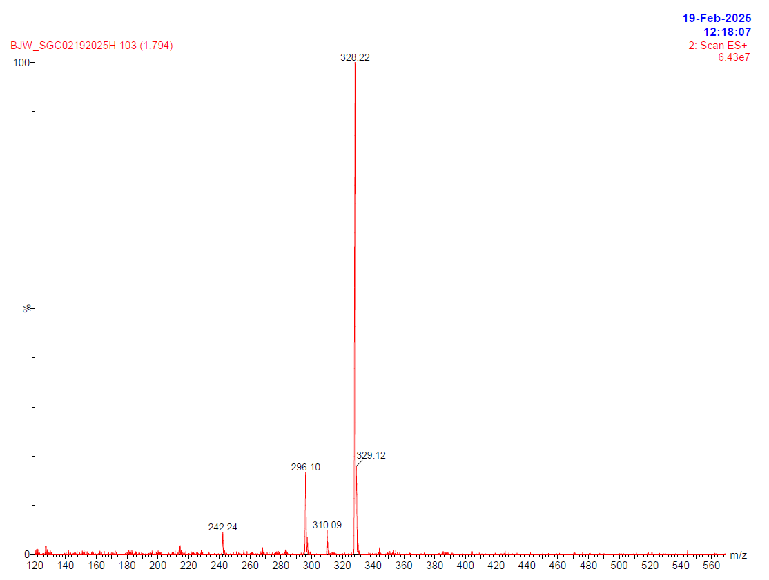
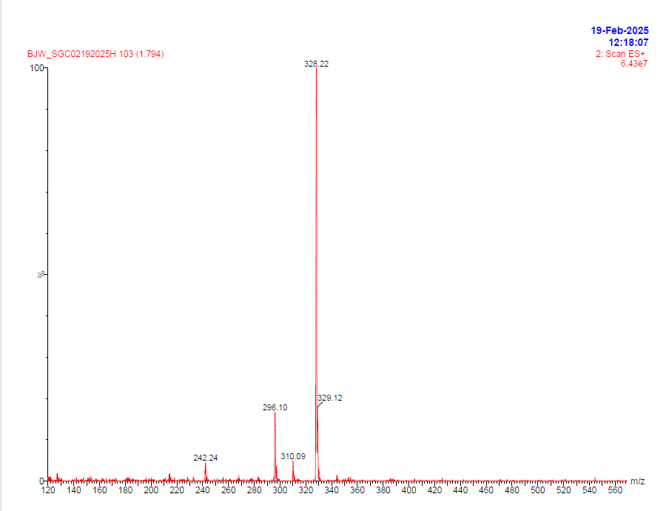
CACHE4HI_1948_91
PARENT MOLECULE
Round1
31 analogs, of the CACHE4H1_1948_91 chemotype and the parent molecule were submitted for round 2.
The parent displaces BODIPY FL-MSC2787102A-1 by FP binding analyses and shows weak binding by SPR.
Primary Screen (% FP at 50 μM)
Trial 1-43.2
Trial 2- 55.5
FP dose response/counter-screen
(round 1 data at 2% DMSO)
CACHE4_HO _1948_1/resupplied parent
Primary Screen (FP %Control)
100 µM – 54
30 µM – 91
10 µM – 99
 | CBL-B (FP assay) run1 | CBL-B (FP assay) run2 | GID4 (FP assay)
Hill Slope | -1.3 | -1.4 | N/A
K_{disp} (µM) | 116 | 86 | N/A
 | CBL-B (FP assay) | GID4 (FP assay)
Hill Slope | -1.9 | -1.7
K_{disp} (µM) | 189 | 378
CBLB
QC data (UPLC-MS analysis): no difference between the two batches
CACHE4H1_1948_91
CACHE4_HO _1948_1
SPR K_{D} – 17 µM
Binding percentage – 28%
*SPR was done with the resupplied parent batch.
NMR binding with ¹⁹F-Trp-labeled CBLB - no clear evidence of binding identified

Slide 12
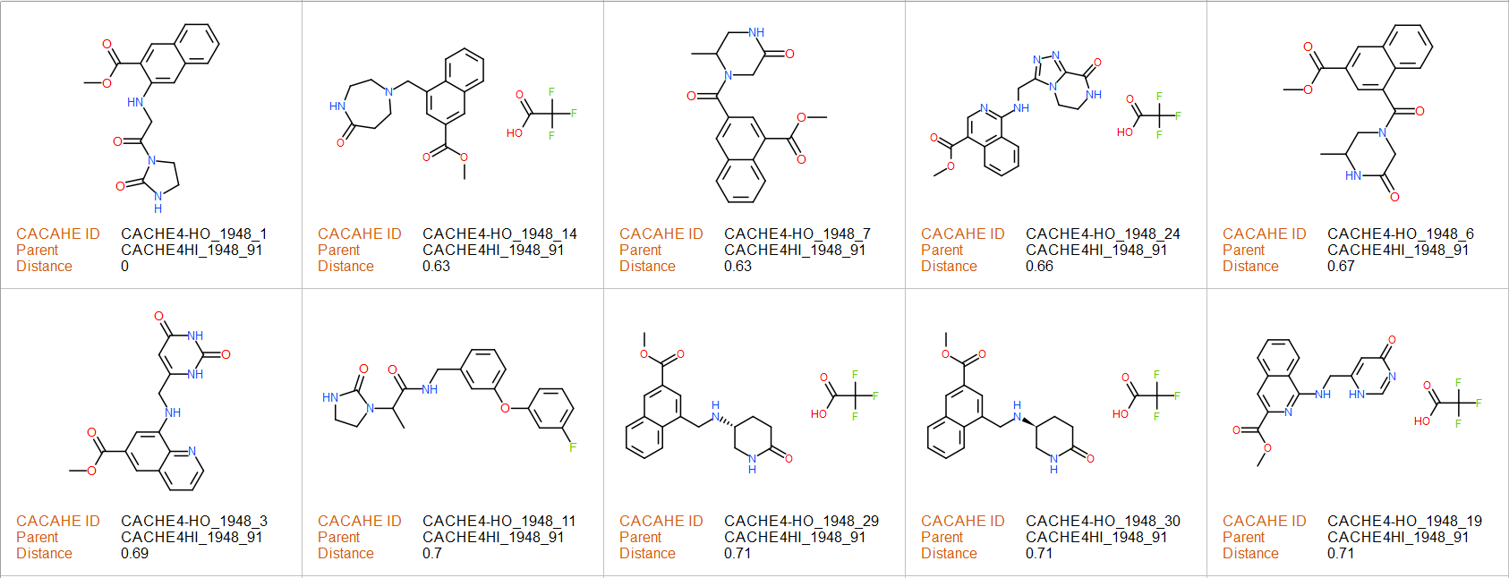
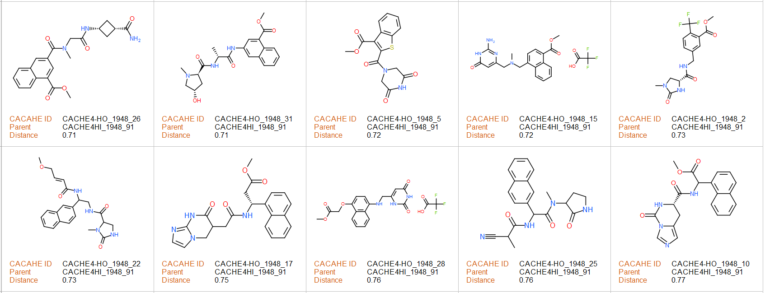
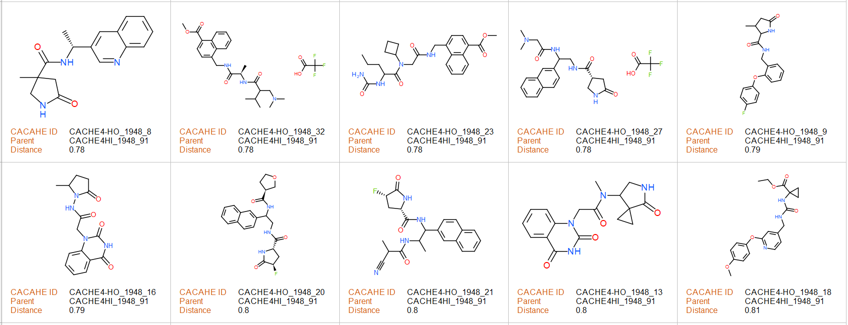
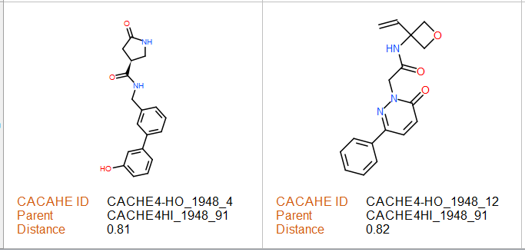
FP and weak SPR
binding
confirmed
CACHE4HI_1948_91
Tested analogs

Slide 13
CACHE#4 – Casitas B-lineage Lymphoma B (CBL-B)
Participant 1954

Slide 14
Hit molecule CACHE4HI_1954_17 that was not followed up for round 2
FP dose response/counter-screen
(round 1 data at 2% DMSO)
 | CBL-B (FP assay) | GID4 (FP assay)
Hill Slope | -1.2 | -0.7
K_{disp} (µM) | 3.1 | 4.1
Binds to GID4
NMR binding with ¹⁹F-Trp-labeled CBLB - no clear evidence of binding identified

Slide 15
CACHE#4 – Casitas B-lineage Lymphoma B (CBL-B)
Participant 1955

Slide 16
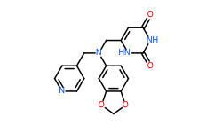
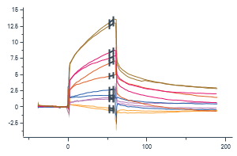
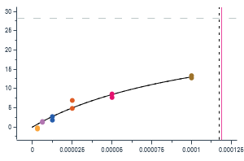
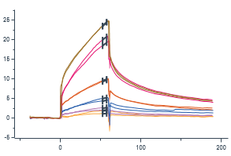
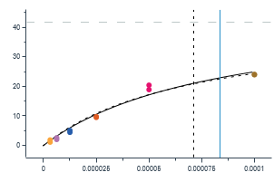
CACHE4HI_1955_60
PARENT MOLECULE
Round1
13 analogs, of the CACHE4HI_1955_60 chemotype and the parent molecule were submitted for round 2.
2 analogs and the resupplied parent molecule displace the BODIPY FL-MSC2787102A-1 in FP assay. CACHE4-HO_1955_5 shows ≤50% displacement of the BODIPY-tracer. CACHE4HO_1955_9 demonstrates 100% displacement of BODIPY-tracer at the top concentration (also the displacement of the GID4 FITC-tracer), only the resupplied parent molecule confirms binding by SPR.
Primary Screen (% FP at 50 μM)
Trial 1-55.5
Trial 2- 51.4
FP dose response/counter-screen
(round 1 data at 2% DMSO)
CACHE4_HO _1955_1/resupplied parent
 | CBL-B (FP assay) run1 | CBL-B (FP assay) run2 | GID4 (FP assay)
Hill Slope | -1.9 | -1.3 | N/A
K_{disp} (µM) | 112 | 112 | N/A
Primary Screen (FP %Control)
100 µM – 52
30 µM – 81
10 µM – 91
CBLB
 | CBL-B (FP assay) | GID4 (FP assay)
Hill Slope | -1.4 | NA
K_{disp} (µM) | 146 | No DR
GID4
CACHE4HI_1955_60
>50% displacement of FL tracer was observed
SPR K_{D} – 119 µM
Binding percentage – 101% (saturation not reached)
Binding to non-related target (GID4):
SPR K_{D} – 84 µM – 110% binding (saturation not reached)
A dubious SPR binding behavior is observed.
NMR binding with ¹⁹F-Trp-labeled CBLB - no clear evidence of binding identified

Slide 17
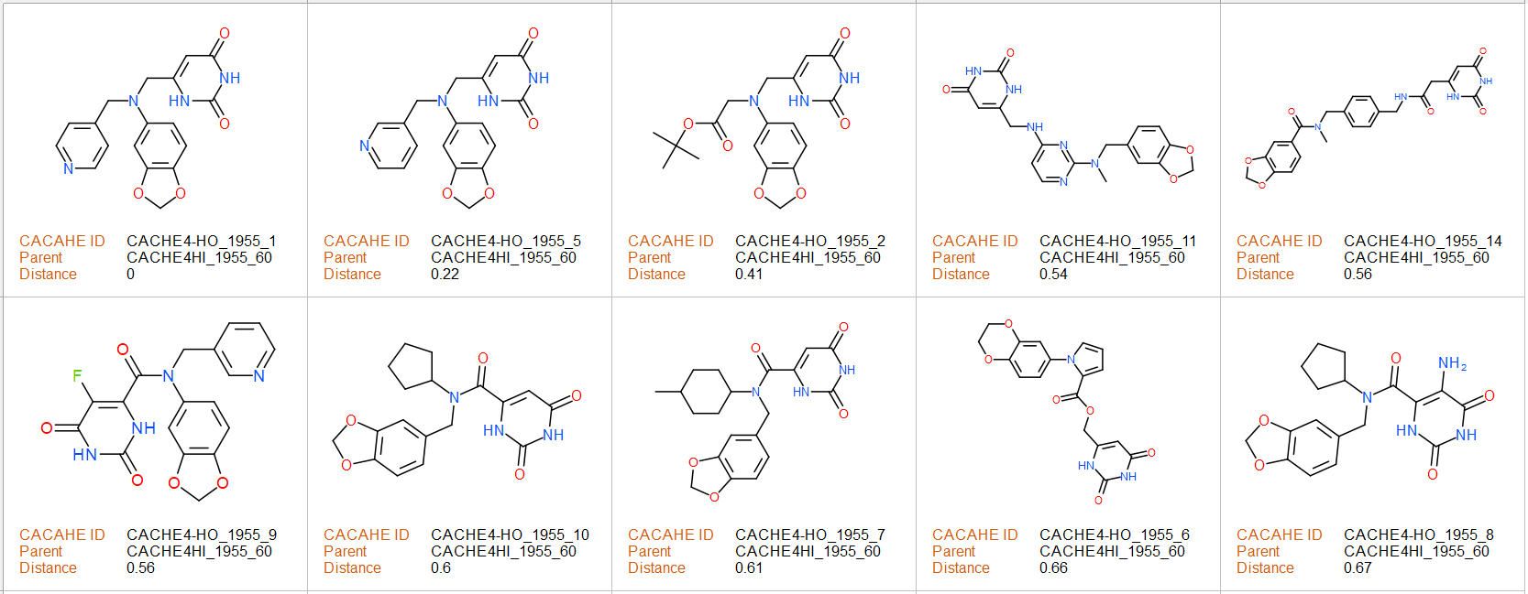
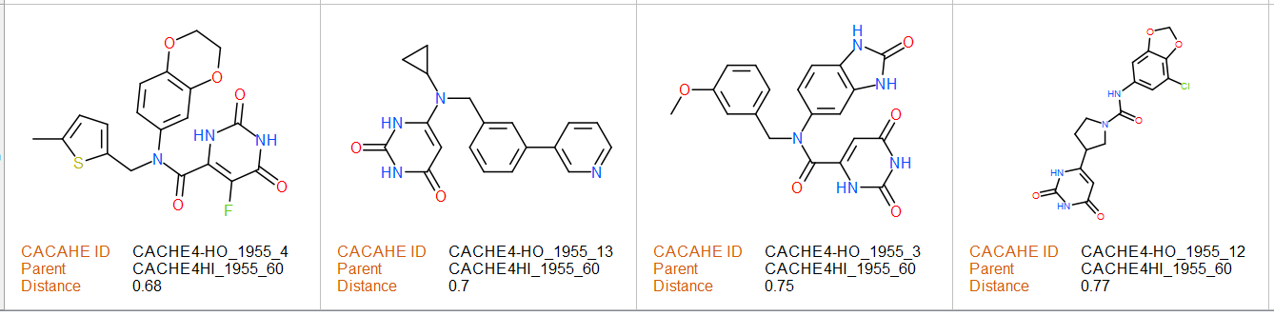
CACHE4HI_1955_60
Tested analogs
FP and SPR
binding
confirmed
FP binding confirmed

Slide 18
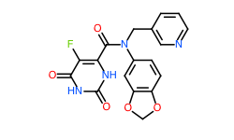
CACHE4-HO_1955_9
Primary Screen (FP %Control)
100 µM – 19
30 µM – 60
10 µM – 84
FP dose response/counter screen
 | CBL-B (FP assay) | GID4 (FP assay)
Hill Slope | -1.3 | -1.5
K_{disp} (µM) | 38 | 127
No evidence of binding by SPR or ¹⁹F NMR
Binds to GID4

Slide 19
CACHE#4 – Casitas B-lineage Lymphoma B (CBL-B)
Participant 1957

Slide 20
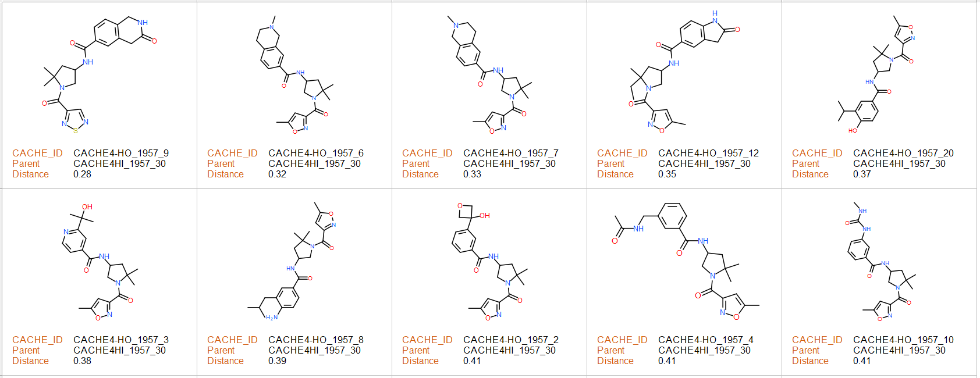
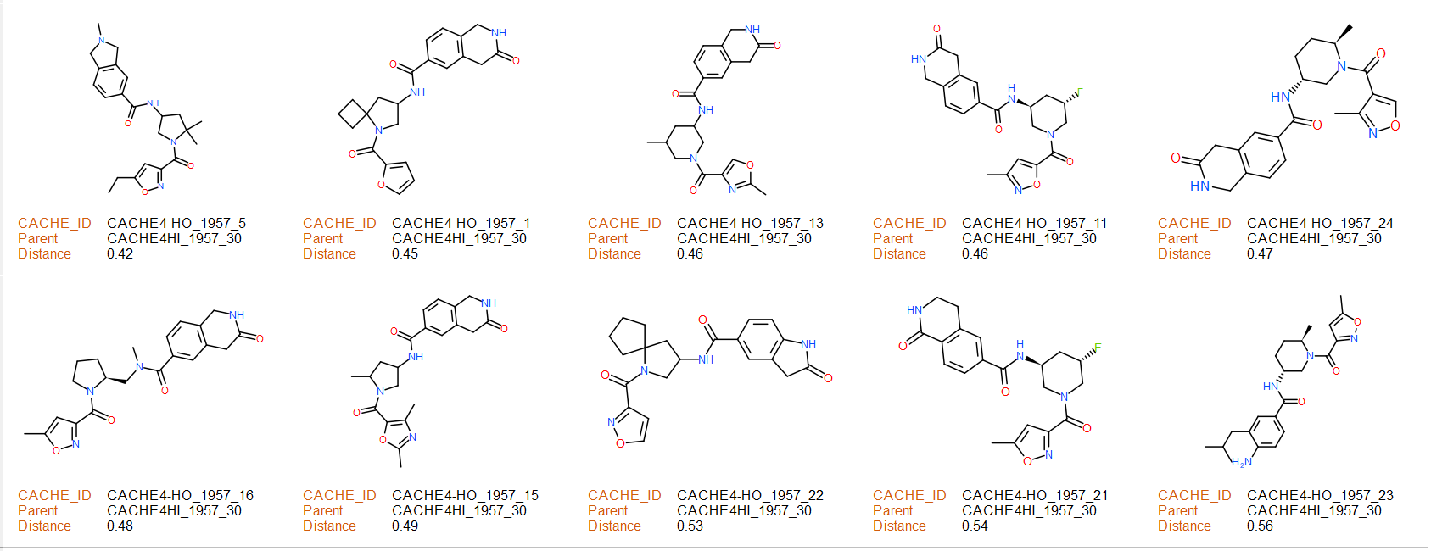
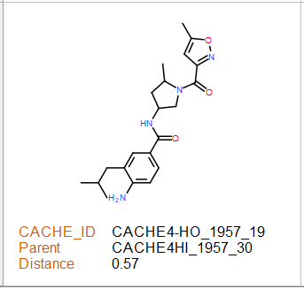
21 analogs, of the CACHE4HI_1957_30 chemotype were submitted for round 2.
None of the compounds displaces the BODIPY FL-MSC2787102A-1 in the FP analyses.
PARENT MOLECULE
Round1
Primary Screen (% FP at 50 μM)
Trial 1- 73
Trial 2- 85
Tested analogs
FP dose response/counter-screen
(round 1 data at 2% DMSO)
 | CBL-B (FP assay) run1 | CBL-B (FP assay) run2 | GID4 (FP assay)
Hill Slope | -2.6 | -3.3 | N/A
K_{disp} (µM) | 96 | 70 | N/A
CACHE4HI_1957_30
100% displacement of FL tracer was observed
NMR binding with ¹⁹F-Trp-labeled CBLB - no clear evidence of binding identified

Slide 21
CACHE#4 – Casitas B-lineage Lymphoma B (CBL-B)
Participant 1958

Slide 22
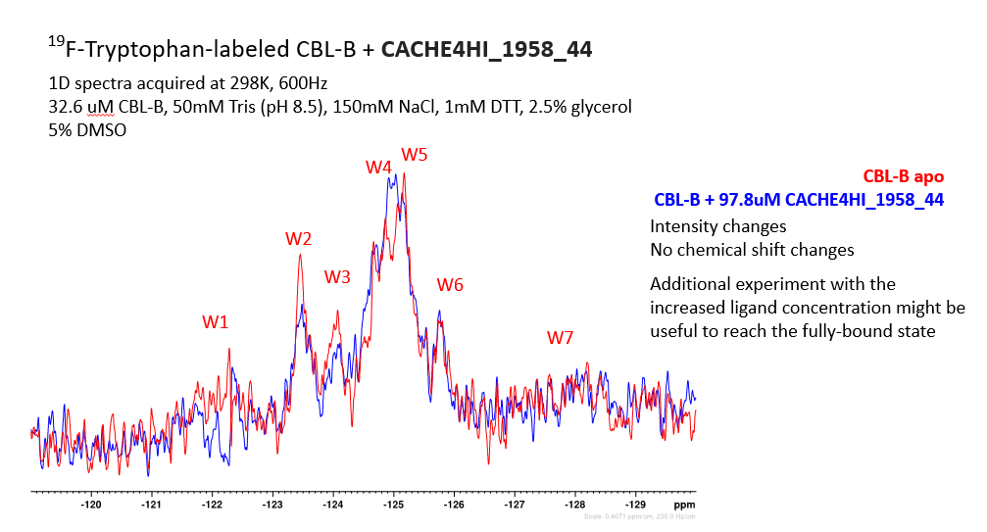
Hit molecule CACHE4HI_1958_44 that was not followed up for round 2
FP dose response/counter-screen
(round 1 data at 2% DMSO)
 | CBL-B (FP assay) | GID4 (FP assay)
Hill Slope | -0.9 | -0.9
K_{disp} (µM) | 125.2 | No DR
NMR binding with ¹⁹F-Trp-labeled CBLB - weak binding

Slide 23
CACHE#4 – Casitas B-lineage Lymphoma B (CBL-B)
Participant 1962

Slide 24
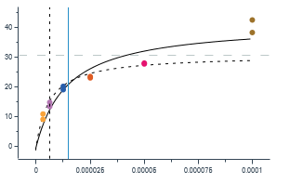


CACHE4HI_1962_33
PARENT MOLECULE
Round1
22 analogs, of the CACHE4HI_1962_33 chemotype, were submitted for round 2.
CACHE4HI_1962_33 is a close analog of patent compounds.
CACHE4_HO_1962_1 displaces the BODIPY FL-MSC2787102A-1 and demonstrates ≤50% displacement at the top concentration in addition to weak binding identified by SPR.
Primary Screen (% FP at 50 μM)
Trial 1-15.8
Trial 2-18.1
FP dose response/counter-screen
(round 1 data at 2% DMSO)
 | CBL-B (FP assay) run1 | CBL-B (FP assay) run2 | GID4 (FP assay)
Hill Slope | -0.7 | -0.7 | N/A
K_{disp} (µM) | 7.7 | 7.2 | N/A
CACHE4HI_1962_33 parent was not resupplied
CBLB
SPR binding confirmed!
NMR binding with ¹⁹F-Trp-labeled CBLB confirmed!
SPR K_{D} – 15 µM
Binding percentage – 135% CBLB Specificity – Yes
Binding percentage to non-related target (GID4) – 0%

Slide 25



FP and SPR binding confirmed
CACHE4HI_1962_33
Tested analogs

Slide 26





CACHE4-HO_1962_1
Primary Screen (FP %Control)
100 µM – 61
30 µM – 84
10 µM – 93
¹⁹F NMR - no clear evidence of binding identified
CBLB
FP dose response/counter screen
 | CBL-B (FP assay) | GID4 (FP assay)
Hill Slope | -1.2 | NA
K_{disp} (µM) | >100 | No DR
GID4
SPR K_{D} = 21 µM
Binding percentage – 32%
Specificity – Yes
Binding percentage to non-related target (GID4) – Linear

Slide 27
CACHE#4 – Casitas B-lineage Lymphoma B (CBL-B)
Participant 1963

Slide 28




CACHE4HI_1963_55
PARENT MOLECULE
Round1
23 analogs, of the CACHE4HI_1963_55 chemotype, and the parent molecule were submitted for round 2.
Only the re-supplied parent molecule displaces the BODIPY FL-MSC2787102A-1 in FP assay and confirms binding by NMR.
Primary Screen (% FP at 50 μM)
Trial 1-43.2
Trial 2- 55.5
FP dose response/counter-screen
Primary Screen (% FP)
100 μM- Overflow
30 μM- 101
10 μM- 102
CACHE4-HO_1963_20/resupplied parent
 | CBL-B (FP assay) | GID4 (FP assay)
Hill Slope | -0.7 | -1.1
K_{disp} (µM) | 583 | 356
¹⁹F NMR confirmation
 | CBL-B (FP assay) run1 | CBL-B (FP assay) run2 | GID4 (FP assay)
Hill Slope | -1.8 | -0.8 | 1.3
K_{disp} (µM) | 136 | 260 | 182
black - control 15 μM compound
red - 15 μM compound + 25 μM protein
Binding confirmed!
Binds to GID4
Binds to GID4
NMR binding with ¹⁹F-Trp-labeled CBL-B - weak binding
QC data (UPLC-MS analysis)
CACHE4HI_1963_55
CACHE4-HO_1963_20
No evidence of binding by SPR
*SPR was done with the resupplied parent batch.

Slide 29



CACHE4HI_1963_55
Tested analogs
FP and NMR binding confirmed

Slide 30
CACHE#4 – Casitas B-lineage Lymphoma B (CBL-B)
Participant 1974

Slide 31


19 analogs, of the CACHE4HI_1974_46 chemotype were submitted for round 2.
None of the tested analogs displaces the BODIPY FL-MSC2787102A-1 in the FP analyses.
PARENT MOLECULE
Round1
Tested analogs
Primary Screen (% FP at 50 μM)
Trial 1-43.2
Trial 2- 55.5
FP dose response/counter-screen
(round 1 data at 2% DMSO)
 | CBL-B (FP assay) run1 | CBL-B (FP assay) run2 | GID4 (FP assay)
Hill Slope | -1.6 | -1.4 | N/A
K_{disp} (µM) | 111 | 101 | N/A
NMR binding with ¹⁹F-Trp-labeled CBLB- no clear evidence of binding identified

Slide 32
CACHE#4 – Casitas B-lineage Lymphoma B (CBL-B)
Participant 2117

Slide 33







CACHE4HI_2117_63
PARENT MOLECULE
Round1
22 analogs, of the CACHE4HI_2117_63 chemotype and the parent molecule were submitted for round 2.
Only the parent molecule displaces the BODIPY FL-MSC2787102A-1 in FP analyses and shows very weak binding by SPR (the parent molecule also displaces the GID4 FITC-tracer).
Primary Screen (% FP at 50 μM)
Trial 1-16
Trial 2- 15
FP dose response/counter-screen
Primary Screen (% FP)
100 μM- Overflow
30 μM- 24
10 μM- 58
CACHE4-HO_2117_23/resupplied parent
 | CBL-B (FP assay) | GID4 (FP assay)
Hill Slope | -1 | -1.3
K_{disp} (µM) | 37 | 140
 | CBL-B (FP assay) run1 | CBL-B (FP assay) run2 | GID4 (FP assay)
Hill Slope | -1.5 | -1.0 | 1.6
K_{disp} (µM) | 14 | 9 | 38
CBLB
Binds to GID4
Binds to GID4
GID4
QC data (UPLC-MS analysis)
CACHE4HI_2117_63
CACHE4-HO_2117_23
NMR binding with ¹⁹F-Trp-labeled CBLB - no clear evidence of binding identified
SPR K_{D} – 45 µM
Binding percentage – 23% (low binder, saturation not reached).
Binding to non-related target (GID4):
14%.
*SPR done with resupplied parent batch
More Impurities

Slide 34



CACHE4HI_2117_63
Tested analogs
FP and weak SPR binding confirmed

