Slide 1
Studying of Casitas B-lineage Lymphoma B (CBL-B) Round 1 hit molecules with ¹⁹F NMR

Slide 2
CBL-B apo: ¹⁹F-Tryptophan-labeled CBL-B (7 tryptophans)
1D spectrum acquired at 298K, 600Hz
34 µM CBL-B, 50mM Tris (pH 8.5), 150mM NaCl, 1mM DTT, 2.5% glycerol
5% DMSO
W5
CBL-B apo
W4
W2
W3
W6
W7
W1

Slide 3
Positive control: ¹⁹F-Tryptophan-labeled CBL-B + C2777683 (an analogue of Nx-1607)
1D spectra acquired at 298K, 600Hz
34 µM CBL-B, 50mM Tris (pH 8.5), 150mM NaCl, 1mM DTT, 2.5% glycerol
1% DMSO
W4
W5
CBL-B apo
CBL-B + 102 µM MSC2777683
W2
Major intensity and chemical shift changes
W3
W6
W1
W7

Slide 4
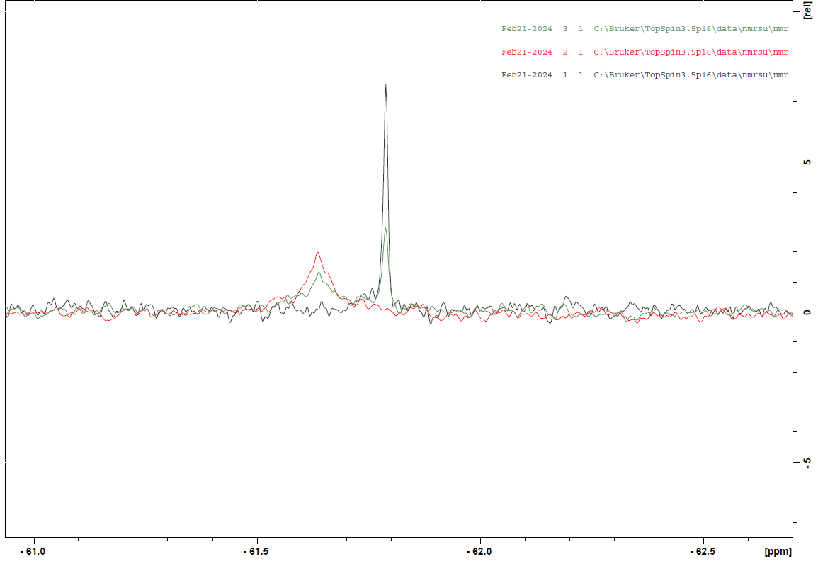
Positive control: CBL-B + C2777683 (an analogue of Nx-1607)
50 mM Tris (pH 8.0), 250 mM NaCl, 1% DMSO
10 µM C2777683
10 µM CBL-B + 10 µM C2777683
20 µM CBL-B + 10 µM C2777683
Major chemical shift changes

Slide 5
¹⁹F-Tryptophan-labeled CBL-B + CACHE4HI_1954_17
1D spectra acquired at 298K, 600Hz
32.6 µM CBL-B, 50mM Tris (pH 8.5), 150mM NaCl, 1mM DTT, 2.5% glycerol
5% DMSO
W4
W5
CBL-B apo
CBL-B + 97.8 µM CACHE4HI_1954_17
W2
Intensity changes
No chemical shift changes
W3
W6
W1
W7

Slide 6
¹⁹F-Tryptophan-labeled CBL-B + CACHE4HI_1962_33
1D spectra acquired at 298K, 600Hz
32.6 µM CBL-B, 50mM Tris (pH 8.5), 150mM NaCl, 1mM DTT, 2.5% glycerol
5% DMSO
W5
W4
CBL-B apo
CBL-B + 97.8 µM CACHE4HI_1962_33
W2
Major intensity and chemical shift changes
W3
W6
W1
W7

Slide 7
¹⁹F-Tryptophan-labeled CBL-B + CACHE4HI_2117_63
1D spectra acquired at 298K, 600Hz
32.6 µM CBL-B, 50mM Tris (pH 8.5), 150mM NaCl, 1mM DTT, 2.5% glycerol
5% DMSO
W4
W5
CBL-B apo
CBL-B + 97.8 µM CACHE4HI_2117_63
W2
Minor intensity changes
No chemical shift changes
W3
W6
W1
W7

Slide 8
¹⁹F-Tryptophan-labeled CBL-B + CACHE4HI_1946_60
1D spectra acquired at 298K, 600Hz
32.6 µM CBL-B, 50mM Tris (pH 8.5), 150mM NaCl, 1mM DTT, 2.5% glycerol
5% DMSO
W5
W4
CBL-B apo
CBL-B + 97.8 µM CACHE4HI_1946_60
W2
Intensity changes across the spectrum
W3
W6
W1
W7

Slide 9
¹⁹F-Tryptophan-labeled CBL-B + CACHE4HI_1963_55
1D spectra acquired at 298K, 600Hz
32.6 µM CBL-B, 50mM Tris (pH 8.5), 150mM NaCl, 1mM DTT, 2.5% glycerol
5% DMSO
W5
W4
CBL-B apo
CBL-B + 97.8 µM CACHE4HI_1963_55
W2
Intensity changes in W7, W5, W4, W3
No chemical shift changes
W3
W6
W1
W7

Slide 10
¹⁹F-Tryptophan-labeled CBL-B + CACHE4HI_1948_91
1D spectra acquired at 298K, 600Hz
32.6 µM CBL-B, 50mM Tris (pH 8.5), 150mM NaCl, 1mM DTT, 2.5% glycerol
5% DMSO
W5
CBL-B apo
CBL-B + 97.8 µM CACHE4HI_1948_91
W4
W2
Chemical shift change in W3:
resembles the change associated with the decreased DMSO concentration
W3
W6
W1
W7

Slide 11
¹⁹F-Tryptophan-labeled CBL-B + CACHE4HI_1946_25
1D spectra acquired at 298K, 600Hz
32.6 µM CBL-B, 50mM Tris (pH 8.5), 150mM NaCl, 1mM DTT, 2.5% glycerol
5% DMSO
W5
CBL-B apo
CBL-B + 97.8 µM CACHE4HI_1946_25
W4
W2
Intensity changes
No chemical shift changes
W3
W6
W1
W7

Slide 12
¹⁹F-Tryptophan-labeled CBL-B + CACHE4HI_1957_30
1D spectra acquired at 298K, 600Hz
32.6 µM CBL-B, 50mM Tris (pH 8.5), 150mM NaCl, 1mM DTT, 2.5% glycerol
5% DMSO
W5
W4
CBL-B apo
CBL-B + 97.8 µM CACHE4HI_1957_30
Intensity changes
No chemical shift changes
W2
W3
W6
W1
W7

Slide 13
¹⁹F-Tryptophan-labeled CBL-B + CACHE4HI_1954_79
1D spectra acquired at 298K, 600Hz
32.6 µM CBL-B, 50mM Tris (pH 8.5), 150mM NaCl, 1mM DTT, 2.5% glycerol
5% DMSO
W5
CBL-B apo
CBL-B + 97.8 µM CACHE4HI_1954_79
W4
Intensity changes
No chemical shift changes
W2
W3
W6
W1
W7

Slide 14
¹⁹F-Tryptophan-labeled CBL-B + CACHE4HI_1958_44
1D spectra acquired at 298K, 600Hz
32.6 µM CBL-B, 50mM Tris (pH 8.5), 150mM NaCl, 1mM DTT, 2.5% glycerol
5% DMSO
W5
W4
CBL-B apo
CBL-B + 97.8 µM CACHE4HI_1958_44
Intensity changes
No chemical shift changes
W2
W3
W6
W1
W7

Slide 15
¹⁹F-Tryptophan-labeled CBL-B + CACHE4HI_1955_60
1D spectra acquired at 298K, 600Hz
32.7 µM CBL-B, 50mM Tris (pH 8.5), 150mM NaCl, 1mM DTT, 2.5% glycerol
5% DMSO
W5
W4
32.6 µM CBL-B apo
20.57 µM CBL-B + 97.8 µM CACHE4HI_1955_60
W2
Some intensity changes
No chemical shift changes
W3
W6
W1
W7

