Slide 1
Studying of Casitas B-lineage Lymphoma B (CBL-B) Round 2 hit molecules with ¹⁹F NMR

Slide 2
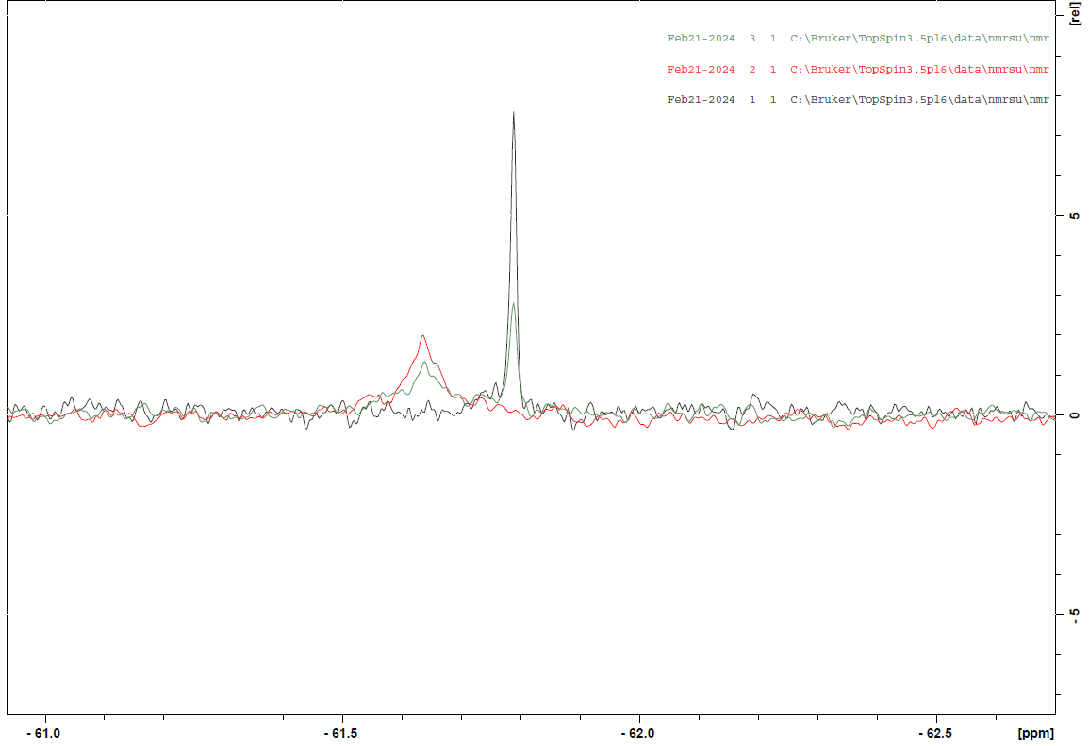
Positive control: CBL-B + C2777683 (an analogue of Nx-1607)
50 mM Tris (pH 8.0), 250 mM NaCl, 1% DMSO
10 µM C2777683
10 µM CBL-B + 10 µM C2777683
20 µM CBL-B + 10 µM C2777683
Major chemical shift changes

Slide 3
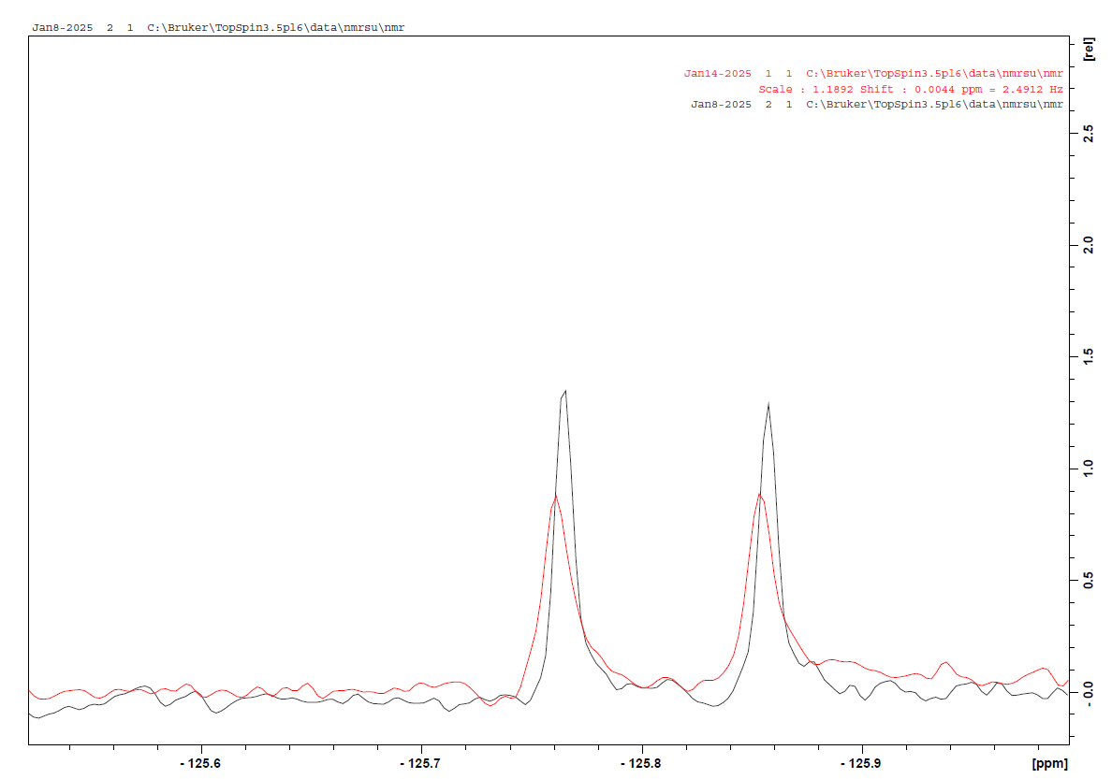
CBL-B + fluorinated CACHE4-HO_1946_15
50 mM Tris (pH 8.0), 250 mM NaCl, 1% DMSO
15 µM CACHE4-HO_1946_15
15 µM CACHE4-HO_1946_15 + 25 µM CBL-B
Downfield shift and broadening of ligand peaks in the presence of CBL-B

Slide 4
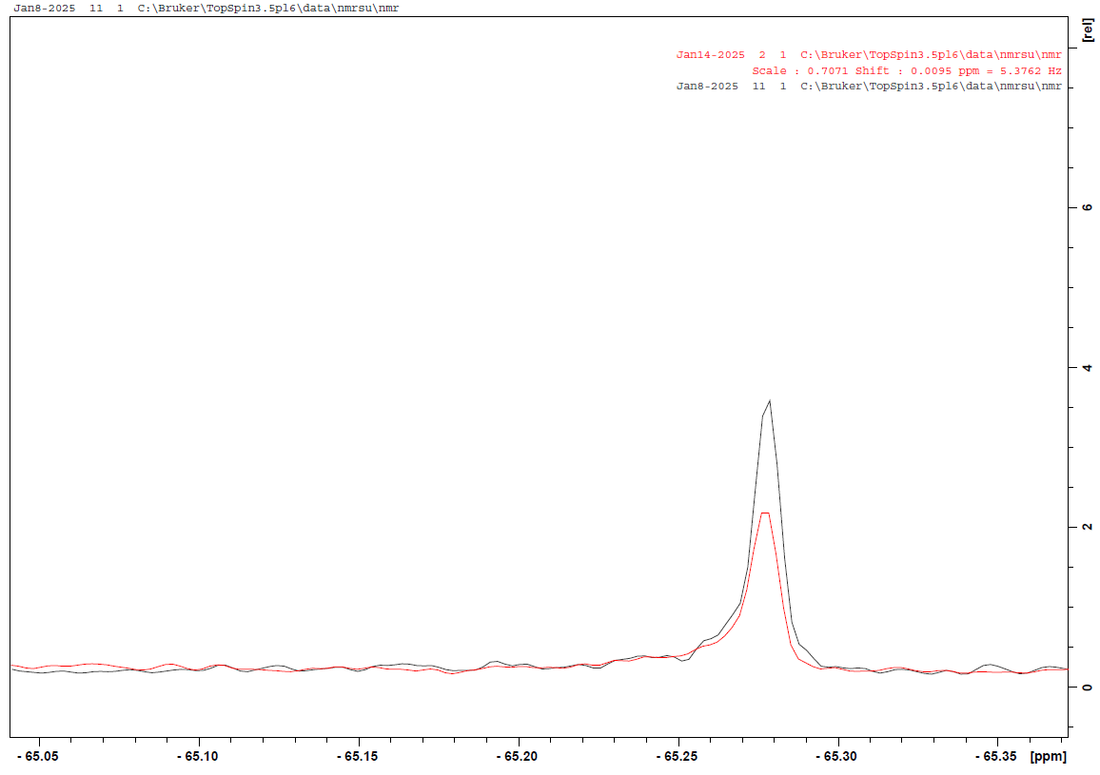
CBL-B + fluorinated CACHE4-HO_1946_36
50 mM Tris (pH 8.0), 250 mM NaCl, 1% DMSO
15 µM CACHE4-HO_1946_36
15 µM CACHE4-HO_1946_36 + 25 µM CBL-B
Broadening of the ligand peak in the presence of CBL-B

Slide 5

CBL-B + fluorinated CACHE4-HO_1946_41
50 mM Tris (pH 8.0), 250 mM NaCl, 1% DMSO
15 µM CACHE4-HO_1946_41
15 µM CACHE4-HO_1946_41 + 25 µM CBL-B
Broadening of the ligand peak in the presence of CBL-B

Slide 6
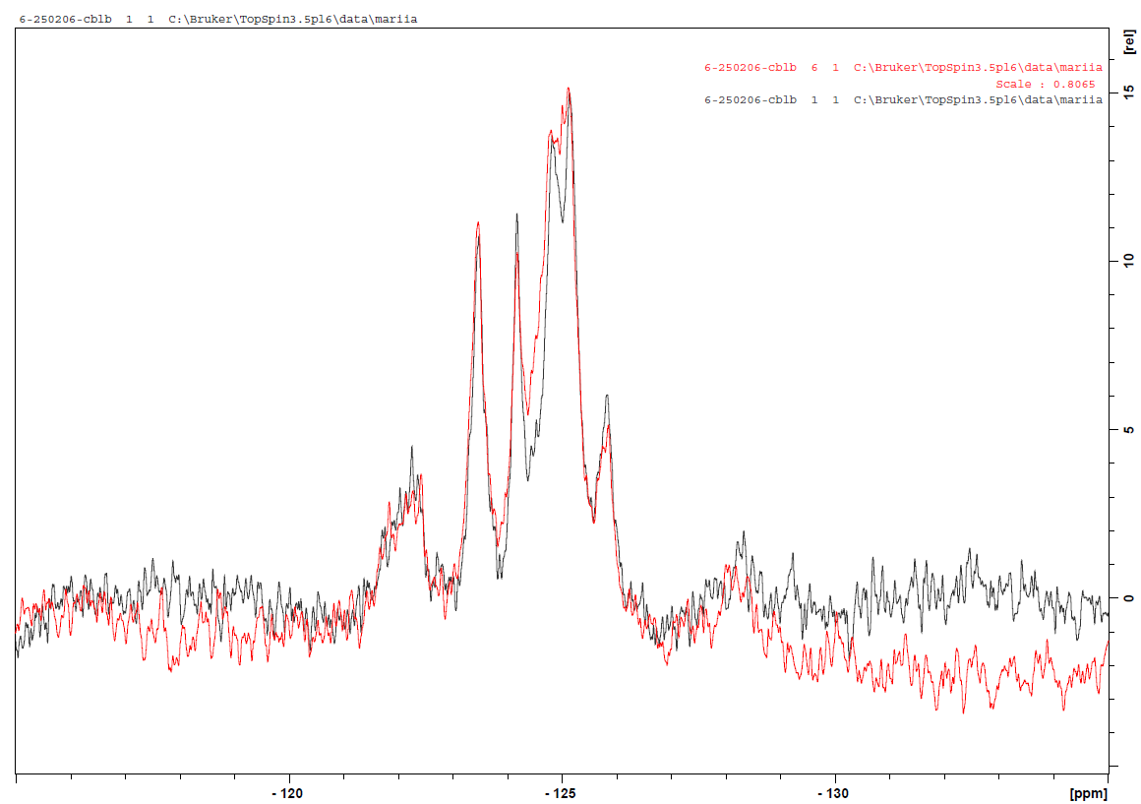
¹⁹F-Tryptophan-labeled CBL-B + CACHE4-HO_1948_1
50 mM Tris (pH 8.5), 150 mM NaCl, 1 mM DTT, 2.5% glycerol, 5% DMSO
50 µM CBL-B
50 µM CBL-B + 100 µM CACHE4-HO_1948_1
At best, subtle intensity changes in the 19F spectrum of CBLB in the presence of the ligand

Slide 7
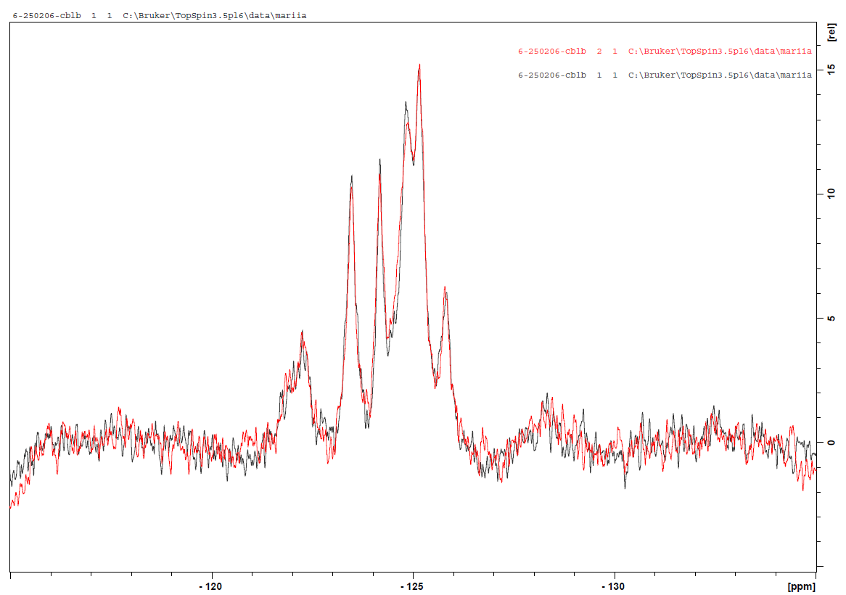
¹⁹F-Tryptophan-labeled CBL-B + CACHE4-HO_1955_1
50 mM Tris (pH 8.5), 150 mM NaCl, 1 mM DTT, 2.5% glycerol, 5% DMSO
50 µM CBL-B
50 µM CBL-B + 100 µM CACHE4-HO_1955_1
No change in the spectrum

Slide 8
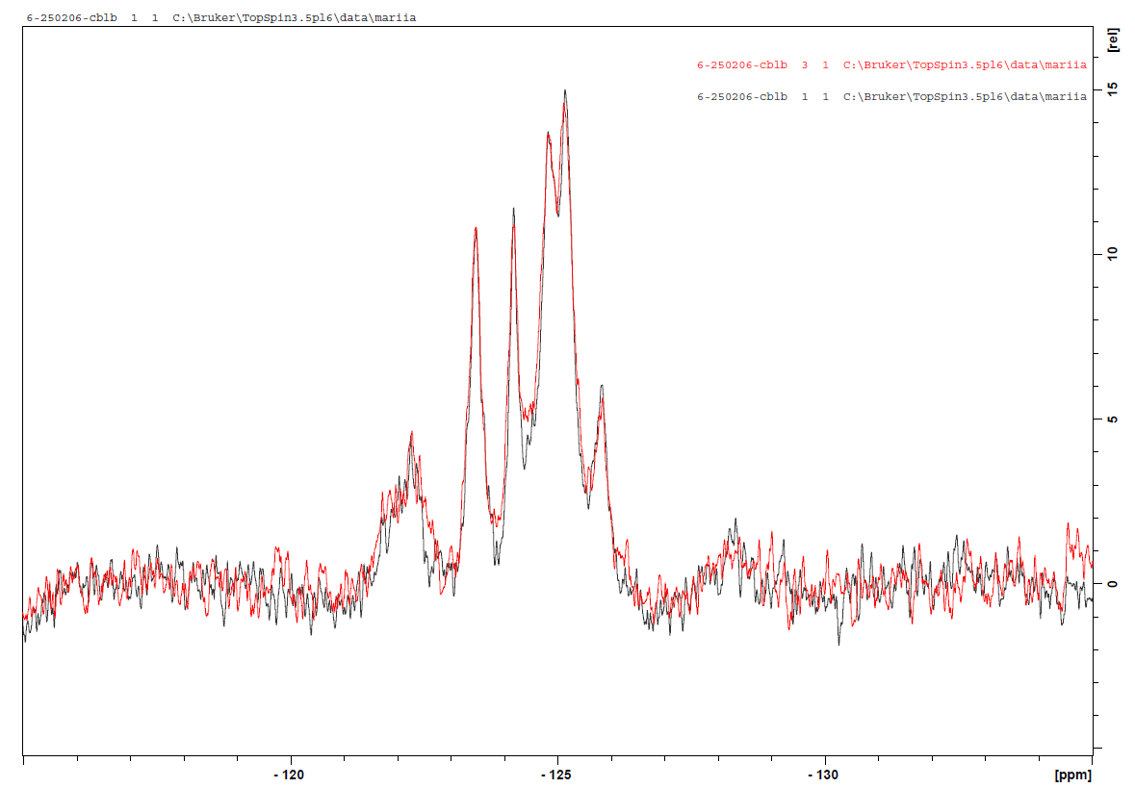
¹⁹F-Tryptophan-labeled CBL-B + CACHE4-HO_1962_1
50 mM Tris (pH 8.5), 150 mM NaCl, 1 mM DTT, 2.5% glycerol, 5% DMSO
50 µM CBL-B
50 µM CBL-B + 100 µM CACHE4-HO_1962_1
No change in the spectrum

Slide 9
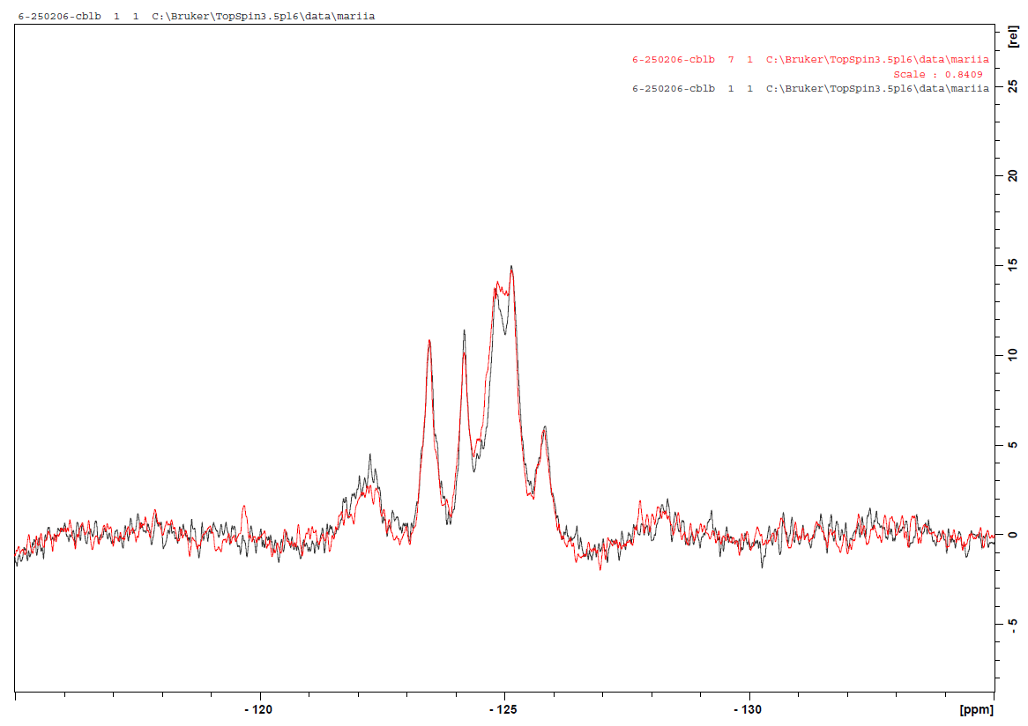
¹⁹F-Tryptophan-labeled CBL-B + CACHE4-HO_1974_46
50 mM Tris (pH 8.5), 150 mM NaCl, 1 mM DTT, 2.5% glycerol, 5% DMSO
50 µM CBL-B
50 µM CBL-B + 100 µM CACHE4-HO_1974_46
At best, subtle intensity changes in the 19F spectrum of CBLB in the presence of the ligand

Slide 10
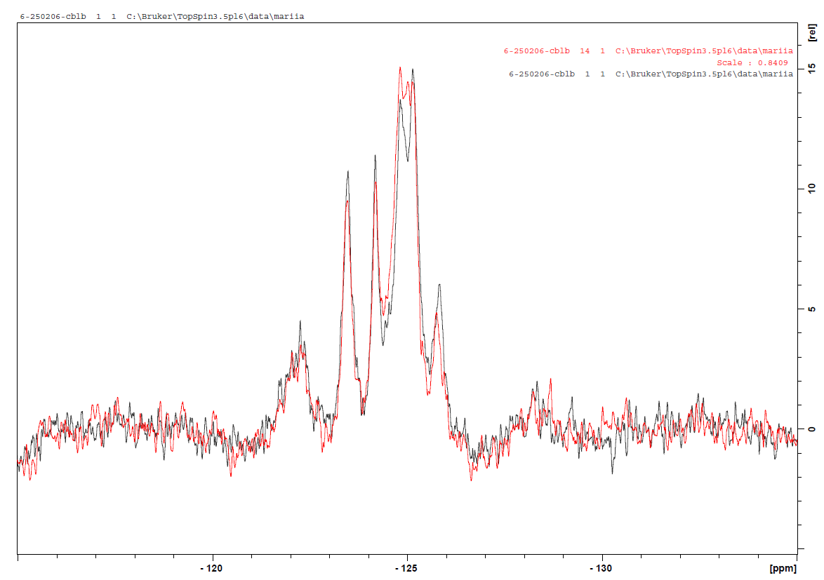
¹⁹F-Tryptophan-labeled CBL-B + CACHE4-HO_2117_23
50 mM Tris (pH 8.5), 150 mM NaCl, 1 mM DTT, 2.5% glycerol, 5% DMSO
50 µM CBL-B
50 µM CBL-B + 100 µM CACHE4-HO_2117_23
At best, subtle intensity changes in the 19F spectrum of CBLB in the presence of the ligand

Slide 11
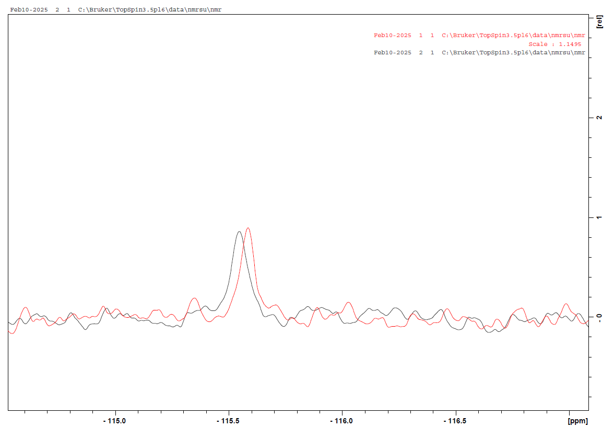
CBL-B + fluorinated CACHE4-HO_1963_20
50 mM Tris (pH 8.0), 250 mM NaCl, 1% DMSO
15 µM CACHE4-HO_1963_20
15 µM CACHE4-HO_1963_20 + 25 µM CBL-B
Shift upfield of ligand peak in the presence of CBL-B

Slide 12
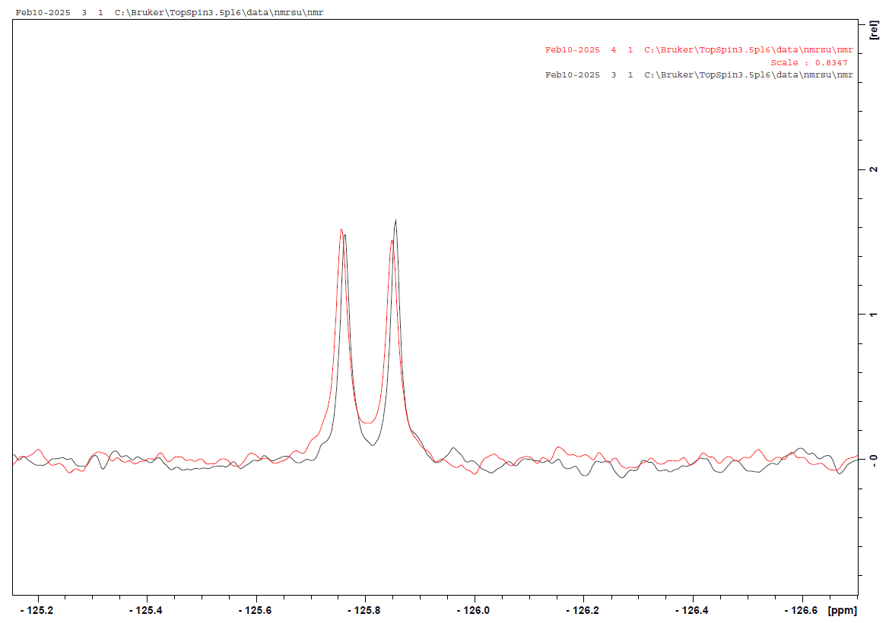
CBL-B + fluorinated CACHE4-HO_1955_9
50 mM Tris (pH 8.0), 250 mM NaCl, 1% DMSO
15 µM CACHE4-HO_1955_9
15 µM CACHE4-HO_1955_9 + 25 µM CBL-B
Downfield shift of the ligand peaks in the presence of CBL-B

